Slide 1
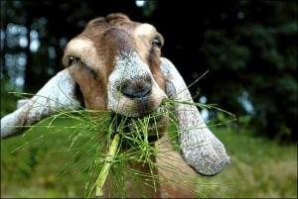
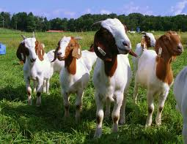
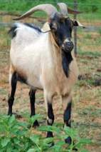
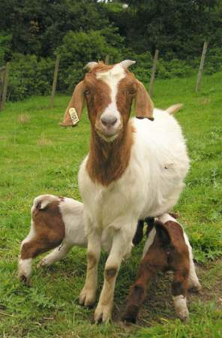

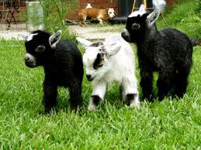
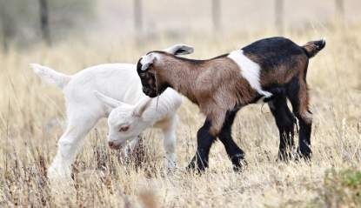
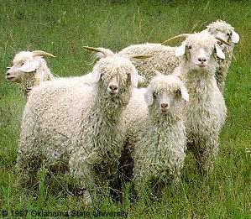
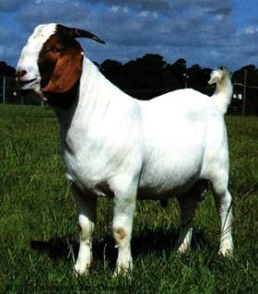
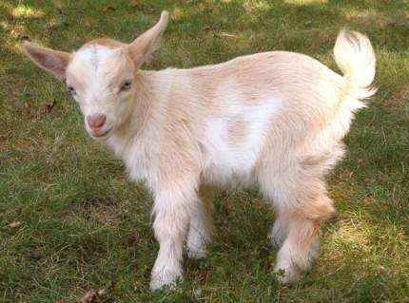

Slide 2
Objectives
Terminology
Breeds
Management Practices
Feeding and Nutrition
Animal Behavior
Animal Growth and Development
Animal Health
Evaluation

Slide 3
Terminology

Slide 4
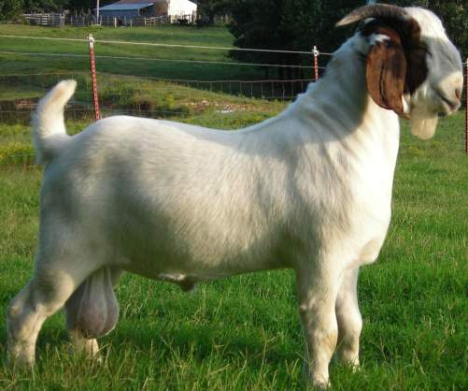
Buck
Sexually mature male

Slide 5
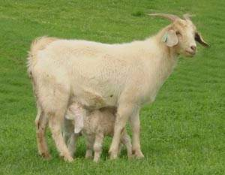
Doe/Nanny
A sexually mature female goat

Slide 6
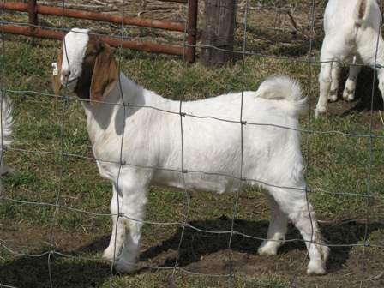
Wether
A castrated male

Slide 7
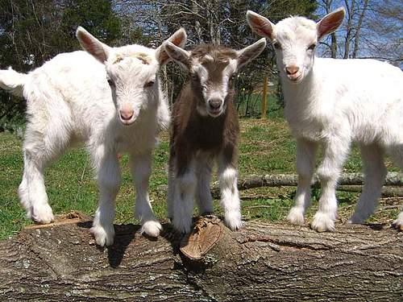
Kid
A young goat

Slide 8
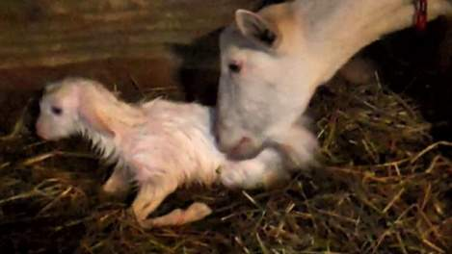
Kidding
Act of giving birth in goats

Slide 9
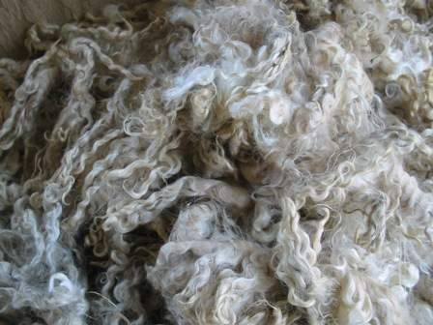
Mohair
The fiber of an Angora goat

Slide 10
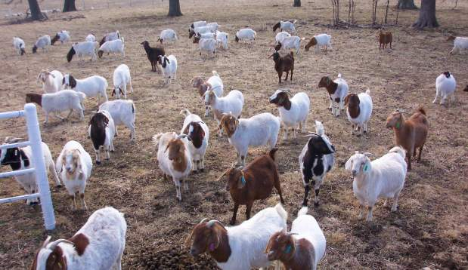
Flock
Herd of goats

Slide 11
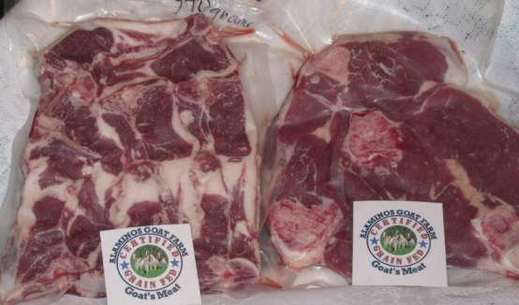

Chevon
Meat from goats

Slide 12
Breeds

Slide 13
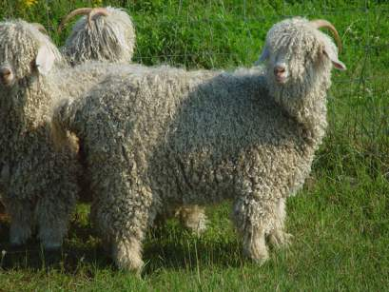
Angora
Originated in Turkey
Produces mohair
Over 90% of the nation’s Angora goats reside in Texas, primarily in the Edward’s Plateau.

Slide 14
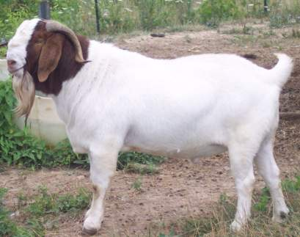
South African Boer
Originated in Africa
Medium sized with prominent horns and broad, drooping ears
Brown head and neck with white body
Valued for meat production

Slide 15
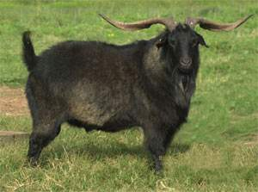
Spanish Goat
Originated in Spain
Horned, any color or color pattern.
Very prolific
Tolerant of harsh conditions
Relatively resistant to parasites
Used for clearing brush and meat production

Slide 16
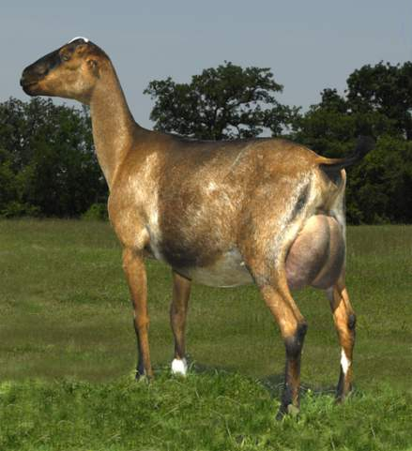
LaMancha
Developed in the United States in the 1950’s
Recognized by their very short ear (maximum of 1 inch)
Any color or pattern
Dairy goat

Slide 17
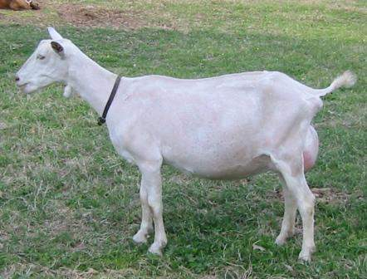
Saanen
Originated in Switzerland
Large size with erect ears
White or light cream
Heaviest milking breed

Slide 18
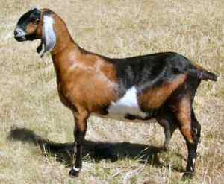

Nubian
Developed in Great Britain from African and Middle Eastern breeds
Large goat with large pendulous ears and a roman nose
Any color or color pattern
Well-suited to hot climates
Dual purpose breed

Slide 19
Management Practices

Slide 20
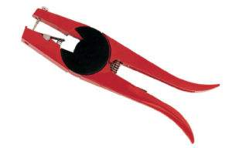
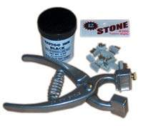
Methods of Identification
Tattoo
Ear Tag

Slide 21
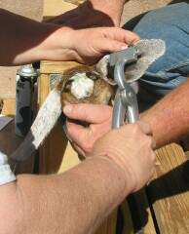
Tattoo
Preferred method of Identification
Does not harm the animals appearance

Slide 22
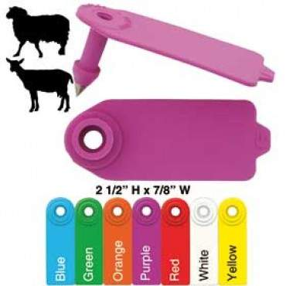
Ear tag
Easier identification method because animals don’t need to be caught
Metal tags are more prone to cause infection
Goats might try to eat tags on the very end of the ear

Slide 23
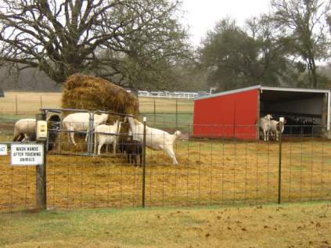
Facility Size
At least 15 square feet of pen per goat
Sheds: 10’ x 15’ providing shade, wind break, and dry space
Bedding: sand or good clean soil for drainage, top with shavings or straw during cold weather
  Change frequently to prevent illness and hoof disease

Slide 24
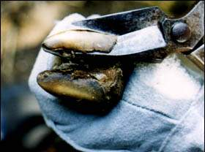
Trimming Hooves
Many foot and leg problems are caused by failure to trim or improper trimming
Time between trimming depends on age, terrain, nutrition and breed.
Goats in pens require more trimming than free ranged goats.

Slide 25
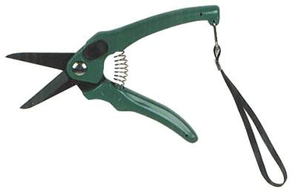
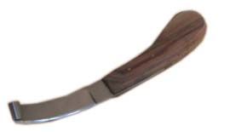
Trimming Tools
Gloves
Set of hoof trimmers and hoof knife

Slide 26
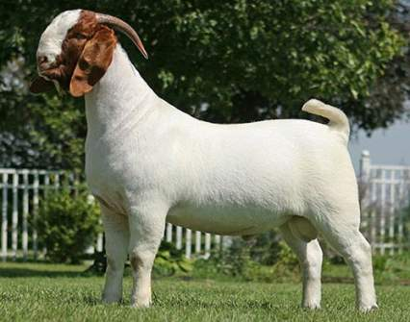
Exercise
A good meat goat looks athletic.
Purpose
  Keep them lean
  Control weight gain
  Build stamina
  Build muscle

Slide 27
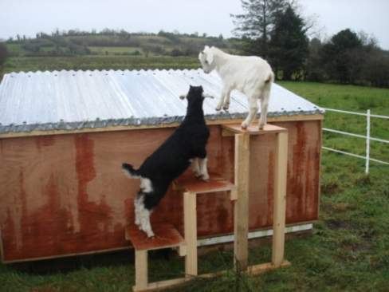

Exercise Techniques
Chasing in a track or exercise pen
Leading at a fast pace
Objects to climb

Slide 28
Feeding and Nutrition

Slide 29
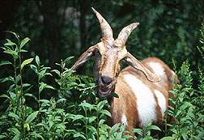
Type of Feed
Fiber (roughage) is essential for the proper functioning of the digestive system
  Can efficiently digest coarse, fibrous plants.
Supplementation of legume hays (higher in protein) is needed if animals have limited access to grazing
High producing (dairy/growing) animals may require a balanced concentrate to meet all their nutritional requirements

Slide 30
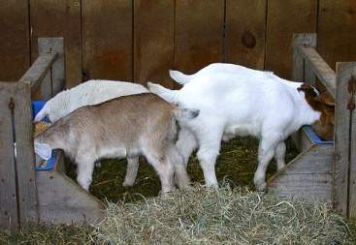
Amount of feed
Appetite is subject to a thermoregulatory brain control - feed intake fluctuates in accordance with environmental temperature
Show Goats should gain between 1/4-1/2 lb. per day.
  This should be obtained with 3-4 lbs of feed per day.
  Adult goats should receive no more than 1.5 lbs of concentrate per day

Slide 31
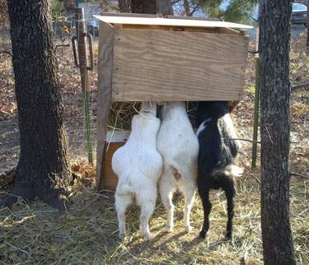
How to feed
Show Goats should be fed on an incline to increase leg muscle

Slide 32
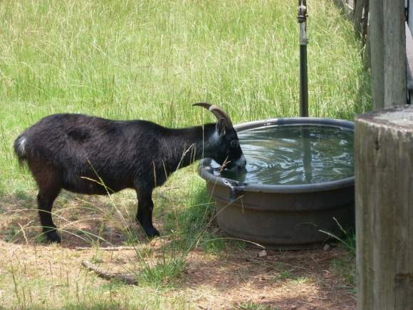
Water
Keep plenty of clean fresh water available at all times.
It is the most important nutrient for your goat!

Slide 33
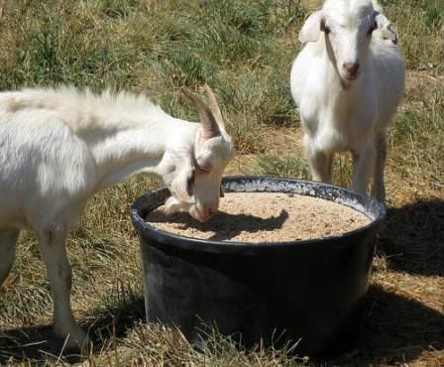
Minerals
Minerals labeled for sheep and goats lacks copper
  Sheep can’t have copper, but goats need copper
Use free choice loose mineral

Slide 34
Animal Behavior

Slide 35
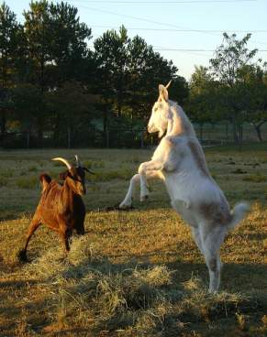
Herd dynamics
Pecking order: each goat has its own place in the herd.
Introducing new goats in the herd will cause aggressive behavior until a new order is established
Goats will head butt to ensure or establish their rank in the herd.

Slide 36
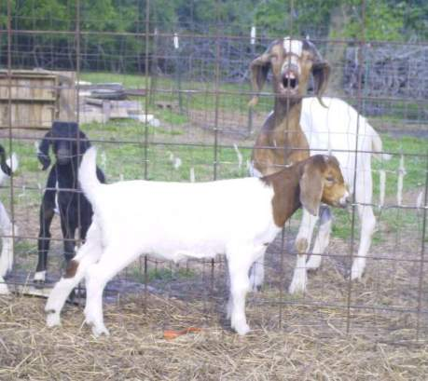
Sneezing
Goats may sneeze to warn other goats of danger

Slide 37
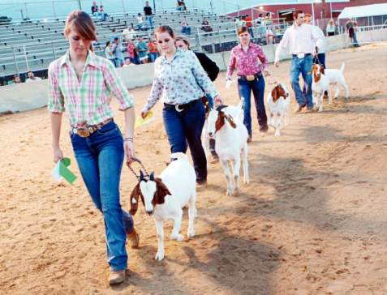
Moving goats
Attempting to push a goat out of the way will result in the animal leaning back.
The best way to move a goat is to pull it.

Slide 38
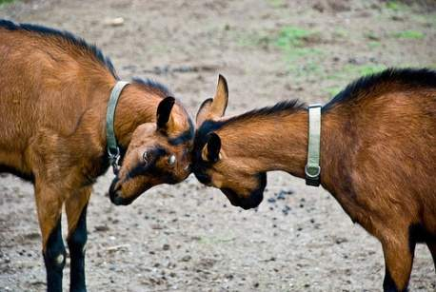
Head-butting and pushing
May exhibit this behavior in play, but mostly it is aggressive
Head-butting and fighting between goats cannot be stopped

Slide 39
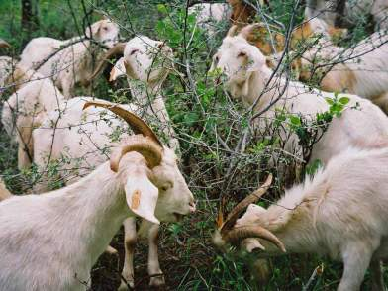
Ingestive Behavior
Differ from other ruminants because they are browsers
Grazing intake is related to the metabolic rate and body size of the goat, varying by breed and age of animal.
Goats tend to spend more time eating each day than other ruminants.
  Often eat for as long as 11 hours.

Slide 40
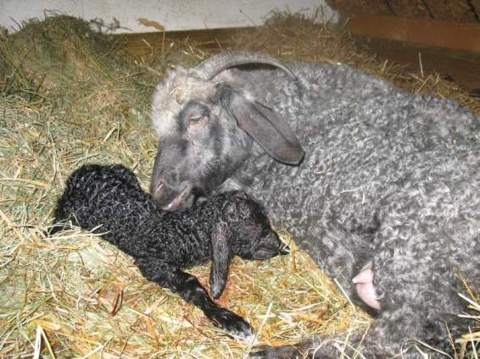
Epimeletic behavior
Care-giving or maternal behavior
Does licking and calling to their kids.

Slide 41
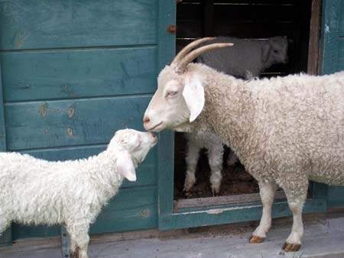
Et-Epimeletic Behavior
(Care-seeking)
Young kids if captured, held or hurt will emit a high pitched general distress call, which is capable of conveying emotional distress

Slide 42
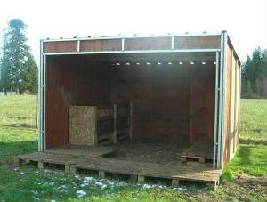

Shelter seeking behavior
Goats are hardy and tolerate heat and cold well, but still need to have access to a well-constructed shed.
Goats will avoid being in the rain. If they sense a storm, they will attempt to find shelter.

Slide 43
Animal Growth and Development

Slide 44

Measures of Growth
Birth weight
60 Day weight
90 Day weight
Yearling weight
Feedlot AGD
Mature weight

Slide 45
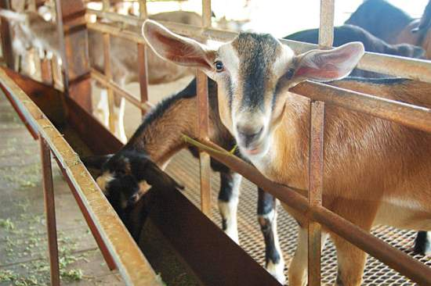
Efficiency of Growth
typically defined as units of feed per unit of gain.
In goats, the feed conversion is the same as lambs, 4-6:1 which means 4-6 pounds of feed consumed equals 1 pound of weight gain.

Slide 46
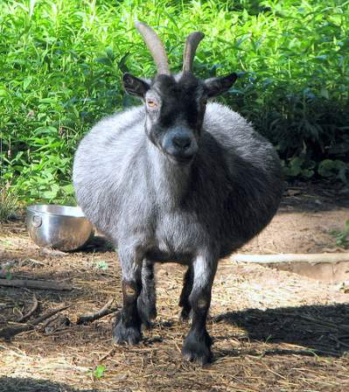
Puberty and Gestation
Age of puberty
  Bucks: 6-8 months
  Does: 6-8 months
Gestation length is 150 days
Seasonal breeders - breed in the fall and give birth in the spring.

Slide 47
Animal Health

Slide 48
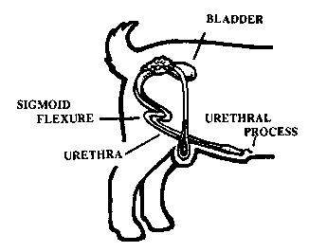
Urinary Calculi
Obstruction of the urinary tract
  most frequently seen in young, castrated males and male goats fed a high grain diet
  calculi are usually comprised of calcium phosphate salts
High grain diets have an imbalance of calcium: phosphorous ratio
  Maintain 2:1 to 4:1ratio

Slide 49
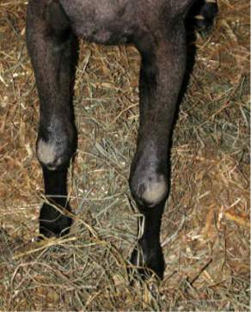
Caprine Arthritis Encephalitis Syndrome (CAE)
Viral disease causing weakness in the rear legs (kids) or swollen joints, particularly the knees (older goats)
No fever or loss of appetite
Unused legs lose muscle strength and structure and the infected kids eventually die
No corrective procedures or treatments

Slide 50
Enterotoxemia
(Over-eating disease)
Caused by the bacterium Clostridium perfringins.
Can have no symptoms or symptoms such as diarrhea that are commonly confused with other diseases
Vaccinate kids once a month from the time they are 1 month old until they are 5-6 months old.
Treatment for the disease can be unrewarding and recoveries are rare

Slide 51

Coccidiosis
Intestinal protozoans characterized by a foul smelling diarrhea, dehydration and fever.
Young kids up to four months of age are particularly susceptible to the disease because their immune systems are not developed.
  Prevent with the medication Albon or Corid for one week beginning at about three or four weeks of age and again if they are very stressed, such as when separated from their mother.
Transmitted through fecal-to-oral contact
Treatment includes Banamine (prescription required) and electrolytes

Slide 52
Evaluation

Slide 53

Genetics
Buy from reputable/proven herds.
Line bred goats can be more predictable then others.

Slide 54
Conformation
Long, level profile
Straight top and underline without dips or breaks
Smooth, flat shoulders
Straight, correct feet and legs
Level hip
Deep and thick hind leg
Forearm - indicator of muscle in young thin goats.
Width of body cavity - indicator of a frame that can support heavy muscle

Slide 55
Cull
Too narrow (body not wide enough to have muscle)
Poor structure (weak top, uneven underline, coarse shoulders, incorrect legs).
Loose hide - wrinkles (the hide should be tight and thin).

Slide 56


Conformation

Slide 57
References
http://www.boergoats.com/clean/articleads.php?art=45
http://fiascofarm.com/goats/behavior.htm
http://www.oces.okstate.edu/kiowa/4-h/Meat%20Goats.pdf
http://www.hunternutrition.com/goatfeedingprogram.html

