Slide 1
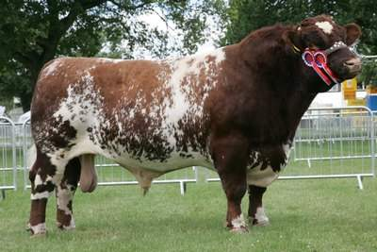
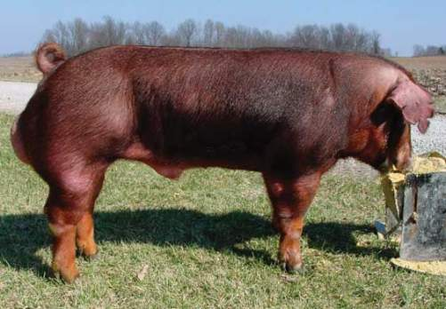
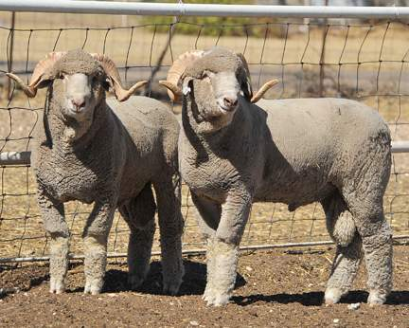
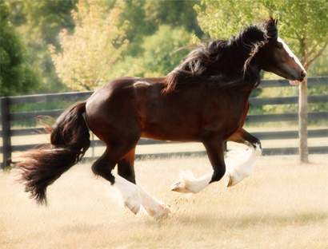
Male Reproduction

Slide 2
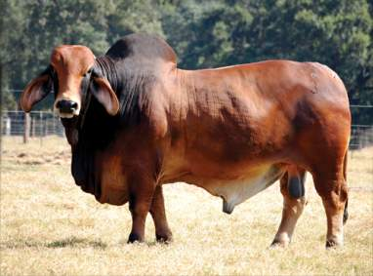
Male Reproduction
Function:
  Produce and deliver fertile sperm to the female reproductive tract
  Produce the hormone Testosterone
Job:
  Fertilize the female egg

Slide 3
Important Terms
Fibroelastic Penis vs. Vascular Penis
  Fibroelastic: uses the sigmoid flexure and retractor muscle to become erect
  Vascular: will fill with blood to become erect
Thermoregulation: regulation of the temperature of the testes to support fertile sperm production
Cryptorchidism: when one or neither testes descend into the scrotum during the fetal stages
Convoluted: contains many veins
Vasectomy: procedure to sterilize a male
Spermatogenesis: formation and growth of sperm

Slide 4
Hormone
Testosterone
  Produced by:
      Leydig Cells (found in the testicles)
  Function:
    Promotes spermatogensis
    Promotes secondary sex characteristics
      Example: horn growth or bright colored feathers in male birds

Slide 5
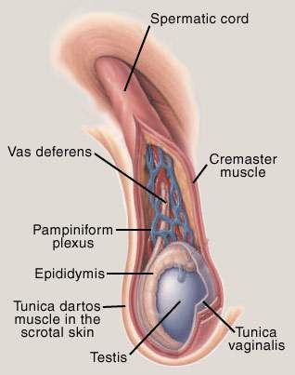
Male Reproduction
Important Organs:
  Scrotum
    Tunica Dartos
  Spermatic Cord
    Ductus Deferens/Vas Deferens
    Pampiniform Plexus
    Cremaster Muscle
  Testicles
  Epididymis
  Penis
    Fibroelastic vs. Vascular

Slide 6
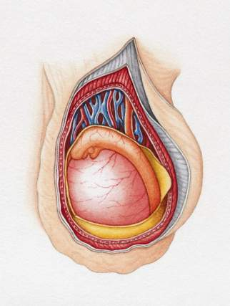
Scrotum
Houses the testes
Function:
  Protection
  Temperature Regulation (thermoregulation)
  Movement of the testes
Layers:
  Skin
    Sweat Glands located here
    Thermal Receptors
  Tunica Dartos Muscle
    Assists in thermoregulation
Tunica Dartos
Skin
Epididymis
Testes

Slide 7
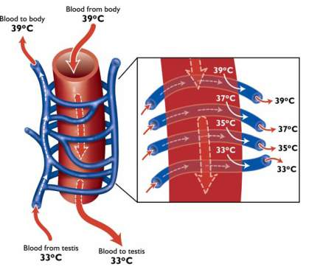
Spermatic Cord
Description: highly convoluted
Function:
  Suspend the testes in the scrotum
  Provide heat cooling system
Houses:
  Ductus Deferens/Vas Deferens:
    Move fertile sperm from the tail of the epididymis to the penis for ejaculation
    This is cut and causes a Vasectomy
  Pampiniform Plexus
    Composed of a testicular artery and veins that cool the blood before circulating throughout the scrotum
  Cremaster muscle
    Supports the testes
    Muscle that will pull testes up during a fight or flight situation
    Holds testes up for a short period of time
Pampiniform Plexus

Slide 8
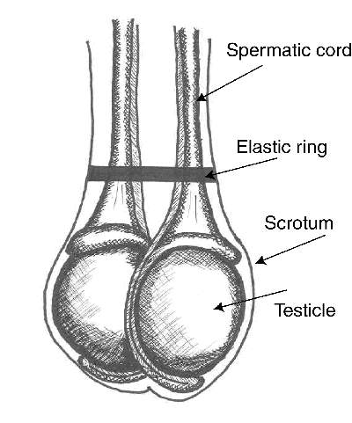
Testicles
Function:
  Produce Sperm
  Produce the hormone Testosterone
Produce 1-25 Billion sperm
Must be 3-6 degrees cooler than the body to keep sperm alive
Takes 45-60 days to produce fertile sperm

Slide 9
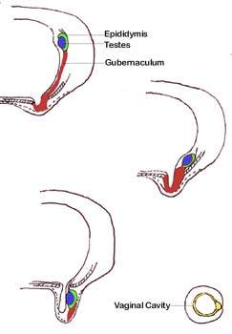
Testicular Descent
In the Fetal stage the testes will descend into the scrotum
  This is important for proper sperm production and temperature control
Gubernaculum:
  Pulls the testes through the Inguinal Ring into the scrotum
Inguinal Ring:
  Ring that is the opening between the body and scrotum
Cryptorchidism:
  Def: Failure of one or both of the testes to descend through the inguinal ring into the scrotum
  Unilateral Cryptorchidism: one testis does NOT descend into the scrotum
    Results in reduced fertile sperm concentration NOT infertile
  Bilateral Cryptorchidism: Neither testes descend into the scrotum
    Results in Sterility/Infertility
Inguinal Ring

Slide 10
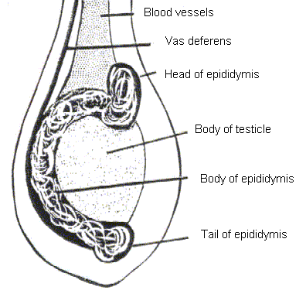
Epididymis
Function:
  Sperm Transport
  Sperm Maturation
  Storage of Sperm
3 Components:
  Head (Caput)
  Body (Corpus)
  Tail (Cauda)
Ductus Deferens

Slide 11
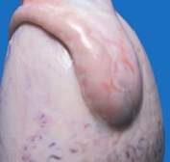
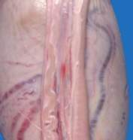
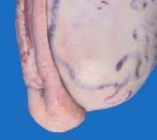
Epididymis Continued
Head (Caput)
  Entry point of produced sperm from the testes
    Sperm are NOT motile
    Sperm are NOT fertile
Body (Corpus)
  Maturation of Sperm
    Some expression of motility
    Some expression of fertility
Tail (Cauda)
  Sperm Storage
    Sperm are motile
    Sperm are fertile
    5-10 ejaculations are stored
    Sperm can bind to an egg

Slide 12
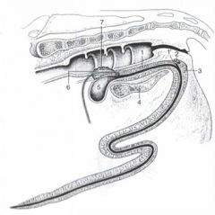
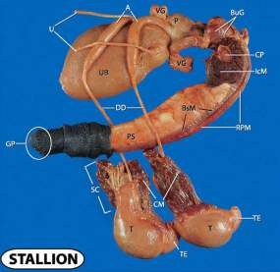
Penis
Fibroelastic Penis
Organ of fertilization of the female
2 Types:
  Fibroelastic Penis
    Sigmoid Flexure (S-curve)
    Rectractor Penis Muscle
  Vascular Penis
Species Differences:
  Fibroelastic Penis:
    Boar, Bull, and Ram
  Vascular Penis
    Stallion and Humans
Sigmoid Flexure
Retractor Penis
Muscle
Vascular Penis

Slide 13
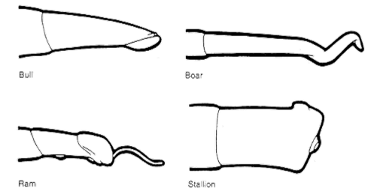
Species Differences
Bull
  Fibroelastic Penis
Ram
  Fibroelastic Penis
  Filiform Appendage
Boar
  Fibroelastic Penis
  Nonpendulous & Inverted testicles (tail of epididymis is above the head of the epididymis)
  Cork Screw Shape (match for the sows corkscrew cervix)
Stallion
  Vascular Penis
    Bell Shaped Penis
  NO Sigmoid Flexure

Slide 14
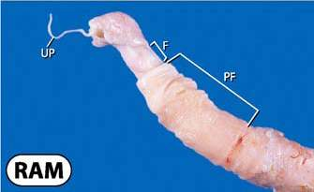
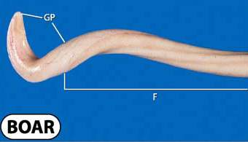
Penis Continued
Fibroelastic Penis:
  Extends in length by a muscle to penetrate the female
  Retractor Muscle
    Helps with erection
  Sigmoid Flexure
    ‘S curve’ that holds penis within the body when not erected or helps extend the penis when erected
  Examples: Bull, Boar, and Ram
  Species Differences:
    Ram:
      Filiform Appendage: Sprays sperm within the vagina for better chance of fertilization
    Boar:
      Corkscrew shaped penis: Matches the sows corkscrew shaped cervix
Filiform appendage

Slide 15
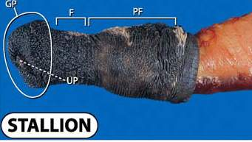
Penis Continued
Vascular Penis
  Penis fills with blood to become erect
  Does NOT include sigmoid flexure
  Examples:
    Stallion
    Human

Slide 16
Sterilization Techniques
Castration
  Removal of the testicles
Vasectomy
  Cutting or severing of the Ductus Deferens
Shortening of Spermatic cord
  Shortening of the spermatic cord to raise the testicles closer to the body
    Raising the testicles closer to the body will cause the temperature to become too hot causing sperm to die or become sterile

Slide 17
Thermoregulation
Thermoregulation is important for the survival of fertile sperm
Sperm will die if:
  Testes become too hot
    Testes need to be 3-6 degrees cooler than the body
    Heat will damage DNA within the sperm
    Heat will cause lower levels of fertility
  Testes become too cold
  Come in contact with blood
Ways of thermoregulation
  Thermoreceptors located on the scrotum sends messages to the brain when too hot or too cold
    Will cause panting to help dissipate heat from the body
  Sweat glands located on the scrotum will allow for cooling
  Tunica Dartos Muscle:
    Muscle layer beneath the skin of the scrotum will expand when too hot and will lift the testes up towards the body if too cold

Slide 18
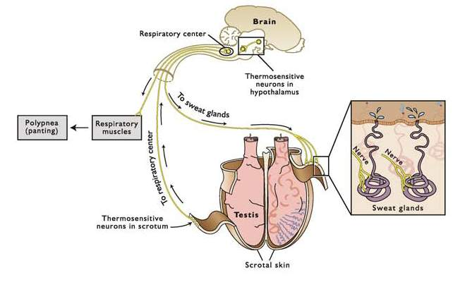
Thermoregulation Continued
How Thermoreceptors and sweat glands communicate with the brain

Slide 19
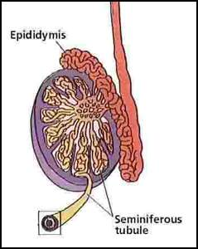
Spermatogenesis
Definition: formation of Sperm
  Sperm are formed and grow within the testes
  Within the testes sperm are grown inside of the seminiferous tubules within the lobules
2 Cell Types:
  Leydig Cells:
    Produce testosterone
    Located outside the seminiferous tubules
  Sertoli Cells:
    Protect and aid in growing sperm
      Aid in Spermatogenesis
    Located inside the seminiferous tubules
Ductus Deferens
Testes

Slide 20
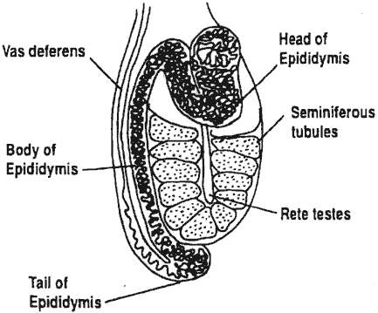
Sperm Transport
Seminiferous Tubules
Epididymis
  Head
  Body
  Tail
Vas Deferens
Penis
Into the Female Tract
Penis

Slide 21
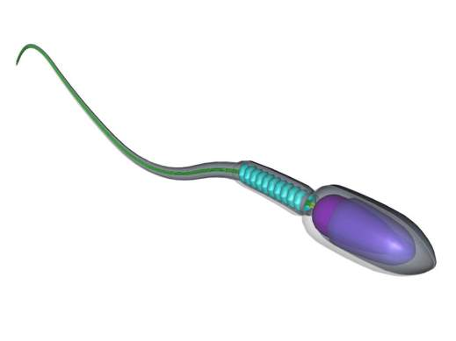
Sperm Anatomy
Head:
  Carries the DNA
Mid-Section (neck)
  Structure
  Holds the head to the tail
Tail
  Motor
  Drives the sperm throughout the male reproductive tract and female reproductive tract to the site of fertilization
Mid-Section
Head
Tail

Slide 22
Sperm Measurements
Sperm is measured by Volume (mL) and Concentration (x10⁶/mL)
Species differences:
Species | Volume (mL) | Concentration (x10⁶/mL)
Ram | 1 | 2000
Bull | 10 | 1000
Stallion | 100 | 500
Boar | 200 | 250

