Slide 1
Estrus Detection and Artificial Insemination

Slide 2
Key Terms

Slide 3
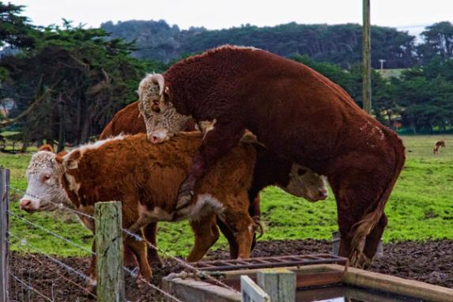
Natural Insemination
Deposition of semen by a male into the reproductive tract of a receptive female under normal body conditions and environment

Slide 4
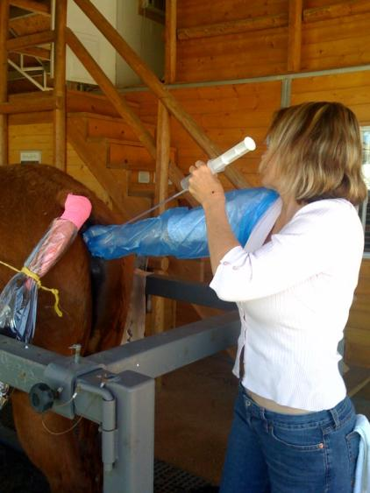
Artificial Insemination
The deliberate introduction of semen into a female for the purpose of fertilization, by means other than ejaculation directly into the vagina or oviduct.

Slide 5
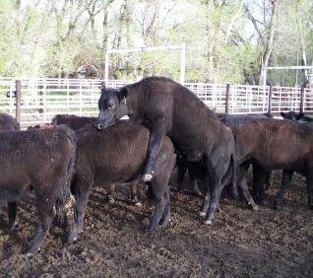
Estrus
The period where the female is receptive to the male, will stand for mating, and is capable of conceiving

Slide 6
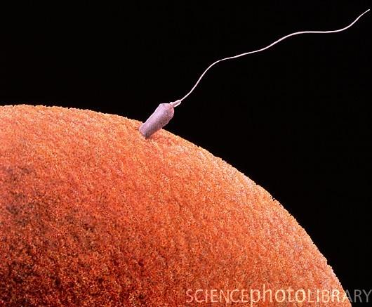
Capacitation
The change undergone by sperm in the female reproductive tract that enables them to penetrate and fertilize an egg

Slide 7
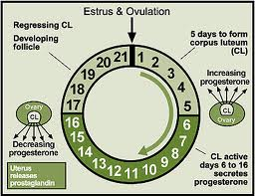
Estrous Cycle
The reproductive cycle of domestic animals.
It is measured from the beginning of one estrus to the beginning of the next.

Slide 8
Estrus Detection

Slide 9
Timing of Events in the Reproductive Cycle
Species | Length of Estrous Cycle | Duration of Estrus | Time of ovulation
Ewe | 17 days | 24-36 hours | 24-30 hours from onset of estrus
Goat | 21 days | 32-40 hours | 30-36 hours from onset of estrus
Sow | 21 days | 48-72 hours | 35-45 hours from onset of estrus
Cow | 21 days | 18-19 hours | 10-11 hours after the end of estrus
Mare | 21 days | 4-8 days | 1-2 days before the end of estrus

Slide 10
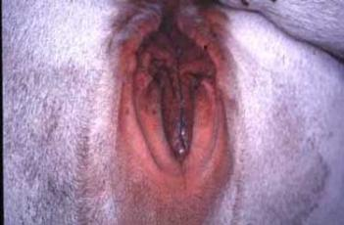
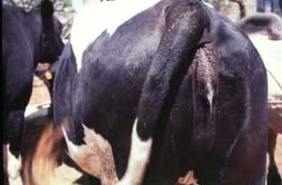
Methods of Estrus Detection
Visual inspection
  30 minutes morning and evening
  Standing to be mounted
  Mounting other animals
  Swollen vulva
  Mucus
Swollen Vulva
Mucus

Slide 11
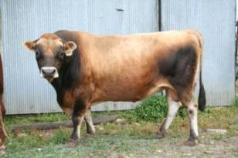
Methods of Estrus Detection
Teaser animals
  Surgically altered
    Vasectomized
    Gomer bull
  Androgenized cows or steers

Slide 12
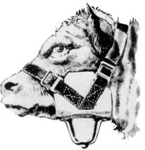
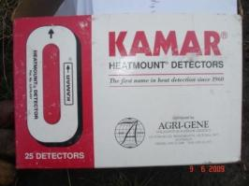
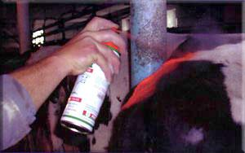
Methods of Estrus Detection
Marker Aids
  Chinball marker
  Heat-Mount detectors (i.e. K-Mar patches)
  Chalk or paint tail head

Slide 13
Considerations of Estrus Detection
Cost
Time and Labor
Ability of male to achieve intromission
Proper Heat Detection is Critical

Slide 14
Artificial Insemination

Slide 15
History
1780- First successful AI in dog - Italy
1900- Use of AI in horses - Russia
1938- First AI co-op for bull semen in US - Rutgers University
1948- 3% of dairy cows bred by AI in the US
1957- American Breeder Service began to use liquid nitrogen to freeze semen and store it in glass ampules

Slide 16
History Cont’d.
1972
  AI organization began using plastic straws for storing semen.
  Smaller in size for more efficient storage and less volume.
  Easier to thaw and control temperature.
  Increase thawing rate
  Increase surface area

Slide 17
Artificial Insemination
Advantages
Disadvantages
Genetic improvement through increased use of superior sires
Disease control
Improving record keeping
Eliminates need for keeping bulls
Time required to detect estrus
Percent of cows in estrus during breeding season
Trained personnel required
Overuse of inferior bulls

Slide 18
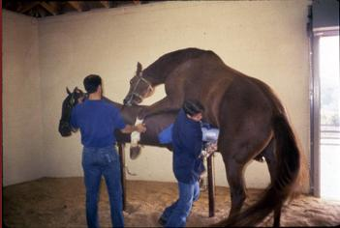
Major steps of artificial insemination
Collection of sperm for the male
Preservation and extension of sperm
Insemination of the female

Slide 19
Collection of semen
Artificial vagina
  Device that simulates vaginal conditions of a female in estrus
Electro ejaculation
  Electrical stimulation of the accessory sex glands and pelvic urethra resulting in ejaculation.

Slide 20
Design of Artificial Vagina
Provide a suitable environment for simulation of the glans penis
Provide an environment that prevents damage to the penis
Provide an environment that maximizes sperm recovery and minimizes sperm insult

Slide 21
Artificial Vaginas
Consist of an outer casing fashioned of reinforced rubber and a liner that is usually rubber and can be lubricated
Temperature and pressure are controlled by the water placed between the liner and the casing
One end of the AV is attached to a funnel that is attached to a semen vessel

Slide 22
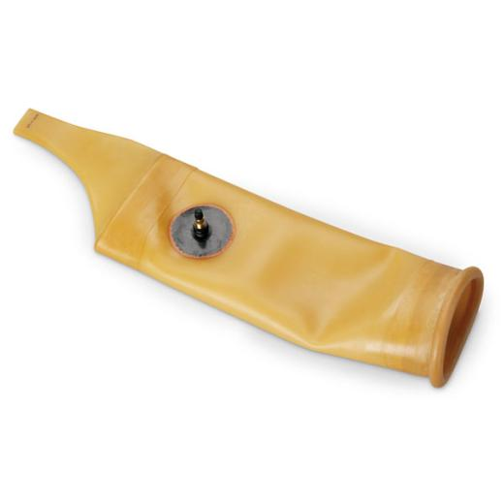
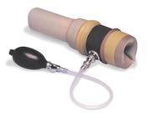
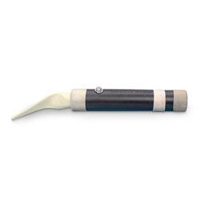
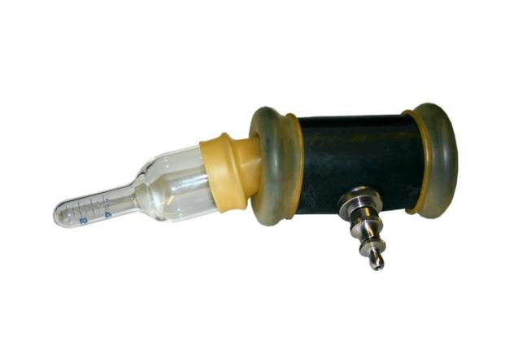
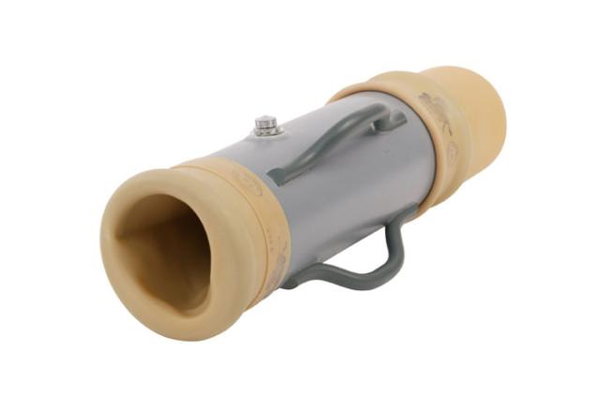
Types of Artificial Vaginas
Bull AV
Horse AV- Colorado Style
Ram AV
Boar
Horse - Missouri Style

Slide 23
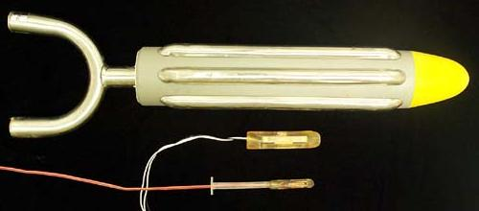
Electro ejaculation
Generally used in males of high genetic value that cannot physically perform mounting and ejaculation.

Slide 24
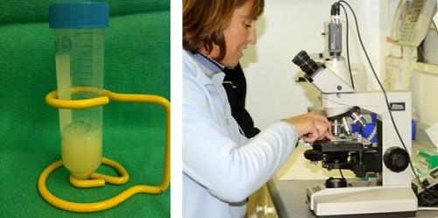
Preservation and extension of sperm
Immediately after collection, the following is needed:
  Ejaculate volume
  Concentration of spermatozoa in the ejaculate
  Percentage of motile sperm

Slide 25
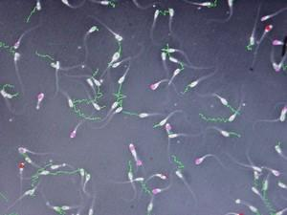
Evaluation of Semen
Total number of sperm in the ejaculate determines the number of insemination doses within each ejaculate.
Good quality - 60% or more motile sperm
Less than 50% motile sperm may be discarded especially if the sperm will be frozen

Slide 26
Determining number of doses
Determination of doses for good quality sperm:
  Ejaculate volume: 6ml
  Sperm concentration: 1.0 x 10⁹ sperm/ml (1 billion)
  Total sperm in ejaculate: 6ml x 1.0 x 10⁹ sperm/ml = 6 x 10⁹ (6 billion)
  Progressive motility: 70%
  Total motile sperm: 6.0 x 10⁹ x 0.7= 4.2x 10⁹ motile sperm/ejaculate
  Desired Concentration: 15 x 10⁶ / dose (1 insemination)
  Number of doses: 4.2 x 10⁹ / 15 x 10⁶ = 280 doses

Slide 27
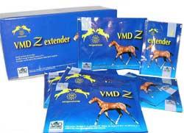
Extenders
Sperm must be preserved in order to inseminate females over a extended period of time.
Extender - the solution in which spermatozoa are diluted
  “extends” the number of sperm and their functional life.

Slide 28
Good Seminal Extenders must:
Be isotonic
Be good buffers
Minimize cold damage
Provide appropriate nutrients
Prevent microbial growth
Maintain viability
Be relatively low in cost

Slide 29
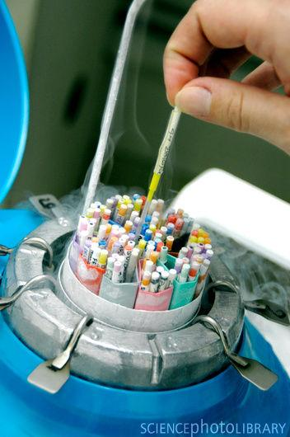
Handling and storing semen
Improper handling and storing of semen may kill the sperm in the sample
Each species of livestock has different criteria for handling and storing semen

Slide 30
Swine Liquid Semen
Liquid semen should be maintained at 64°F for maximum fertility
  Maintains good fertility for 5 - 7 days at this temperature
Re-evaluate semen if the temperature deviates from 50-80°F or is stored longer than 5 days
Liquid semen comes ready to inseminate (no need to thaw)

Slide 31
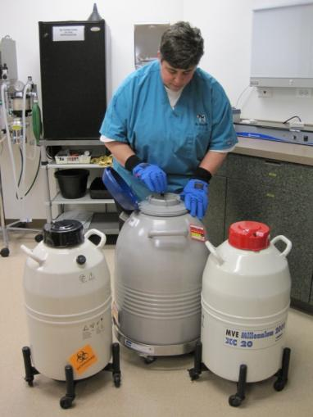
Frozen Semen
Stored in a liquid Nitrogen tank
Can be stored for long periods of time
  The level of liquid Nitrogen should never drop below four inches
Frozen semen needs to be thawed immediately prior to use

Slide 32
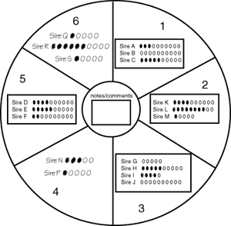
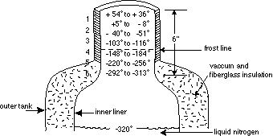
Liquid nitrogen storage tank

Slide 33
Retrieving Frozen Semen
Quickly remove semen from canister to prevent damage
Do no withdraw canister above the frost line
If desired semen is not retrieved in a few seconds, lower the canister back into the liquid nitrogen for 30 seconds to cool completely
Remove semen from the tank with forceps
Keep semen out of direct sunlight
  ultraviolet light has a spermicidal effect.
Note the location of the semen in the tank before removing plug from tank

Slide 34
thawing frozen swine semen
Warm frozen extender to 68°F
Remove one straw from the storage container and place in a 122°F water bath for 45 seconds.
  Do not hold the straw during this thaw period
Remove the straw from water and dry thoroughly
Hold straw vertically and snip off the upper tip
Place sealed end over the open bottle of extender and snip to allow the semen to drain into the bottle
Rinse the straw by aspirating extender into the straw

Slide 35
Thawing cattle semen
Place frozen semen in a 90° to 95°F water bath for at least 40 seconds
Completely dry the semen straw after thawing
  Water is lethal to sperm
Warm AI gun to avoid cold-shocking the semen.
Cut semen straw at crimped end, not the end with the cotton plug.
Place a plastic sheath over straw and gun

Slide 36
Thawing Horse Semen
Thaw semen in a 99°F water bath for 60 seconds
Hold straw with long forceps and thaw in an upright position
The air bubble in the center of the straw rising to the top indicates the semen is thawed
Dry straw and cut off the ball end
Cut other end of straw and allow semen to flow into the test tube.
Attach an AI breeding pipette to a syringe and aspirate the semen

Slide 37
Thawing Goat Semen (Ice Water Method)
Create an insulated ice water bath (38 - 42°F)
Remove ampule from tank and place immediately into thaw box.
  Ampule should not come into direct contact with ice, place in a cup with holes
Ampule may sit in ice water for as long as 30 minutes with no damage
Use semen immediately upon removal from water
The layer of ice on the ampule must be removed before opening to avoid possible contamination

Slide 38
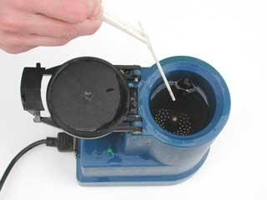
Thawing Goat semen (Warm water method)
Create a warm water bath (92 to 98°F)
Thawing will be completed in about 1 minute
Ampules Should be used within 5 minutes

Slide 39
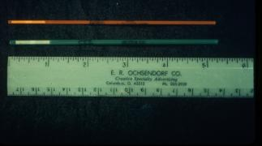
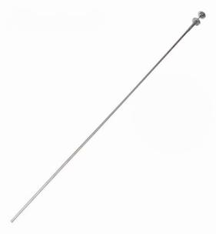
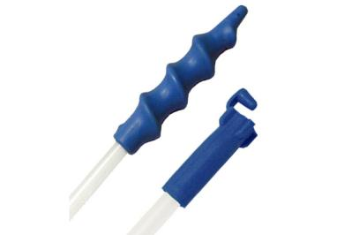
Methods of Artificial Insemination in female

Slide 40
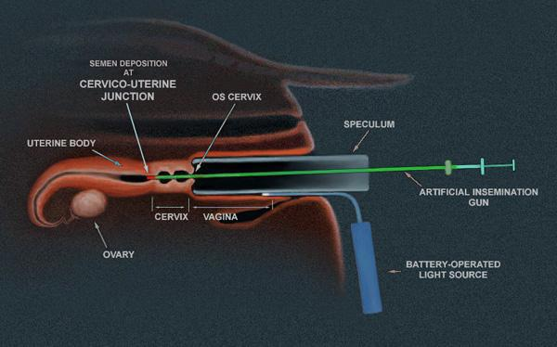
Deer and Goat
Speculum- tube like instrument that spans vulva and posterior vagina allowing for visual inspection of os cervix

Slide 41
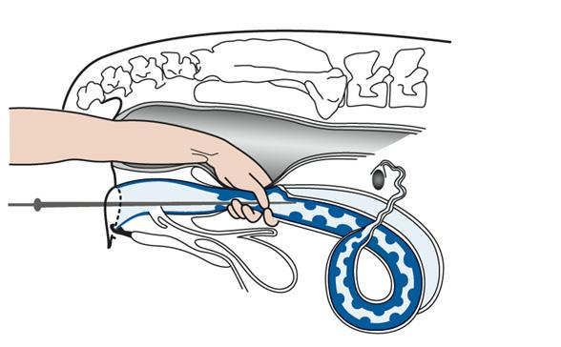
Cow
Rectocervical- manipulation of the cervix over the insemination gun via the rectum
Utilize AM/PM rule for timing insemination

Slide 42
AM/PM Rule for Cattle
Universally accepted time for insemination
Cows detected in estrus in the morning are bred that same afternoon, those found in estrus in the afternoon are bred the next morning

Slide 43
8 Step procedure
Thaw frozen semen slowly
Place plastic glove over hand and arm.
Lubricate plastic glove.
Restrain animal
Insert arm in animal’s rectum
Grasp the animal’s cervix through the rectum
Insert inseminating tube through the animal’s vagina and into cervix.
Deposit semen into animal’s cervix.

Slide 44
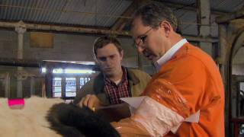
Cow AI Video
AI in cattle

Slide 45
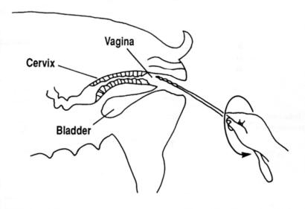
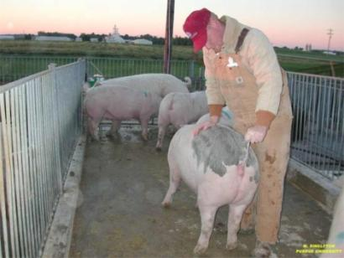
Sow
Introduce the spirette with a counter-clockwise rotation into the cervix
Gilts - inseminate 12 hours after detection of estrus
Sows - inseminate 24 hours after detection of estrus

Slide 46
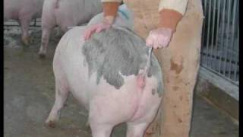
Sow AI video
Sow AI

Slide 47
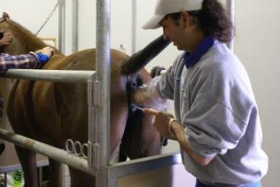
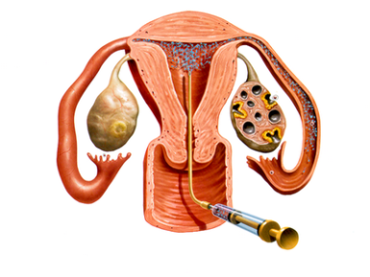
Mare
Vaginocervical - introduction of the insemination gun into the cervix via the vagina
Insemination time is based on a presence of a 35mm follicle, open cervix, and detection of estrus

Slide 48
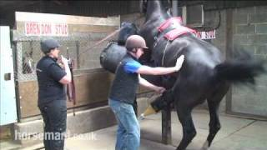
Mare AI Video
Mare AI

Slide 49
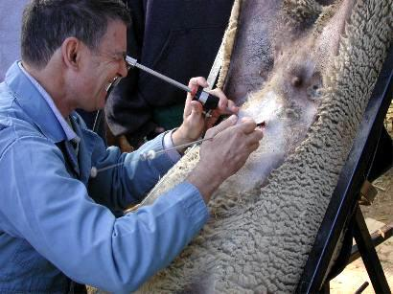
Sheep
Laparoscopy - surgical introduction of semen directly into the uterine horns

Slide 50

EWE AI Video
Ewe AI

Slide 51
References
http://aces.nmsu.edu/pubs/_d/d-303.pdf
http://www.pilchuckvet.com/articles/handling-of-frozen-stallion-semen
http://www.goatworld.com/articles/ai/ai.shtml
Pathways to Pregnancy and Parturition, Second Revised Edition, P.L Senger
Texas A&M University ANSC 433 Lab Manual

