Slide 1
Life Science Organ Systems Gas Exchange
Post-Test

Slide 2
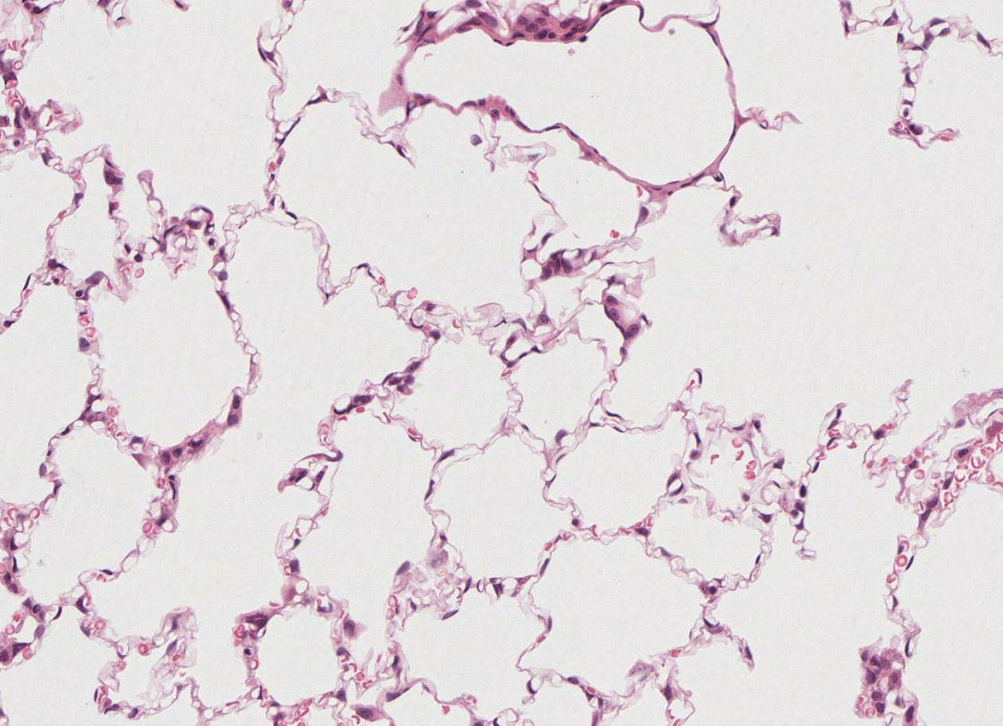
The following is a microscope slide showing alveoli in the lung. What are the pink/purple structures lining the air spaces?
a. Globs of mucous
b. Drops of stain
c. Dust particles caught in the lungs
d. Lung cells

Slide 3
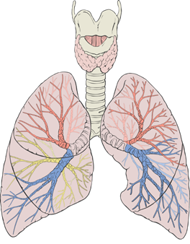
Below is a diagram of a human organ system. What is the function of this organ system?
a. To breakdown food into usable nutrients
b. To bring oxygen to the bloodstream and remove carbon dioxide from the blood
c. To transport nutrients and oxygen to cells and remove carbon dioxide and other waste products from the cells via the bloodstream
d. To facilitate communication between body systems via electrical impulses
By Patrick J. Lynch, medical illustrator - Patrick J. Lynch, medical illustrator, CC BY 2.5, https://commons.wikimedia.org/w/index.php?curid=1496626

Slide 4
The lining of the alveoli in the lungs are an example of a(n) _____
a. Organ system
b. Organ
c. Tissue
d. Cell

Slide 5
During times of high stress, the body releases a hormone called epinephrine. This hormone causes a person’s bronchi to dilate and their heart rate to increase. Why would this response be helpful?
a. During times of stress, the body doesn’t need as much oxygen
b. When the body is relaxed, more blood flow goes to the digestive system
c. When the body is under stress, more oxygen is needed for cells to prepare to fight or flee
d. Increasing oxygen during times of stress doesn’t really do anything

Slide 6
Which of the following lists components of the respiratory system from simplest to most complex?
a. Lungs→ respiratory system→ alveoli → lung cells
b. Lung cells→ alveoli→ lungs→ respiratory system
c. Alveoli→ respiratory system → lung cells→ lungs
d. Respiratory system→ lung cells→ lungs→ alveoli

