Slide 1
Organ Systems
Detoxification

Slide 2
Navigation Table
Organ Systems: Detoxification
Pre-Test
Introduction
Why It Matters
What We Know
How We Know
Story Time
Common Hazards
Activities
Self-Study Game
Post-Test
Glossary

Slide 3
Detoxification
Pre-Test
Organ Systems: Detoxification
Pre-Test
Introduction
Why It Matters
What We Know
How We Know
Story Time
Common Hazards
Activities
Self-Study Game
Post-Test
Glossary
Click a link below to take the pre-test for this unit!
  Google assessment

Slide 4
Detoxification
Organ Systems: Detoxification
Pre-Test
Introduction
Why It Matters
What We Know
How We Know
Story Time
Common Hazards
Activities
Self-Study Game
Post-Test
Glossary
Introduction

Slide 5
Introduction
Detoxification
Organ Systems: Detoxification
Pre-Test
Introduction
Why It Matters
What We Know
How We Know
Story Time
Common Hazards
Activities
Self-Study Game
Post-Test
Glossary
Toxic substances are everywhere. The body can be exposed to toxic chemicals in the environment, but some toxins are produced in the body through normal body chemical reactions.
How can our bodies cope? This module explains some of the ways that animals and humans combat and eliminate toxic chemicals. The organ systems involved include the lungs, the skin, and the digestive tract, but two organs are especially important: the liver and the kidneys.
We call the process of eliminating toxins "detoxification." Different organs detoxify in varying ways.
Lungs can detoxify by removing gases (gas anesthetics are removed from the body by the lungs).
Skin can detoxify by reducing the penetration of toxic substances (toxins in water don't get in through the skin well; however, toxins in oils penetrate easily).
Digestive System can detoxify by eliminating toxic foods by either vomiting or diarrhea.
Kidneys detoxify by secreting toxins or filtering toxins out of the blood into urine.
Liver detoxifies by changing the chemical nature of many toxins.
Kidney and liver are especially important. They are discussed separately because they work in different ways.

Slide 6
Detoxification
Objectives
Organ Systems: Detoxification
Pre-Test
Introduction
Why It Matters
What We Know
How We Know
Story Time
Common Hazards
Activities
Self-Study Game
Post-Test
Glossary
After completing this lesson, each student should be able to:
  Explain why detoxification systems are needed in the body
  Identify the systems in the body that have detoxification functions and summarize how they perform their detoxifying actions

Slide 7
Detoxification
Organ Systems: Detoxification
Pre-Test
Introduction
Why It Matters
What We Know
How We Know
Story Time
Common Hazards
Activities
Self-Study Game
Post-Test
Glossary
Why It Matters

Slide 8
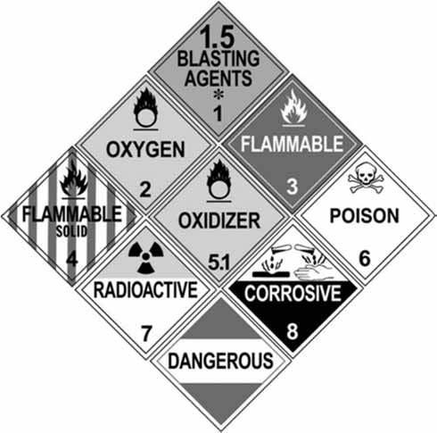
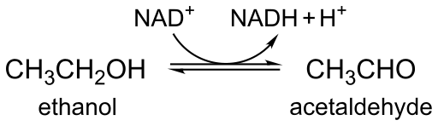
Toxins Are Everywhere
Why It Matters
Detoxification
Organ Systems: Detoxification
Pre-Test
Introduction
Why It Matters
What We Know
How We Know
Story Time
Common Hazards
Activities
Self-Study Game
Post-Test
Glossary
You would be sick all the time if your body did not have ways to detoxify all the bad things that you breathe, drink, eat, and get on your skin. In fact, you could not even live. The world is full of bad chemicals, even without man-made pollution.
But toxins would still be a problem even if we lived in a clean environment. Our own body makes toxic chemicals, many as by-products of normal body processes. For example, did you know that one product the body makes as a by-product of its normal chemical reactions is ethyl alcohol (the kind found in alcoholic drinks)? And the body changes alcohol into an even more toxic compound, acetaldehyde! But your body has a way of taking care of those toxic compounds!
Toxic Hazards Labels Source: California DMV
Most of the ethanol in the body is broken down in the liver and transformed into a toxic compound called acetaldehyde (CH₃CHO), a known carcinogen (cancer causing agent).

Slide 9
Detoxification
Organ Systems: Detoxification
Pre-Test
Introduction
Why It Matters
What We Know
How We Know
Story Time
Common Hazards
Activities
Self-Study Game
Post-Test
Glossary
What We Know

Slide 10
What We Know
Detoxification
Organ Systems: Detoxification
Pre-Test
Introduction
Why It Matters
What We Know
How We Know
Story Time
Common Hazards
Activities
Self-Study Game
Post-Test
Glossary
What do we do with these toxins?
So how does the body work to detoxify the chemicals it is exposed to? Much of that depends on which chemicals they are and where they come from. Many products of bodily metabolism are waste products that the body either does not need or cannot use. The body may even be damaged by some of metabolism's products. Thus, mechanisms exist to rid the body of these damaging chemicals. In addition, many chemicals in our environment are damaging to the body, and such products need to be eliminated or destroyed.
Three organ systems act in indirect ways to detoxify…

Slide 11
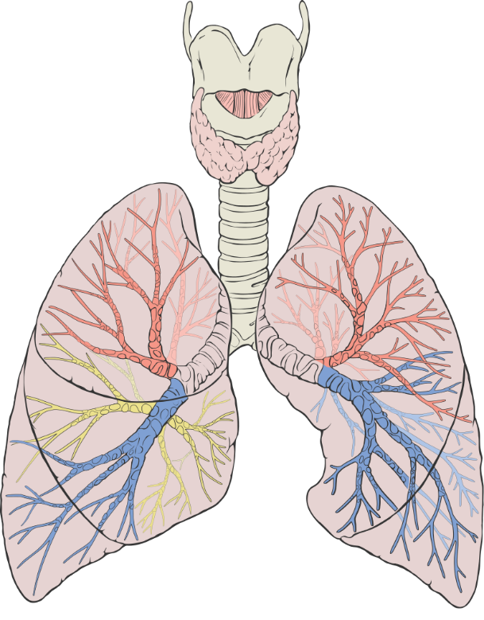
What We Know
Detoxification
Organ Systems: Detoxification
Pre-Test
Introduction
Why It Matters
What We Know
How We Know
Story Time
Common Hazards
Activities
Self-Study Game
Post-Test
Glossary
What do we do with these toxins? Cont’d
Respiratory System- the lungs remove toxic gases and volatile chemicals that can be breathed out of the body. An example is the chemical acetaldehyde, which is created when the liver destroys alcohol. Acetaldehyde is what you smell on the breath of a person who has drunk a lot of alcohol. This gas would be lethal if it were not removed from the blood by way of the lungs. Gas anesthetics are eliminated from the body mostly by way of the lungs.
By Patrick J. Lynch, medical illustrator - Patrick J. Lynch, medical illustrator, CC BY 2.5, https://commons.wikimedia.org/w/index.php?curid=1496626

Slide 12
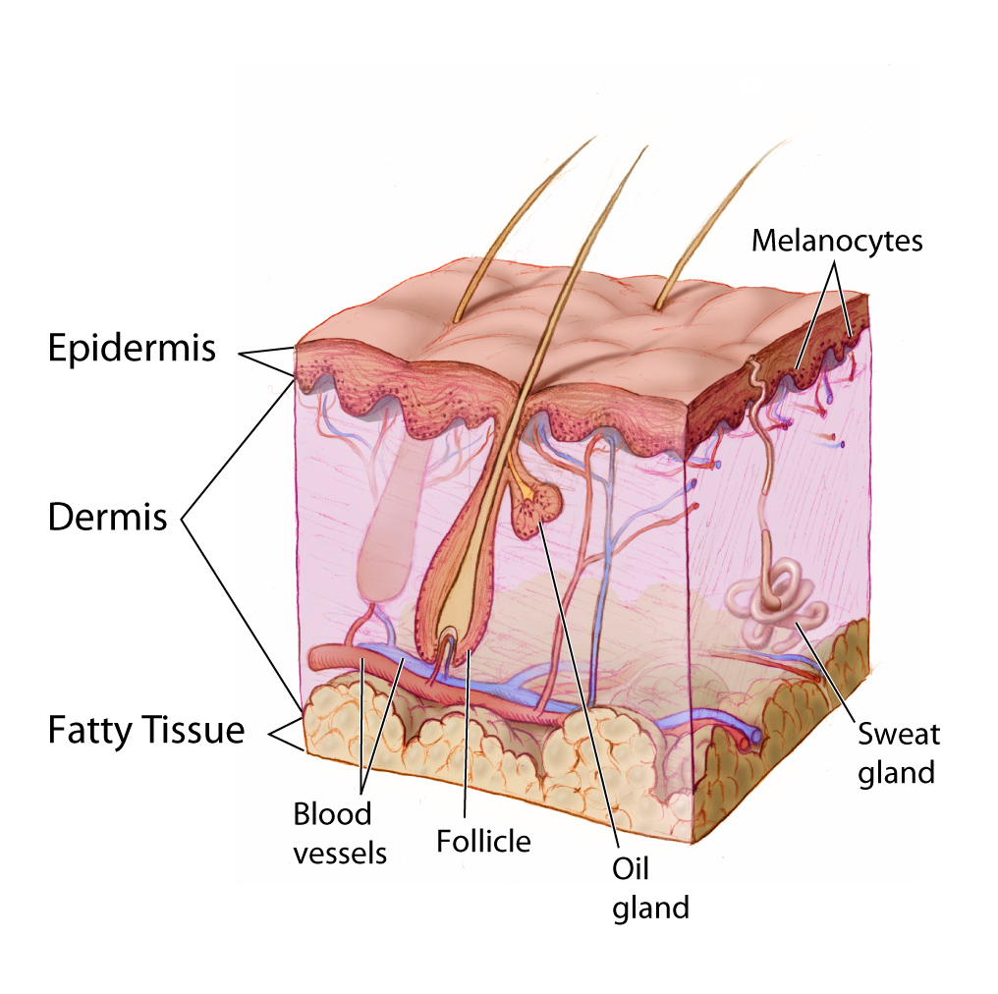
What We Know
Detoxification
Organ Systems: Detoxification
Pre-Test
Introduction
Why It Matters
What We Know
How We Know
Story Time
Common Hazards
Activities
Self-Study Game
Post-Test
Glossary
What do we do with these toxins? Cont’d
Integumentary System- Some toxins can dissolve in sweat and be removed from the body through the skin. It is a common belief that stimulating sweat with intense exercise or heat will help clean the body of toxins. But there is not much medical evidence that this is practical. Excess sweating can cause loss of water, which may be more hazardous than the toxins.
The Skin
Image Credit: https://visualsonline.cancer.gov/details.cfm?imageid=4604
Creator Don Bliss

Slide 13
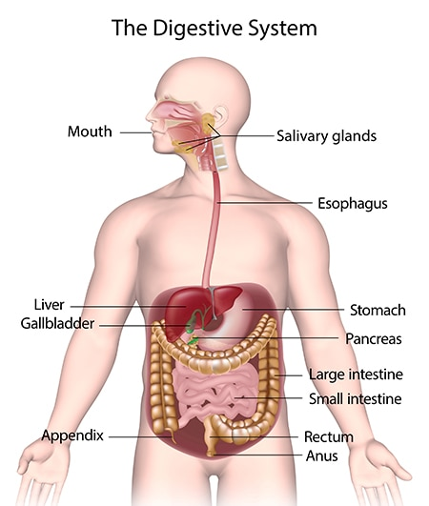
What We Know
Detoxification
Organ Systems: Detoxification
Pre-Test
Introduction
Why It Matters
What We Know
How We Know
Story Time
Common Hazards
Activities
Self-Study Game
Post-Test
Glossary
What do we do with these toxins? Cont’d
Digestive System - toxins that are taken in by eating or drinking can be eliminated in the feces. This is particularly true in the case of "food poisoning," where the body defends itself by vomiting and diarrhea in order to remove the toxins quickly.
Source: NIH NIDDK
There are two very vital organs that have a direct role in detoxification. In fact, detoxification is the main reason we have these organs. Let’s talk about the liver and the kidneys.

Slide 14
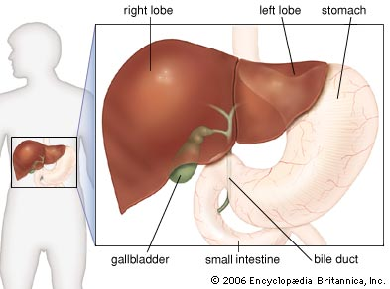
What We Know
Detoxification
Organ Systems: Detoxification
Pre-Test
Introduction
Why It Matters
What We Know
How We Know
Story Time
Common Hazards
Activities
Self-Study Game
Post-Test
Glossary
Liver
Cell Operations of the Liver
  All substances that are absorbed in the digestive tract enter the veins that drain the gut and are carried in this venous blood to the liver. Think of the liver as the gatekeeper between the intestines and the general blood circulation. This is one of the few cases where venous blood comes INTO an organ. Because you have been told that the liver detoxifies chemicals, do you see why the liver gets its input of blood from the blood that drains from the gut?
  The liver detoxifies numerous toxins. It also destroys drugs, such as alcohol, nicotine, and prescription medicines, because these things are not normal to the body. Some medicines have the bad side effect of damaging liver cells. It is like a war between liver cells and the medicine, because the liver is programmed to destroy foreign chemicals and cannot know that medicines are supposed to be good for the body nor know which medicines may damage the liver cells in the process of destroying the drug.
Liver. Image. Encyclopedia Britannica. https://www.britannica.com/science/liver#/media/1/344579/149103

Slide 15
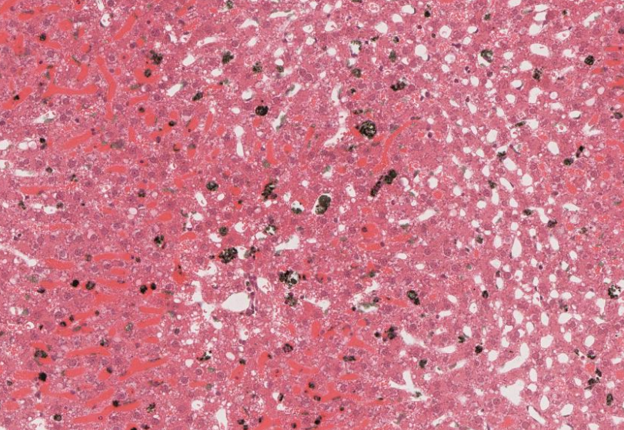
What We Know
Detoxification
Organ Systems: Detoxification
Pre-Test
Introduction
Why It Matters
What We Know
How We Know
Story Time
Common Hazards
Activities
Self-Study Game
Post-Test
Glossary
Liver Cont’d
How do you suppose any organ could specialize to detoxify? The liver takes a two-step approach. If we examine the liver under a microscope, we see rows of liver cells with small spaces in between that act as a filter to remove dead cells, microorganisms, and chemicals as the blood flows slowly through the liver. This filter includes Kupffer cells that engulf ("eat") the sludge that is left trapped in the filter.
Once inside the Kupffer cells, the sludge must be broken down. This is where the two steps take place. Step one includes an enzyme, cytochrome p-450, to detoxify the damaging chemicals. This means that the harmful chemical gets broken down into smaller parts that are not harmful to the body. Step two of detoxification is when the Kupffer cells add materials to the chemical to be broken down, and this new chemical is not harmful to the body. This addition of materials to a harmful substance is called conjugation. Once steps one and two have been performed, the sludge is ready to be added back to the regular blood stream as waste, and it never harms the body. We have a wonderful, life-saving detoxification plant.
Microscope slide of liver with colloidal carbon. The Kupffer cells have engulfed the carbon and are consequently black.

Slide 16
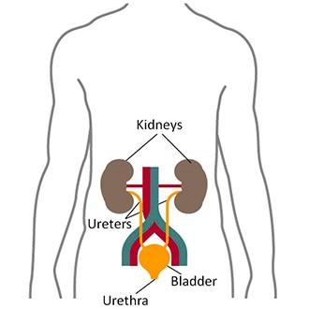
What We Know
Detoxification
Organ Systems: Detoxification
Pre-Test
Introduction
Why It Matters
What We Know
How We Know
Story Time
Common Hazards
Activities
Self-Study Game
Post-Test
Glossary
Kidneys
Functions of the Kidney
  The first place that blood from the stomach and intestines goes is to the liver. But then the blood leaving the liver goes to the heart and is pumped directly to the kidneys that are part of the excretory system. Kidneys regulate the balance of water, minerals, and salts in the body, but they also have a very important role in detoxification.
  With about 150 liters of blood being pumped through the kidneys every day, they do a big job for such a small organ! Their main function is to take all of the blood in the body and clean it.
There are two kidneys. They are bean-shaped and located just below the rib cage on each side of the body.
Source: NIH NIDDK

Slide 17
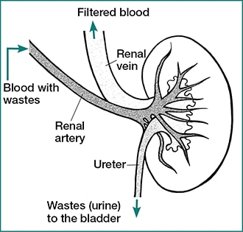
What We Know
Detoxification
Organ Systems: Detoxification
Pre-Test
Introduction
Why It Matters
What We Know
How We Know
Story Time
Common Hazards
Activities
Self-Study Game
Post-Test
Glossary
Kidneys Cont’d
How does the blood get in and out of the kidney?
  Blood flows into the kidney through a very large artery called the renal artery. The word “renal” means “relating to the kidneys.” The renal artery branches and becomes smaller and smaller blood vessels until it gets into the tiny structures of the kidneys. The blood that is filtered by the kidney leaves the kidney through the renal vein. Why do you think it is called the renal vein?

Slide 18
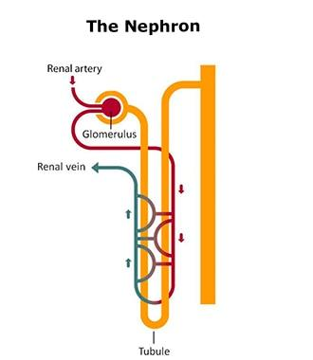
What We Know
Detoxification
Organ Systems: Detoxification
Pre-Test
Introduction
Why It Matters
What We Know
How We Know
Story Time
Common Hazards
Activities
Self-Study Game
Post-Test
Glossary
Kidneys Cont’d
What happens in the kidney?
  Your kidneys are made of millions of filtering units called nephrons. Each nephron includes a tiny filter called a glomerulus, and a tubule. The glomerulus is a cluster of tiny blood vessels. The walls of the glomerulus are so thin that they let small molecules of wastes and fluids (mostly water) pass through them and into the tubules. But larger molecules, like proteins and blood cells, stay inside the blood vessel.
  Next to the tubule is a blood vessel. As the materials flow through the tubule, some are reabsorbed into the blood vessel. That includes water, minerals, and nutrients that your body needs. The tubule also removes excess acid from the blood. The rest of the fluids and wastes in the tubule becomes urine.
Source: NIH NIDDK
  The urine exits the kidney through the ureter and then flows to the bladder, where it is stored until you are ready for it to exit the body through the urethra. Most of the water and other substances out of the 150 liters of blood that the kidney filters each day are returned to your blood by the tubules. You only produce about 1-2 liters of urine a day!

Slide 19
Detoxification
Organ Systems: Detoxification
Pre-Test
Introduction
Why It Matters
What We Know
How We Know
Story Time
Common Hazards
Activities
Self-Study Game
Post-Test
Glossary
How We Know

Slide 20
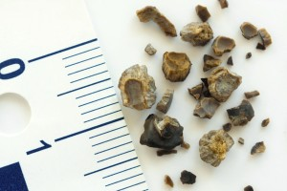
Kidney Function
How We Know
Detoxification
Organ Systems: Detoxification
Pre-Test
Introduction
Why It Matters
What We Know
How We Know
Story Time
Common Hazards
Activities
Self-Study Game
Post-Test
Glossary
We learned earlier that kidneys detoxify the body by secreting toxins or filtering toxins out of the blood into urine. But how do we know this?
The best way to learn what kidneys do is to examine the product of their function- urine. Examining the urine is also a good way to know if anything is wrong with kidney function. Medical technicians in hospitals and clinics routinely examine urine ("urinalysis") looking for any abnormalities. Any abnormalities could signal kidney disease. Examples of diseases that can be detected by urinalysis include diabetes, kidney stones, and chronic infections of the urinary tract.
Kidneys stones, after they have been concentrated and removed from urine. Such stones in the urine can block urine formation and cause severe pain.
Source: Harvard Medical School

Slide 21
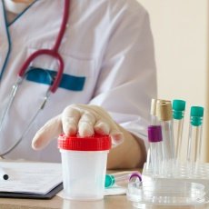
Urinalysis
How We Know
Detoxification
Organ Systems: Detoxification
Pre-Test
Introduction
Why It Matters
What We Know
How We Know
Story Time
Common Hazards
Activities
Self-Study Game
Post-Test
Glossary
Urine is analyzed in three ways:
  Unmagnified ("macroscopic"): check for amount, color, clarity
  Chemical analysis with a "dip stick": check for acidity, density, amount of protein, glucose, ketones, nitrites, and white blood cells. Special tests can be done for other substances, such as illegal drugs.
  Magnified (microscopic): check for crystals, squamous (flat) cells, bacteria, and other large objects.
Source: MedlinePlus

Slide 22
Urinalysis
How We Know
Detoxification
Organ Systems: Detoxification
Pre-Test
Introduction
Why It Matters
What We Know
How We Know
Story Time
Common Hazards
Activities
Self-Study Game
Post-Test
Glossary
Macroscopic Abnormalities:
  Not enough urine might mean that the kidneys are not filtering blood well.
  Too much urine might mean that the kidneys are not reabsorbing the water that is filtered out of blood - a common sign of diabetes mellitus.
  Urine should be yellow. If it is pale or clear it may mean dilution, either because too much water is being lost or it could be that you just drank a lot of liquid.
Chemical Abnormalities:
  Red blood cells should not be in urine, unless the urine is collected from females during menstruation.
  White blood cells should not be in urine. They could indicate infection of the kidneys, bladder, or other parts of the urinary tract.
  Too many crystals and stones could indicate a risk for blockage of the urinary tract. This prevents urine from being discharged, puts pressure on the kidney tubules, and stops urine formation.

Slide 23
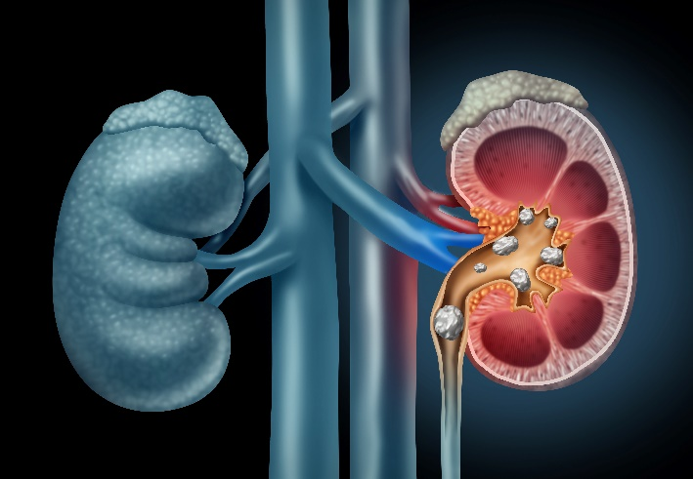
Kidney Failure
How We Know
Detoxification
Organ Systems: Detoxification
Pre-Test
Introduction
Why It Matters
What We Know
How We Know
Story Time
Common Hazards
Activities
Self-Study Game
Post-Test
Glossary
Kidneys can become physically damaged by precipitates such as stones or by excess pressure (high blood pressure, obstructions in the bladder or the tube (urethra) that leads outside the body). The damage can progress to renal insufficiency and end-stage kidney disease, which require renal dialysis or a kidney transplant.
An Artistic Representation of Kidney Stones. Source: Harvard Medical School

Slide 24
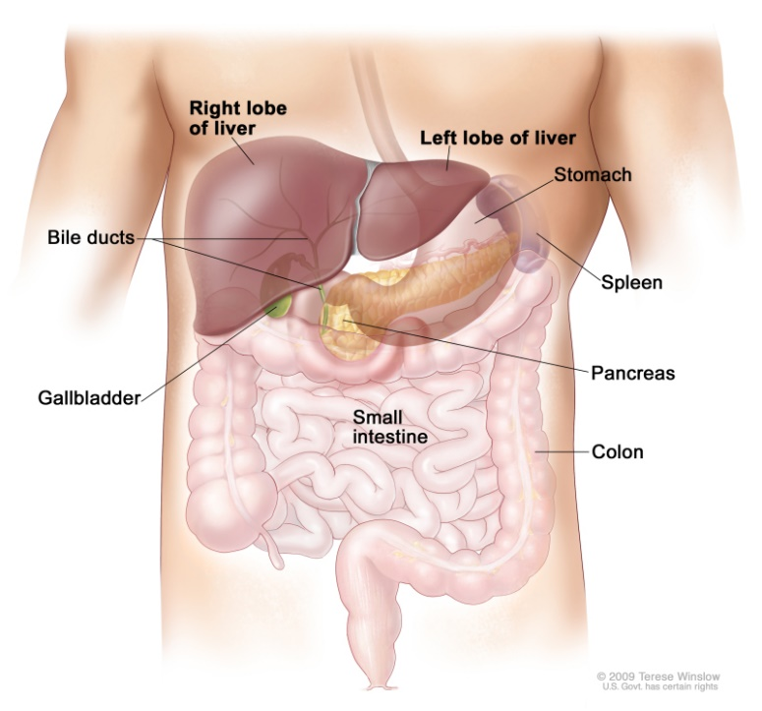
Liver Functions
How We Know
Detoxification
Organ Systems: Detoxification
Pre-Test
Introduction
Why It Matters
What We Know
How We Know
Story Time
Common Hazards
Activities
Self-Study Game
Post-Test
Glossary
Source: NCBI
Artist: Terese Winslow
The liver’s main jobs are to filter the blood coming from the digestive tract, detoxify chemicals, and metabolize drugs. We discovered these functions in a variety of ways.
Observing the liver tells us a lot about its function:
huge veins come into the liver from the gut
venous blood flows past single rows of liver cells
blood takes about 8 seconds to pass by the liver cells
the flow path exposes blood to many phagocytotic cells
Comparing the chemical contents of the blood coming in with that of the blood leaving the liver shows that the liver must:
make urea, a protein waste product
make bile, which is released from the gall bladder to the intestines (makes fat easier to digest)
remove low density lipids (LDL) and add high density lipids (HDL) to blood, thus protecting against hardening of the arteries
convert and detoxify many drugs and toxins

Slide 25
Medical Application- Liver Function Tests
How We Know
Detoxification
Organ Systems: Detoxification
Pre-Test
Introduction
Why It Matters
What We Know
How We Know
Story Time
Common Hazards
Activities
Self-Study Game
Post-Test
Glossary
Because the liver is so vital for life, it is important to know if the liver is working normally. This is especially true in older age, when the liver is most likely to be damaged. There are several laboratory tests that doctors can perform to check if liver function is normal. Any symptoms of illness that might occur because of a poorly functioning liver will prompt a physician to consider ordering a medical laboratory to perform certain liver function tests on a blood sample. Such symptoms could include a yellowing of skin and membranes of the eye (called jaundice), a prolonged bleeding after cuts and bruises, and swollen or hardness of the liver (which the doctor determines by pressing on your abdomen over the liver). Unfortunately, you can have severe liver damage long before obvious symptoms appear. Sometimes, even the laboratory tests fail to detect severe liver damage.

Slide 26
Medical Application- Liver Function Tests
How We Know
Detoxification
Organ Systems: Detoxification
Pre-Test
Introduction
Why It Matters
What We Know
How We Know
Story Time
Common Hazards
Activities
Self-Study Game
Post-Test
Glossary
The lab tests look for:
  Certain enzymes - these leak from damaged liver cells into the blood
  Bilirubin (a normal by-product of red blood cell turnover) - builds up when liver is too damaged to remove it. This appears as jaundice.
  Albumin (this protein is made in the liver) - decreases in liver damage
  Blood clotting proteins (these are made in the liver) - clotting time is prolonged when liver is damaged
Many prescription drugs can damage the liver in the process of being deactivated by liver cells. But the most common causes of liver damage are alcohol abuse and certain virus infections (viral hepatitis).

Slide 27
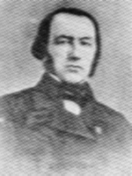
Detoxification
Storytime
Organ Systems: Detoxification
Pre-Test
Introduction
Why It Matters
What We Know
How We Know
Story Time
Common Hazards
Activities
Self-Study Game
Post-Test
Glossary
Claude Bernard (1813-1878)
Experimenting on animals is a controversial practice. Many people think that animals have rights and should not be subjected to experimentation. Medical researchers, however, hold the view that animal research is necessary to human welfare and is certainly more defensible than eating animals. Experimenting on animals, also known as vivisection, was established as acceptable scientific practice by Claude Bernard. It was he who showed how much could be learned and applied to medical practice through vivisection.
In defending biomedical research on animals, the American Medical Association says:
"In fact, virtually every advance in medical science in the 20th century, from antibiotics and vaccines to antidepressant drugs and organ transplants, has been achieved either directly or indirectly through the use of animals in laboratory experiments."

Slide 28

Early Life
Storytime
Detoxification
Organ Systems: Detoxification
Pre-Test
Introduction
Why It Matters
What We Know
How We Know
Story Time
Common Hazards
Activities
Self-Study Game
Post-Test
Glossary
Claude Bernard was born near Villefranche (20km north of Lyons-see photo on right of his birthplace, now a museum), where his father worked the Chevalier de Quincieux estate. His father was a winemaker and Claude helped him tend the vineyards and process the harvest. His mother, Jeanne Saulnier, had a peasant background. His father went broke in a wine-marketing venture, and the family was poor. Claude studied Latin with a local priest and was taken in as a student in a Jesuit school at Villefranche. That school taught no science, and it is amazing that Claude developed an early interest in science. He studied at the middle school in Thoissey, but he quit school without a diploma and apprenticed to a chemist named Millet in a Lyon suburb. His work there was apparently boring, but he did enjoy the errands he ran to the nearby veterinary school.

Slide 29
Schooling
Storytime
Detoxification
Organ Systems: Detoxification
Pre-Test
Introduction
Why It Matters
What We Know
How We Know
Story Time
Common Hazards
Activities
Self-Study Game
Post-Test
Glossary
While at Lyon, Claude developed an interest in medicine, perhaps in part because of his exposure to the veterinary school. Claude left Lyon to study medicine in Paris between 1834 and 1843. Claude was not a particularly good student, but then he had a very poor school background. Of 29 students passing the examination for the internship, Bernard ranked 26th. He failed the examination that would have qualified him to teach in the medical school, so he began collaborating with others in research projects.
Claude Bernard worked with François Magendie the leading physiologist of his time. For a while, Claude worked in Magendie's shadow, but it soon became clear that Claude could hold his own with the best, even Magendie. In 1854 a chair of general physiology was created for Claude in the Sorbonne, and he was elected to the Academy of Sciences. When Magendie died in 1855, Bernard succeeded him as full professor before succeeding him to the experimental medicine chair at the Ollège de France in 1855.
Claude did not have his own laboratory at first, but his fame was such that he had a personal interview with Emperor Napoleon, who made sure that a lab was constructed for him.

Slide 30
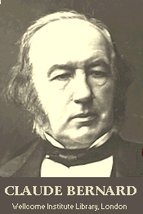
Medical Contributions
Storytime
Detoxification
Organ Systems: Detoxification
Pre-Test
Introduction
Why It Matters
What We Know
How We Know
Story Time
Common Hazards
Activities
Self-Study Game
Post-Test
Glossary
During most of the 1800s, France was the world leader in medicine, and Claude Bernard grew up in that culture where advances in medicine were being driven by the scientific method. Claude became a leader in using the scientific method and, in fact, is generally considered the founder of modern experimental physiology. One of the lasting contributions he made was his demonstration of the value of hypothesis-driven research. Claude's experiments began with a hypothesis, and tests were designed that would either support or refute the hypothesis, and that in turn guided the next steps in experimentation. Claude had three guiding principles for his own research; he believed that 1) the notion of "vital force" does not explain life; (2) animal research (vivisection) is indispensable for physiological research; and (3) life is mechanistically determined by physic-chemical forces.

Slide 31
Medical Contributions Cont’d
Storytime
Detoxification
Organ Systems: Detoxification
Pre-Test
Introduction
Why It Matters
What We Know
How We Know
Story Time
Common Hazards
Activities
Self-Study Game
Post-Test
Glossary
Of the many lasting discoveries made by Claude, one stands out because it is such a fundamental principle. The principle (called a scientific law in Physics) is that the internal workings of warm-blooded animals are more or less constant and that physiological mechanisms resist external forces that would alter this state. This is the principle of homeostasis, which was further advanced by his successor Walter Cannon.
Among his many other discoveries were experimental demonstrations of many of the functions of the liver. He showed that secretions of the pancreas contained digestive enzymes. He showed that certain parts of the pancreas were involved in diabetes. He also showed that the contraction and relaxation of small blood vessels were regulated by nerves. In addition, he demonstrated that there was a functional junction between nerves and muscle and that curare (a muscle relaxant used in anesthesia) blocks this junction. If they had been awarding Nobel Prizes in those days, Claude would have won several. His contemporary, Louis Pasteur, called him "physiology itself."
Ironically, the organ systems that Claude spent so many years studying were the very ones that caused his own illness and death. Claude apparently developed chronic enteritis, with disease affecting the pancreas and the liver.

Slide 32
References
Storytime
Detoxification
Organ Systems: Detoxification
Pre-Test
Introduction
Why It Matters
What We Know
How We Know
Story Time
Common Hazards
Activities
Self-Study Game
Post-Test
Glossary
Bayliss, L.E. Living Control Systems, English University Press, London, 1966
LaFollette, Hugh and Niall Shanks. "Animal Experimentation: The Legacy of Claude Bernard".
The Claude Bernard Museum. http://www.claude-bernard.co.uk/page20.htm

Slide 33
Detoxification
Organ Systems: Detoxification
Pre-Test
Introduction
Why It Matters
What We Know
How We Know
Story Time
Common Hazards
Activities
Self-Study Game
Post-Test
Glossary
Common Hazards

Slide 34
Common Hazards
Detoxification
Organ Systems: Detoxification
Pre-Test
Introduction
Why It Matters
What We Know
How We Know
Story Time
Common Hazards
Activities
Self-Study Game
Post-Test
Glossary
There are many hazards to the organs that detoxify the body. These include hepatitis (damages the liver), and heavy metals (hazard to kidneys, liver and other parts of the body). Free radicals are chemicals that can be produced in the body or that the body can be exposed to from external sources. They can be hazardous to the body in multiple ways. We will discuss each of these hazards separately because the hazards have different mechanisms of action.

Slide 35
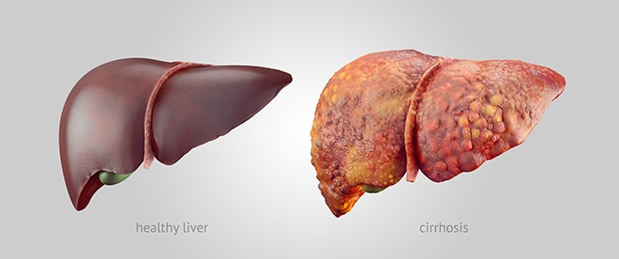
Hepatitis
Common Hazards
Detoxification
Organ Systems: Detoxification
Pre-Test
Introduction
Why It Matters
What We Know
How We Know
Story Time
Common Hazards
Activities
Self-Study Game
Post-Test
Glossary
Hepatitis is irritation (inflammation) of liver. (The word ending "itis" means inflammation). However, many causes of hepatitis go beyond inflammation and end in death of liver cells and eventual replacement with scar tissue (called "cirrhosis" of the liver).
Source: NIH NIDDK

Slide 36
Hepatitis Cont’d
Common Hazards
Detoxification
Organ Systems: Detoxification
Pre-Test
Introduction
Why It Matters
What We Know
How We Know
Story Time
Common Hazards
Activities
Self-Study Game
Post-Test
Glossary
Causes of hepatitis range from excessive drug or alcohol consumption to viruses. Hepatitis can even be caused by our own immune system. This occurs when a genetically defective immune system begins to attack liver cells after the immune system is activated, usually by a virus.
The breakdown of alcohol causes the release of many chemicals that are toxic to the liver. A buildup of these chemicals will cause hepatitis. After a long history of alcohol abuse, people will develop cirrhosis of the liver. See more on alcohol’s effects on the body here.

Slide 37
Hepatitis Cont’d
Common Hazards
Detoxification
Organ Systems: Detoxification
Pre-Test
Introduction
Why It Matters
What We Know
How We Know
Story Time
Common Hazards
Activities
Self-Study Game
Post-Test
Glossary
Certain viral infections can also cause hepatitis. There are six different hepatitis viruses:
  hepatitis A - vaccine available. Spread by feces of infected person (contaminated food or water)
  hepatitis B - vaccine available. Spread by blood (transfusions, contaminated needles, etc.) and bodily fluids (sex, shared toothbrushes) from infected person.
  hepatitis C - no vaccine available. Spread by blood and body fluids of infected person. The leading reason for liver transplants.
  hepatitis D - no vaccine available. Spread by blood and blood fluids from infected person. Only occurs in the presence of a hepatitis B infection.
  hepatitis E - no vaccine available. Spread by feces of infected person.
Knowing how these viruses are spread should help you know what you need to do to prevent infection.
Sometimes hepatitis goes away by itself. If it does not, it can be treated with drugs. Sometimes hepatitis lasts a lifetime. Vaccines can help prevent some viral forms. Another way of preventing hepatitis is to avoid abusing drugs or alcohol.
For more information see the Center for Disease Control and Prevention site.

Slide 38
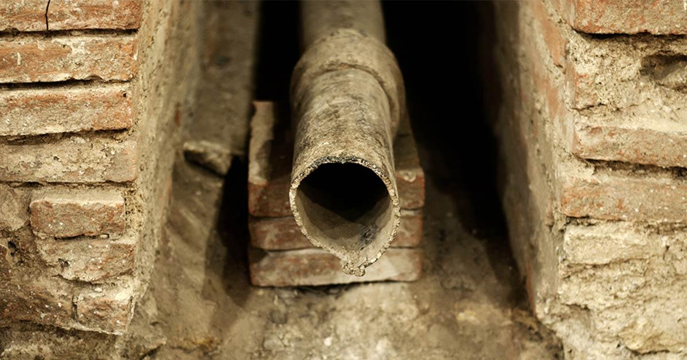
Heavy Metals
Common Hazards
Detoxification
Organ Systems: Detoxification
Pre-Test
Introduction
Why It Matters
What We Know
How We Know
Story Time
Common Hazards
Activities
Self-Study Game
Post-Test
Glossary
Four heavy metals (cadmium, mercury, lead and chromium) are all toxic to the kidneys. They also cause damage to other organs of the body, including the liver.
Plumbing pipes in old buildings can be made of lead. Source: U.S. National Library of Medicine

Slide 39
Heavy Metals: Lead
Common Hazards
Detoxification
Organ Systems: Detoxification
Pre-Test
Introduction
Why It Matters
What We Know
How We Know
Story Time
Common Hazards
Activities
Self-Study Game
Post-Test
Glossary
Lead is a naturally occurring element. It is found in the Earth’s crust in small amounts. It can be helpful to the body, but it can also be toxic to humans and animals.
Other sources of lead include old paint, old plumbing pipes, contaminated water, batteries, industrial processes, leaded gasoline, some cosmetics, and some toys and containers made of metal, imported from other countries.
You can be exposed to lead by ingestion (swallowing, like water), inhaling (breathing), or by skin contact (touching).
Lead is damaging to the kidneys and liver. Lead can also affect almost every organ and system in the body. It is most damaging to the central nervous system.
Children are the most susceptible to the effects of lead.
Women who are pregnant can pass lead to their unborn baby. This can cause the baby to be born too early or to small. It can also cause damage to the baby’s brain, kidneys, and nervous system.
Lead, even at low levels, causes behavior and learning problems, lower IQ, hyperactivity, slowed growth, hearing problems, and anemia in children. Exposure to lead can cause cancer. It can even cause seizures, coma and death!
For more information about lead, click here or here.

Slide 40
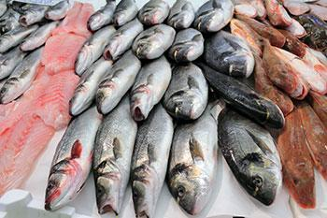
Heavy Metals: Mercury
Common Hazards
Detoxification
Organ Systems: Detoxification
Pre-Test
Introduction
Why It Matters
What We Know
How We Know
Story Time
Common Hazards
Activities
Self-Study Game
Post-Test
Glossary
Mercury occurs naturally in the earth’s crust. It is release into the environment in various ways. Human activity is currently the main cause of mercury release, especially in the coal industry.
All people are exposed to small amounts of mercury, however eating large quantities of contaminated fish or shellfish and exposure through inhaling of mercury by workers in industrial settings are the main ways of getting toxic levels of mercury.
The kidneys concentrate mercury.
Mercury reacts with other proteins and enzymes in the kidney cells and can eventually kill them.
Mercury is also a neurotoxin, or a substance that is poisonous to nerve tissue.
Mercury bioaccumulates in food chains. In other words, it is passed from one organism to the next. If a large fish eats many small fish that contain mercury, the mercury from all of those small fish stay in the large fish. If a human eats the large fish, the mercury accumulates in the human. As the human eats more and more large fish, he becomes more and more contaminated with mercury. Certain fish accumulate mercury more than others.
Consuming large quantities of fish increases a person’s exposure to mercury. Source: NIEHS
For more about mercury, click here or here.

Slide 41
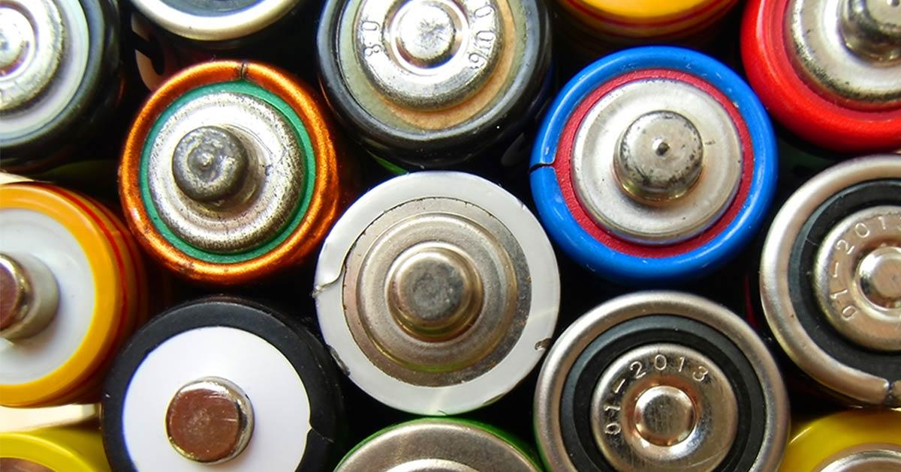
Heavy Metals: Cadmium
Common Hazards
Detoxification
Organ Systems: Detoxification
Pre-Test
Introduction
Why It Matters
What We Know
How We Know
Story Time
Common Hazards
Activities
Self-Study Game
Post-Test
Glossary
The process of manufacturing batteries uses cadmium Source: U.S. National Library of Medicine
Cadmium is a naturally occurring metal found in mineral deposits. Some natural areas have high levels of cadmium.
Cadmium is used in making batteries, metal coatings, solar cells, and some plastics.
Cadmium is absorbed into plant and animal sources, and people are exposed through their diet. Cigarette smoke also contains cadmium, so breathing that smoke exposes people to cadmium. Workers who work in industries like battery manufacturing or other workplaces that use cadmium can also be exposed.
Exposure to small amounts of cadmium over a long time may cause it to build up in the kidneys.
Cadmium damages kidney tubules (also causes anemia and bone and mineral loss).
Cadmium reacts with proteins and accumulates in the kidneys.
It substitutes for zinc in enzymes and changes enzyme action.
More about Cadmium

Slide 42

Heavy Metals: Chromium
Common Hazards
Detoxification
Organ Systems: Detoxification
Pre-Test
Introduction
Why It Matters
What We Know
How We Know
Story Time
Common Hazards
Activities
Self-Study Game
Post-Test
Glossary
Chromium is found naturally in rocks, plants, soil, and animals.
One type of chromium, chromium-3, is an essential diet requirement for humans and is found in vegetables, fruits, meats, grains, and yeast.
Chromium-6 is found in the environment but can also be produced by industrial processes. It is used in electroplating, stainless steel production, leather tanning, textile manufacturing, and wood preservation.
Chromium can be inhaled, ingested in food or water, or absorbed through the skin. If inhaled, it can cause lung cancer.
Chromium is reabsorbed by the tubule cells in the kidney and becomes very concentrated.
It interferes with energy exchange and can become a corrosive acid. This can cause renal (kidney) failure.
Chromium is produced by industrial processes. Source: NIEHS
More about Chromium

Slide 43

Free Radicals
Common Hazards
Detoxification
Organ Systems: Detoxification
Pre-Test
Introduction
Why It Matters
What We Know
How We Know
Story Time
Common Hazards
Activities
Self-Study Game
Post-Test
Glossary
Have you heard all the advertisements for Vitamin E, selenium, and Vitamin C as antioxidant substances needed to combat free radicals? Free radicals are substances produced either from normal cell processes in the body or from external sources (pollution, cigarette smoke, X-rays, ozone, industrial chemicals, medication). They have a dual role as both toxic and beneficial compounds, since they can be either harmful or helpful to the body. At low or moderate concentrations, they help some cellular processes and are even involved in the body’s defense against diseases. But at high or excessive levels, they can damage important cell parts like the cell membrane and even DNA. They are not specifically toxic to the kidney and liver, but they do cause other effects in the body. Sometimes, these radicals cause cancer and contribute to aging. Much research has been done on the effects of eating anti-oxidant rich foods and taking antioxidant supplements on slowing the aging process and even preventing cancer or other diseases. Currently, the research shows that consuming antioxidant rich foods might help to protect against diseases. However, rigorous trials of antioxidant supplements in large numbers of people have not found that high doses of these prevent diseases.
See these sites for more information:
  Antioxidants: In Depth
  Myth vs. Reality on Anti-Aging Vitamins
  Antioxidants
  Antioxidants and Cancer
Antioxidant rich foods

Slide 44
Detoxification
Organ Systems: Detoxification
Pre-Test
Introduction
Why It Matters
What We Know
How We Know
Story Time
Common Hazards
Activities
Self-Study Game
Post-Test
Glossary
Activities

Slide 45
Click to download an activity
Activities
Detoxification
Organ Systems: Detoxification
Pre-Test
Introduction
Why It Matters
What We Know
How We Know
Story Time
Common Hazards
Activities
Self-Study Game
Post-Test
Glossary
Student Activity Sheet #1- What’s the Right Dose?
Student Activity Sheet #3- Kidney Dissection

Slide 46
Detoxification
Organ Systems: Detoxification
Pre-Test
Introduction
Why It Matters
What We Know
How We Know
Story Time
Common Hazards
Activities
Self-Study Game
Post-Test
Glossary
Self-Study Game

Slide 47
Click to play a game
Self-Study Game
Detoxification
Organ Systems: Detoxification
Pre-Test
Introduction
Why It Matters
What We Know
How We Know
Story Time
Common Hazards
Activities
Self-Study Game
Post-Test
Glossary
Quizizz

Slide 48
Detoxification
Post-Test
Organ Systems: Detoxification
Pre-Test
Introduction
Why It Matters
What We Know
How We Know
Story Time
Common Hazards
Activities
Self-Study Game
Post-Test
Glossary
Click below to take the post-test for this unit!
  Google assessment

Slide 49
A-E
Detoxification
Glossary
Organ Systems: Detoxification
Pre-Test
Introduction
Why It Matters
What We Know
How We Know
Story Time
Common Hazards
Activities
Self-Study Game
Post-Test
Glossary
anesthetic - a chemical that makes you lose feeling and awareness. A general anesthetic is one that will cause you to lose consciousness. A local anesthetic will cause a loss of feeling in a particular area or part of the body. Return to Introduction
bacteria – single-celled microorganisms that can be free living or live in/on other organisms. Return to How We Know
cirrhosis - scarring of the liver that can lead to liver failure caused by diseases and conditions that damage the liver like hepatitis and chronic alcoholism. Return to Common Hazards
diabetes - a chronic condition of having abnormally high levels of sugar (glucose) in the blood. This disease is usually caused by a deficiency in insulin, a hormone that lowers the blood's glucose level. The excess glucose in the blood is excreted through urine. The body needs this glucose to make energy. For example, the brain only uses glucose to make energy. Without enough glucose, the brain will stop functioning. Return to How We Know
dialysis - a procedure in which a special machine, called a dialysis machine, filters out waste products from a person's blood. The filtering is based on the rates of diffusion for different substances in the blood as they pass through a permeable membrane. Return to How We Know
enzyme - a protein that speeds up chemical reactions in living organisms. Enzymes lower the energy necessary to turn a set of reactants into other products. Without enzymes, we could not exist. Return to What We Know | Return to How We Know

Slide 50
H-M
Detoxification
Glossary
Organ Systems: Detoxification
Pre-Test
Introduction
Why It Matters
What We Know
How We Know
Story Time
Common Hazards
Activities
Self-Study Game
Post-Test
Glossary
high density lipids - lipids that help transport cholesterol from the tissues to the liver for excretion into bile. Hence, they are considered to be a good kind of lipid. Return to How We Know
jaundice - a yellowing of the skin, usually showing up in the whites of the eyes, fingernails, and other lightly pigmented parts of the body surface. There are three main causes: 1) accumulation of a breakdown product (called bilirubin) of excessive destruction of red blood cells (bruises often have localized jaundice in the early stage of healing), 2) a failure of the liver to remove the normal amounts of bilirubin, or 3) failure of elimination of bilirubin via the bile that is normally made in the liver and dumped into the intestine as a waste product. Return to How We Know
ketones - a class of body chemicals in which part of the molecule contains a carbon-oxygen bond (C= O).These form from the breakdown of fats and proteins in the liver. They can accumulate to toxic levels if the blood sugar falls too low (as in certain diabetes situations, starvation, or eating a high fat-low carbohydrate diet). They are toxic because they make the body fluids too acid for enzymes to work properly. Return to How We Know
low density lipids - lipids that help transport cholesterol from the liver to the tissues. Hence, they are considered the "bad" kind of lipid. Return to How We Know
metabolism - a series of chemical reactions that build and destroy molecules necessary for life using what we eat and drink as fuel. Return to What We Know

Slide 51
N-W
Detoxification
Glossary
Organ Systems: Detoxification
Pre-Test
Introduction
Why It Matters
What We Know
How We Know
Story Time
Common Hazards
Activities
Self-Study Game
Post-Test
Glossary
nitrites - chemicals that contain a nitrogen and oxygen atom (NO) that are made from nitrates by microbes in the gut or soil. Nitrates provide the nitrogen content in fertilizer. Obviously, farm animals can be poisoned by eating fertilizer and even plants that have been over-fertilized. These are poisonous because they bind to hemoglobin and keep it from carrying oxygen in the blood. In large enough concentrations, nitrites and their reaction products can promote cancer. See https://agrilifeextension.tamu.edu/library/water/drinking-water-problems-nitrates/ for information on nitrites/nitrates in drinking water. Return to How We Know
phagocytosis - the process by which certain cells destroy toxins and other organic matter by wrapping their cell membrane around it and incorporating it into the phagocytic cell, where enzymes break down the chemicals and destroy them. Return to How We Know
renal - relating to or involving the kidneys. Return to How We Know
toxin - a poisonous agent produced by certain animals, plants, and bacteria. A toxin usually has a large molecular weight and is antigenic. Return to Introduction
volatile - quickly vaporizable (turns to gas) at low temperatures. Volatile chemicals are usually very reactive and dangerous. Return to What We Know
white blood cell - (one main type is called a. leukocyte) One of the cells in the immune system that helps fight invaders. The white blood cell count (WBC) increases when a foreign antigen, such as bacteria or virus, enters the body. A normal WBC is between 4,000 and 11,000 white blood cells per microliter. Return to How We Know

