Slide 1
Life Science Organ Systems Detoxification
Pre-Test

Slide 2
What organ system is responsible for filtering blood and regulating water, salts, and minerals in the body as well as removing toxins?
A. The excretory system
B. The digestive system
C. The lymphatic system
D. The circulatory system

Slide 3
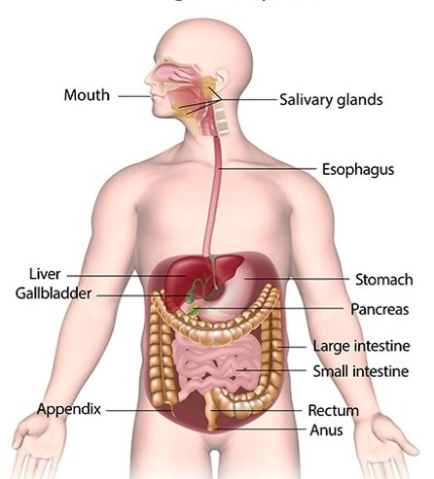
The following diagram illustrates what level of bodily organization?
A. Cell
B. Tissue
C. Organ
D. Organ system

Slide 4
Which of the following describes a defense mechanism the body has against toxins that are ingested (eaten)?
A. Coughing and sneezing
B. Eyes watering
C. Vomiting and diarrhea
D. Fever and chills

Slide 5
The presence of white blood cells called Kupffer cells in the liver that ingest unfiltered “sludge” left from blood flowing through the liver shows the interaction of what two organ systems?
A. The immune and digestive systems
B. The circulatory and endocrine systems
C. The reproductive and excretory systems
D. The lymphatic and nervous systems

Slide 6
There are six hepatitis viruses that can all damage and scar the liver, but not all have vaccinations and not all are spread by the same pathways. What conclusion can be drawn from this?
A. All microorganisms are the same and can be treated the same
B. Multiple microorganisms can cause similar diseases
C. All microorganisms cause the same diseases
D. No two microorganisms can cause the same disease

