Slide 1
Life Science Organ Systems Coordination & Control
Pre-Test

Slide 2
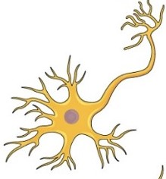
What is the structure below?
a. A nerve cell (neuron)
b. A nerve
c. A brain
d. A bug

Slide 3
2. What is the main function of the nervous system?
a. To transport nutrients and oxygen to cells, remove carbon dioxide and other waste products from the cells, and allow for efficient gas exchange
b. To bring oxygen to the bloodstream and remove carbon dioxide from the blood
c. To protect the body from damage and water loss
d. To facilitate communication between body systems via electrical impulses

Slide 4
3. The brain falls into what level of organization?
a. Organ system
b. Organ
c. Tissue
d. Cell

Slide 5
4. A neuron is an example of a ________
a. Cell
b. Tissue
c. Organ
d. Organ system

Slide 6
5. If you feel happy after doing well on a test, you are more likely to recreate behaviors that help you to perform better on exams. Why is this?
a. The brain tends to repeat lazy behavior
b. There is an outside force making you
c. Gaining a happy feeling acts as positive reinforcement for studious behaviors
d. Feeling happy acts as positive punishment for studying

