Slide 1
Life Science Organ Systems Coordination & Control
Post-Test

Slide 2
The smallest structural/functional unit of the nervous system is the ______
a. Brain
b. Neuron (nerve cell)
c. Nerve
d. Spinal cord

Slide 3
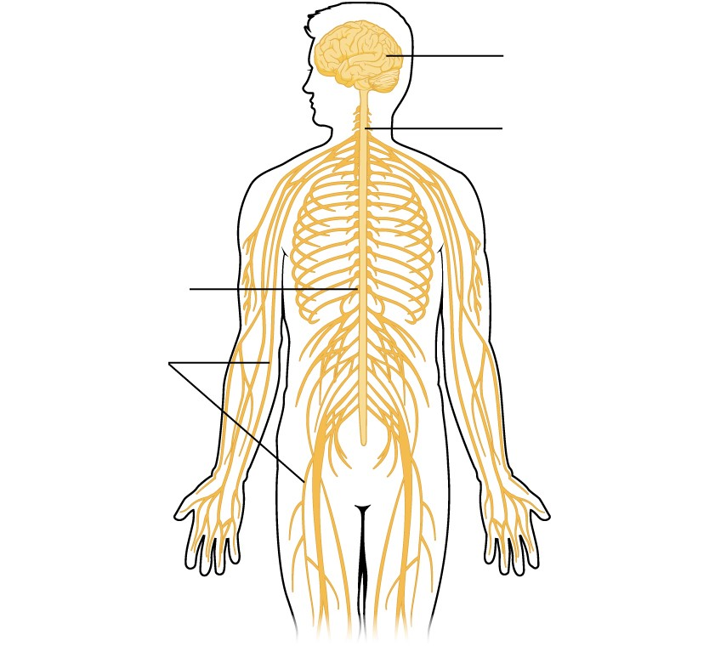
2. Below is a diagram of an organ system. What is the function of this system?
a. To break down food into usable nutrients
b. To bring oxygen to the bloodstream and remove carbon dioxide from the blood
c. To facilitate communication between the body systems via electrical impulses
d. To transport nutrients and oxygen to cells and remove carbon dioxide and other waste products from the cells via the bloodstream

Slide 4
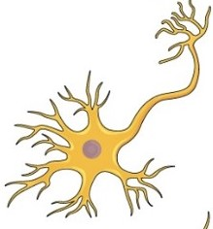
3. The following image represents a structure at what level of bodily organization?
a. Organism
b. Organ system
c. Tissue
d. Cell

Slide 5
4. An example of a tissue in the nervous system would be a ______
a. Brain
b. Neuron
c. Nerve
d. Spinal cord

Slide 6
5. When touching a hot stove, a person’s hand jerks back before even thinking about it. Why does this happen?
a. Muscle cells have the ability to sense heat and can react without nervous control
b. Peripheral nerves can act without input from the central nervous system
c. The brain directly tells the muscle to move in any situation
d. The nerve impulse travels to the spinal cord and back as a reflex before going to the brain for conscious recognition

