Slide 1
Organ Systems
Bodily Defenses

Slide 2
Options for navigation Table
Organ Systems: Bodily Defenses
Pre-Test
Introduction
Why It Matters
What We Know
How We Know
Story Time
Common Hazards
Activities
Self-Study Game
Post-Test
Glossary

Slide 3
Bodily Defenses
Pre-Test
Organ Systems: Bodily Defenses
Pre-Test
Introduction
Why It Matters
What We Know
How We Know
Story Time
Common Hazards
Activities
Self-Study Game
Post-Test
Glossary
Click a link below to take the pre-test for this unit!
Google assessment

Slide 4
Bodily Defenses
Organ Systems: Bodily Defenses
Pre-Test
Introduction
Why It Matters
What We Know
How We Know
Story Time
Common Hazards
Activities
Self-Study Game
Post-Test
Glossary
Introduction

Slide 5
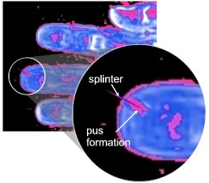
Introduction
Bodily Defenses
Organ Systems: Bodily Defenses
Pre-Test
Introduction
Why It Matters
What We Know
How We Know
Story Time
Common Hazards
Activities
Self-Study Game
Post-Test
Glossary
Ouch! You've got a splinter in your finger! Since you can't remove all of it, two days later a small pocket of pus forms around the splinter. Why?
What has happened here? The splinter has penetrated your body's first line of defense, the skin. You need the wound to heal. Meanwhile, your body needs to protect itself from the spread of infection from germs that were on the splinter. A second line of defense has to be mobilized.
Skin is your first line of defense against "foreign invaders." If there is a break in the skin, the second-line defenses of the immune system are activated.
This module will help you understand how your body reacts to such invasions and what you can do to help your bodily defenses.

Slide 6
Bodily Defenses
Objectives
Organ Systems: Bodily Defenses
Pre-Test
Introduction
Why It Matters
What We Know
How We Know
Story Time
Common Hazards
Activities
Self-Study Game
Post-Test
Glossary
After completing this lesson, each student should be able to:
Understand the structure and function of the immune system.
Explain how the skin (integumentary system) acts to provide protection to underlying tissues from infection and disease.
Describe what the lymphatic system is and what it does.
Explain the principles of vaccination and the different types of immunity that it can confer.
Summarize the hazardous nature of sunburn and of AIDS.

Slide 7
Bodily Defenses
Organ Systems: Bodily Defenses
Pre-Test
Introduction
Why It Matters
What We Know
How We Know
Story Time
Common Hazards
Activities
Self-Study Game
Post-Test
Glossary
Why It Matters

Slide 8
Why It Matters
Bodily Defenses
Organ Systems: Bodily Defenses
Pre-Test
Introduction
Why It Matters
What We Know
How We Know
Story Time
Common Hazards
Activities
Self-Study Game
Post-Test
Glossary
Our bodies are continually being attacked by bacteria and viruses. We must have defense mechanisms or otherwise we would be sick all the time.
Defense mechanisms fall into two categories:
Keep the germs out of the body (that is what skin does)
Fight the germs once they get inside the body (that is what the immune system does)

Slide 9
Vaccines & Diseases
Why It Matters
Bodily Defenses
Organ Systems: Bodily Defenses
Pre-Test
Introduction
Why It Matters
What We Know
How We Know
Story Time
Common Hazards
Activities
Self-Study Game
Post-Test
Glossary
In the 1950s in the U.S., a disease called polio was causing hundreds of thousands of children to be crippled for life, as their muscle cells were destroyed by the virus. Polio was one of the most feared diseases in the U.S. Some children had to live inside an "iron lung" that breathed for them because their chest muscles were dead and they were unable to breathe on their own. In 1955, the U.S. began widespread vaccinations. By 1979, polio virus had been completely eliminated across the country. Polio is now on the verge of being eliminated worldwide. (View more about polio).
Another major disease, smallpox, raged for hundreds of years in all parts of the world. An estimated 300 million people died from smallpox in the 20th century. The disease was so common and deadly that a worldwide campaign to eliminate it began when a vaccine was developed. The vaccine left a scar on the skin, but it was worth it to prevent smallpox. Because so many people around the world were vaccinated, the disease has apparently disappeared. No reports of smallpox have appeared since 1977, and in 1980 it was declared to be eradicated by the World Health Organization. (Access more information about the role of vaccination in eradicating smallpox).
Of course, we don't have vaccines that work against all diseases. Throughout this unit, we will learn how the body fights diseases both with and without the help of vaccines. We will introduce the structures and functions involved in bodily defenses that keep you safe and healthy.

Slide 10
Bodily Defenses
Organ Systems: Bodily Defenses
Pre-Test
Introduction
Why It Matters
What We Know
How We Know
Story Time
Common Hazards
Activities
Self-Study Game
Post-Test
Glossary
What We Know

Slide 11
What We Know
Bodily Defenses
Structure and Function of the Skin
Organ Systems: Bodily Defenses
Pre-Test
Introduction
Why It Matters
What We Know
How We Know
Story Time
Common Hazards
Activities
Self-Study Game
Post-Test
Glossary
The body must protect its cells from harm. To do harm, chemicals and other damaging substances have to get inside the body. The first line of defense is the skin, which is part of the integumentary system. Skin forms the body’s outer covering and forms a barrier to protect the body from chemicals, disease, UV light, and physical damage. It prevents many (but not all) harmful substances from entering the body.
The distinct properties of skin include:
creates a mechanical barrier
has several layers of cells, packed together
has an outer layer of dead and dying cells
has an inner layer of regenerating cells
contains nerve endings that register pain and modified neuronal cells that register cold, heat, and pressure
contains blood vessels, especially in the innermost parts

Slide 12
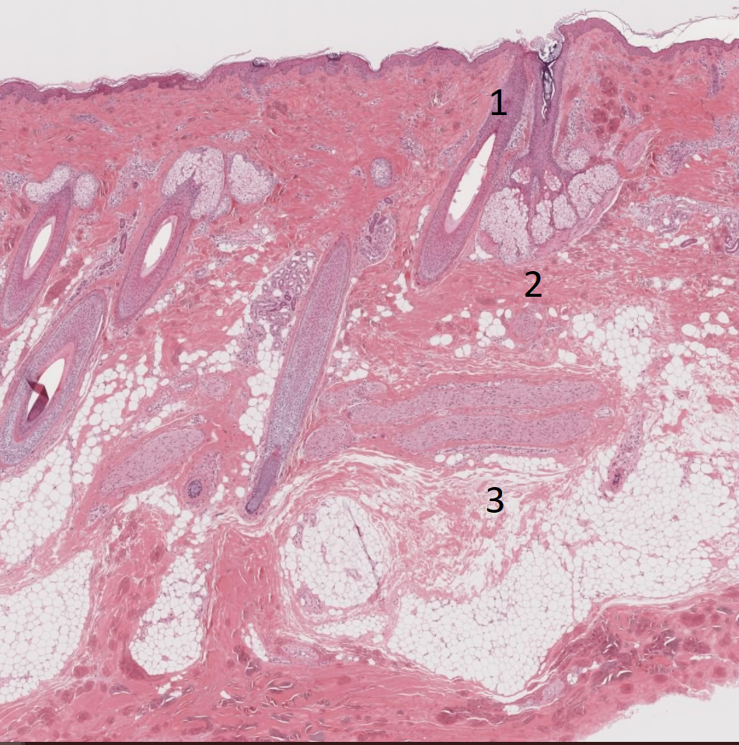
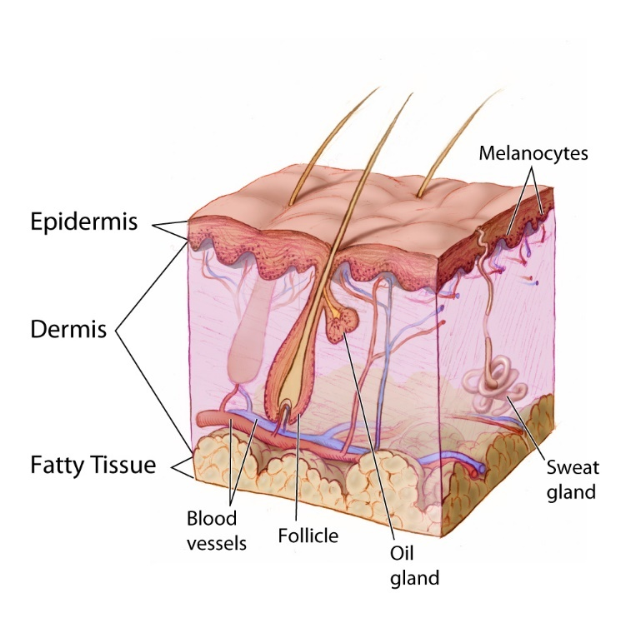
What We Know
Bodily Defenses
Structure and Function of the Skin Cont’d
Organ Systems: Bodily Defenses
Pre-Test
Introduction
Why It Matters
What We Know
How We Know
Story Time
Common Hazards
Activities
Self-Study Game
Post-Test
Glossary
1 = hair follicle
2 = oil gland
3 = connective tissue
Source: NIH
The outermost layer at the top of the picture is what we usually think of as skin. Its surface is made up of dead cells, whereas new ones are continually being made and moving toward the surface. In other words, you are continually "shedding your skin," but it happens so slowly that it is not obvious.
Skin consists mostly of an outer zone of flat, dead cells and inner layers of dividing and growing cells. Like overlapping shingles on a roof, these cells form an effective barrier to protect the cells of other tissues beneath the skin. The barrier also helps to keep the body from losing water.
Skin also has blood vessels in its deeper parts (to nourish the dividing and growing cells) and various nerve fibers to register outside temperatures, touch and pressure stimulation of skin, and special types of nerve fibers that make you feel pain when you are injured.

Slide 13
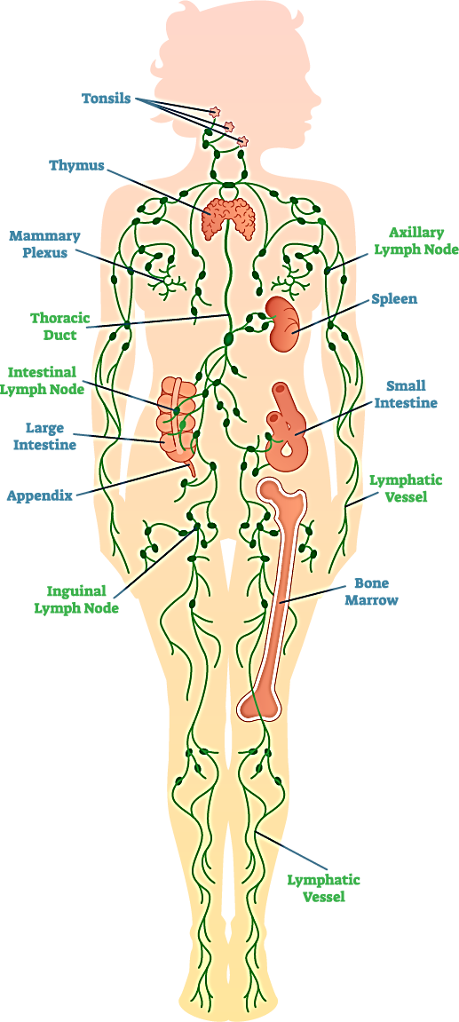
What We Know
Bodily Defenses
Immune & Lymphatic Systems
Organ Systems: Bodily Defenses
Pre-Test
Introduction
Why It Matters
What We Know
How We Know
Story Time
Common Hazards
Activities
Self-Study Game
Post-Test
Glossary
Remember the example of the splinter from the introduction? The body considers a splinter (and the bacteria on it) as a foreign invader. When such invaders are detected, two body systems, the immune and lymphatic systems, are called into action. Specific defense cells are mobilized and travel through the blood and lymph vessels to seek out the invader and fight it. These cells are called white blood cells because they are, in fact, white cells in the blood. One type of white cell is the lymphocyte, which develop in many lymph nodes scattered throughout the body. Lymph nodes are connected together by way of their own system of vessels, which eventually drain into veins near the heart. Altogether, we refer to that as the lymphatic system.
Lymph nodes are located throughout your body. They drain lymph fluid from nearby organs or areas of your body.
Source: CDC

Slide 14
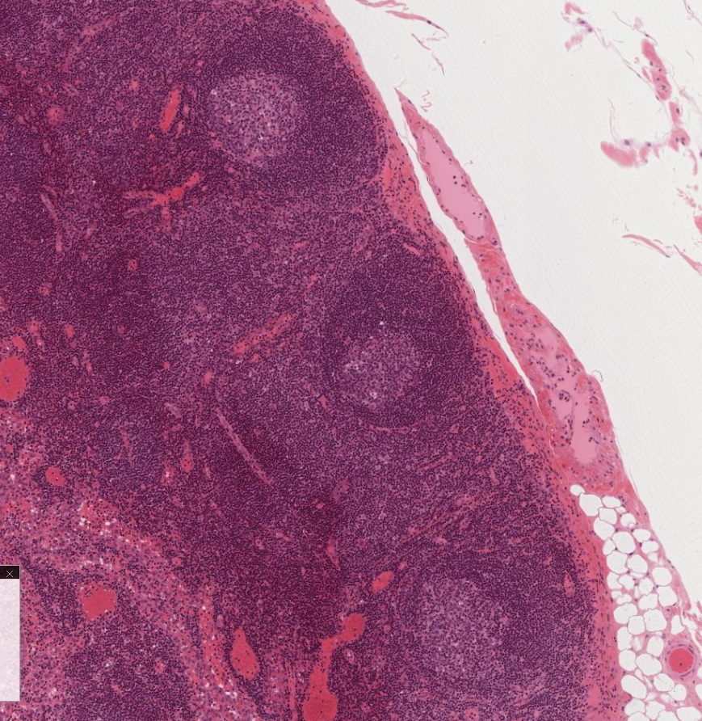
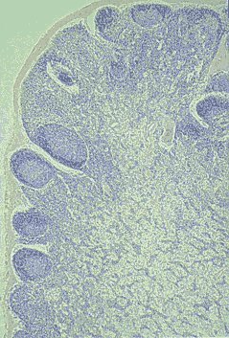
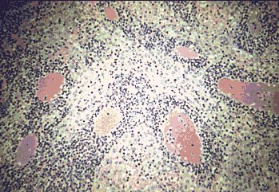
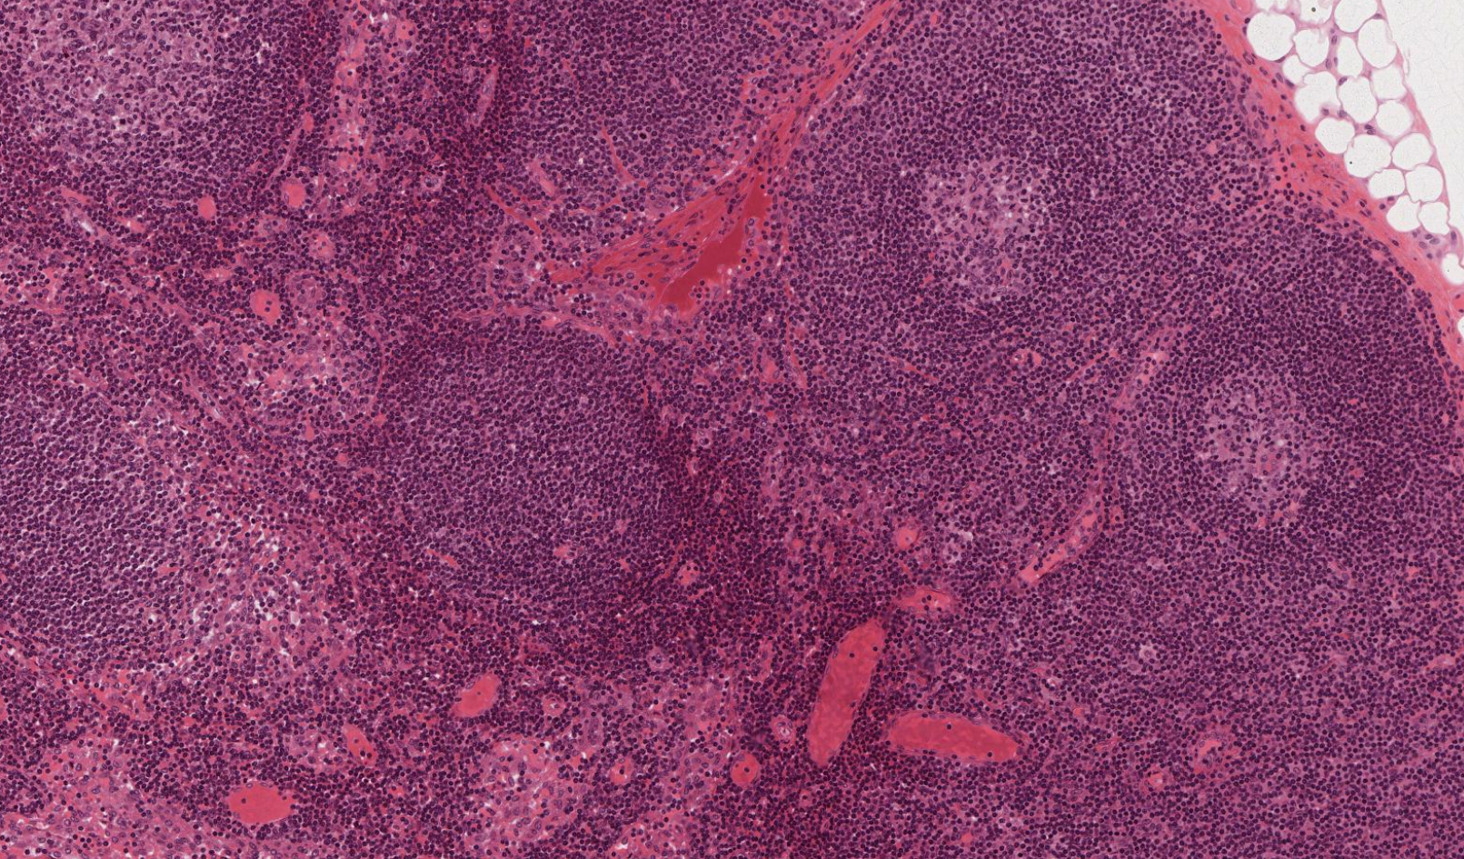
What We Know
Bodily Defenses
Immune & Lymphatic Systems Cont’d
Organ Systems: Bodily Defenses
Pre-Test
Introduction
Why It Matters
What We Know
How We Know
Story Time
Common Hazards
Activities
Self-Study Game
Post-Test
Glossary
The photos on the left show magnified views of slices of lymph node. The circular zones contain lymphocytes that have been stored by the lymph node.
The photos on the right show an even higher magnification of a lymph node. The black dots are tiny white blood cells, lymphocytes, and the clear areas are the blood and lymph vessels that will carry the lymphocytes to other parts of the body.

Slide 15
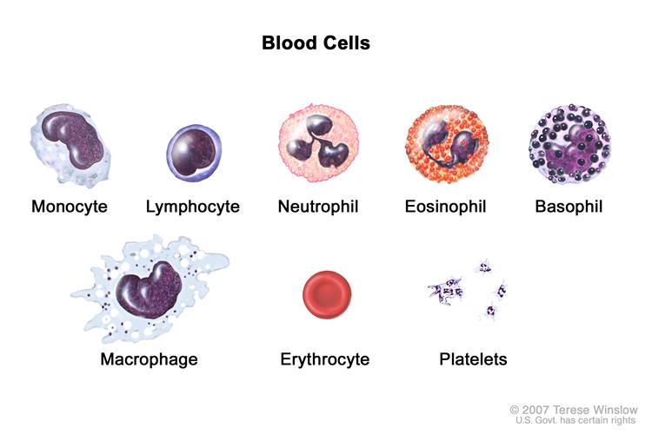
What We Know
Bodily Defenses
White Blood Cells
Organ Systems: Bodily Defenses
Pre-Test
Introduction
Why It Matters
What We Know
How We Know
Story Time
Common Hazards
Activities
Self-Study Game
Post-Test
Glossary
While talking about the lymph node, we mentioned a type of white blood cell called a lymphocyte. There are actually several kinds of white blood cells and they each have unique structures and functions.
Types of White Blood Cells
Modified from: https://www.cancer.gov/images/cdr/live/CDR503952-750.jpg

Slide 16
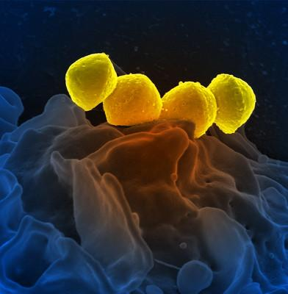
What We Know
Bodily Defenses
White Blood Cells: Neutrophils
Organ Systems: Bodily Defenses
Pre-Test
Introduction
Why It Matters
What We Know
How We Know
Story Time
Common Hazards
Activities
Self-Study Game
Post-Test
Glossary
There are five types of white blood cells, but only two are of importance in this discussion. One type is the neutrophil, which accounts for about 60% of all white cells. During infections, these cells divide and are dumped into the blood stream and lymph fluids to combat the infection. They fight invaders by "eating" bacteria and other foreign matter. The neutrophil membrane wraps around the invader and traps it inside the neutrophil. Once inside, digestive enzymes in the neutrophil destroy the invader. This process is called phagocytosis.
Yellow Streptococcus bacteria attached to a human neutrophil. This is one of the bacteria that cause “Strep throat.” Credit: National Institute of Allergy and Infectious Diseases, National Institutes of Health

Slide 17
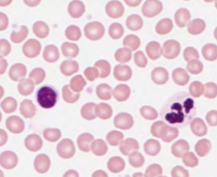
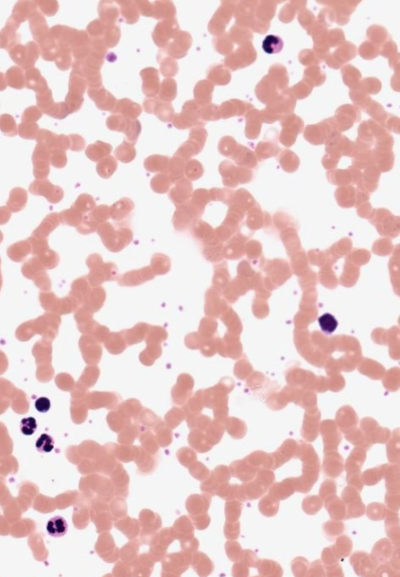
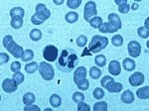
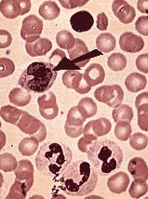
What We Know
Bodily Defenses
White Blood Cells: Neutrophils
Organ Systems: Bodily Defenses
Pre-Test
Introduction
Why It Matters
What We Know
How We Know
Story Time
Common Hazards
Activities
Self-Study Game
Post-Test
Glossary
The cell nucleus in new, young neutrophils tends to break into pieces as they age. Thus, by counting the percentage of neutrophils that have a single, intact nucleus, a doctor can know that the body is responding as expected to an infection.
monocyte
On the right, two white blood cells surrounded by red blood cells. The one indicated by the arrow is a mature neutrophil. The one just to the left is a lymphocyte.
On the left, three mature neutrophils at the bottom, a lymphocyte near the top, and a monocyte (arrow). The monocyte matures into a large macrophage cell.
lymphocytes
neutrophils
monocyte

Slide 18
What We Know
Bodily Defenses
White Blood Cells: Lymphocytes
Organ Systems: Bodily Defenses
Pre-Test
Introduction
Why It Matters
What We Know
How We Know
Story Time
Common Hazards
Activities
Self-Study Game
Post-Test
Glossary
The other important type of white cell is the lymphocyte, which comes in two forms, a T-type and a B-type.
One of the T-type lymphocytes is called a Killer T-cell. Killer T-cells either kill foreign cells on contact or help by releasing chemicals called cytotoxins (“cyto”- cell, “toxin”- poison) that assist in killing invaders. Cytotoxins are the chemical weapons that Killer T-cells use to destroy infected cells. Viruses are harmful invaders that take over healthy cells and direct them to make many more viruses. When those new viruses get out of the cell, they can infect even more healthy cells. By killing infected cells before these viruses get out, cytotoxins protect healthy cells.

Slide 19
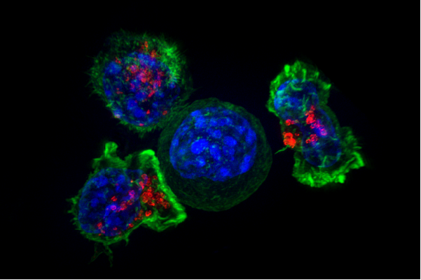
What We Know
Bodily Defenses
White Blood Cells: Lymphocytes Cont’d
Organ Systems: Bodily Defenses
Pre-Test
Introduction
Why It Matters
What We Know
How We Know
Story Time
Common Hazards
Activities
Self-Study Game
Post-Test
Glossary
Different kinds of cytotoxins work in different ways. Some cytotoxins make holes in the cell membrane, so the inside of the cell is not protected from the outside. Without a full membrane, the cell dies. Cell death because of this kind of break in the cell membrane is called lysis. Killer T-cells recognize the surface proteins on other cells, and when they come in contact with an infected cell, it is killed.
These Killer T-cell lymphocytes are made in a gland at the base of the neck, called the thymus. This gland is very large in young people but almost disappears in old age. Production of T-cells can be reactivated at any time if a foreign antigen is presented. T-cells also play a role in the rejection of transplanted tissue and in fighting cancer. For a fun way to learn the immune system, click here for a comic book version!
But how do the lymphocytes even know that there is an invader that they need to fight? Let’s find out!
Image of a group of T-cells surrounding a cancer cell. Source: NIH Image Gallery

Slide 20
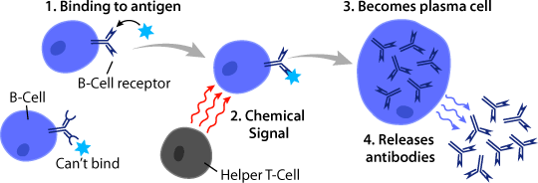
What We Know
Bodily Defenses
White Blood Cells: Lymphocytes
Organ Systems: Bodily Defenses
Pre-Test
Introduction
Why It Matters
What We Know
How We Know
Story Time
Common Hazards
Activities
Self-Study Game
Post-Test
Glossary
B-type lymphocytes make circulating antibodies. The B-type is made in bone marrow and matures in the lymph nodes. When a B-cell is activated by binding to an antigen or by signals from other immune cells, it becomes activated and proliferates (multiplies) and differentiates (specializes). B-cells can turn into memory B-cells which stay in the body long-term and recognize and quickly respond to repeat infections. They can also turn into plasma cells which secrete proteins called antibodies that travel through blood and tissue and bind to and inactivate antigens.
Diagram of B-cell activation and differentiation into a plasma cell.
Source: © Arizona Board of Regents / ASU Ask A Biologist.

Slide 21
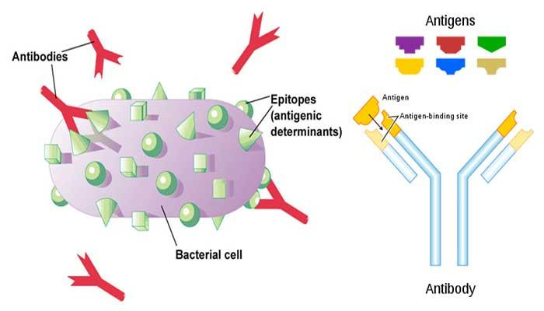
What We Know
Bodily Defenses
What is an Antibody?
Organ Systems: Bodily Defenses
Pre-Test
Introduction
Why It Matters
What We Know
How We Know
Story Time
Common Hazards
Activities
Self-Study Game
Post-Test
Glossary
An antibody is a Y-shaped protein. It contains two light chains of amino acids and two heavy chains (there is more about this in the Cells Are Us module).
In theory, there could be some 10³⁰ antibodies, one for each of the multitude of potential antigens that our bodies might be exposed to. But if we only have about 30,000 genes, how could our body make so many antibodies? The answer is that most of every antibody is the same, with only the extremities of the molecule being variable. And, genes on three chromosomes work together in various ways to make an antibody. The "one gene-one protein" idea does not apply to antibodies.

Slide 22
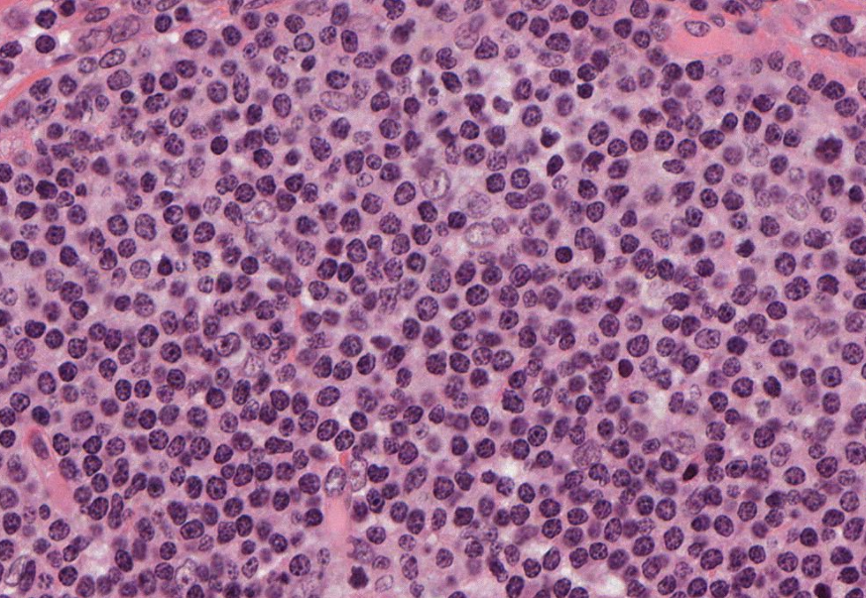
What We Know
Bodily Defenses
What is an Antibody? Cont’d
Organ Systems: Bodily Defenses
Pre-Test
Introduction
Why It Matters
What We Know
How We Know
Story Time
Common Hazards
Activities
Self-Study Game
Post-Test
Glossary
Circulating antibodies are actually manufactured and released by a so-called "B-cell" white blood cell. These cells are made in the bone marrow and migrate out into blood and lymph (a filtrate of blood that has its own circulatory system, moving through lymph nodes). The antibodies released by B-cells find circulating proteins from bacteria, fungi, or viruses and inactivate them.
Once antibodies are triggered, it is time for the white blood cells to move in.

Slide 23
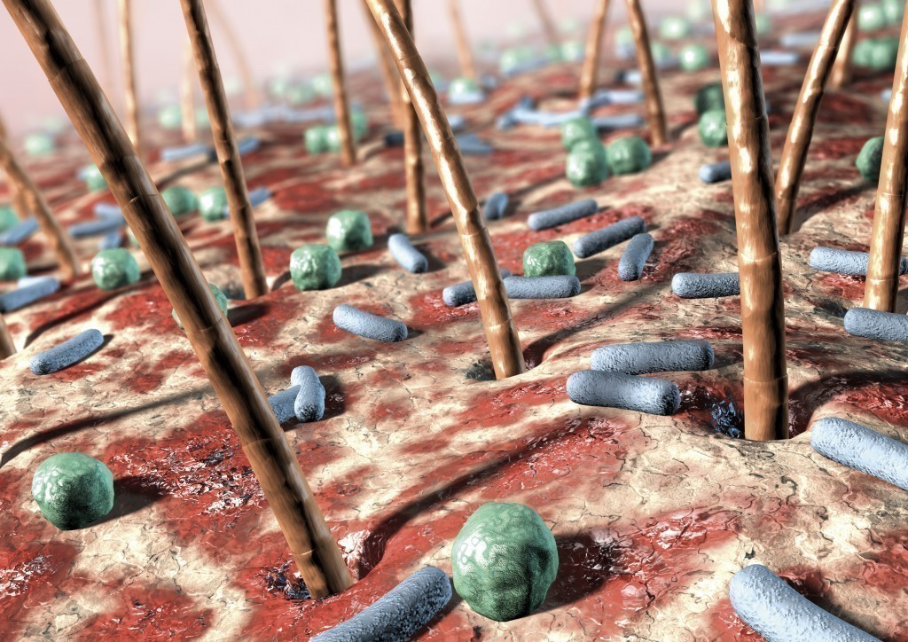
What We Know
Bodily Defenses
Invaders!
Organ Systems: Bodily Defenses
Pre-Test
Introduction
Why It Matters
What We Know
How We Know
Story Time
Common Hazards
Activities
Self-Study Game
Post-Test
Glossary
When there is an invader in the body, like the bacteria on the splinter, the first challenge for the immune system is to know that the skin's first line of defense has been penetrated so the white blood cells can be sent to the location. So how does the immune system know that an invasion has occurred and that invaders have penetrated the skin?
Computer Artwork of bacteria (blue and green) on human skin. How does the body know if bacteria make it past the barrier of the skin? Photo courtesy of https://microbiologyonline.org/

Slide 24
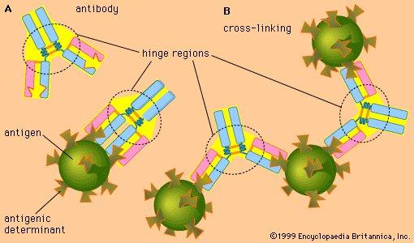
What We Know
Bodily Defenses
Invaders! Cont’d
Organ Systems: Bodily Defenses
Pre-Test
Introduction
Why It Matters
What We Know
How We Know
Story Time
Common Hazards
Activities
Self-Study Game
Post-Test
Glossary
The answer is that certain cells of the immune system recognize that molecules on the surface of the bacteria and other foreign bodies are not native to the body. These substances that cause an immune response are called antigens. Cells of your body have proteins, as well as carbohydrates and lipids (fats), on their surface that the immune system recognizes and leaves alone. But substances that are not recognized stimulate the immune system to make antibodies, which are proteins that attach to the foreign bodies and make them inactive. Many antibodies circulate in the blood, while others are anchored in cells. The free-circulating antibodies can be transferred from one individual to another by blood transfusions or from mother to newborn via the milk for the first day or two after birth. The antibodies attached to cells can only be transferred by transferring the entire cell, which is makes them less transferable since the recipient's own immune system would attack the "foreign" cells.
Image from Encyclopedia Britannica

Slide 25
What We Know
Bodily Defenses
Fighting the Invaders!
Organ Systems: Bodily Defenses
Pre-Test
Introduction
Why It Matters
What We Know
How We Know
Story Time
Common Hazards
Activities
Self-Study Game
Post-Test
Glossary
Now that the body knows that there is an invader, the immune system has two approaches to attacking that invader:
1. Ingestion by certain migrating blood cells, such as macrophages and a type of white cell known as neutrophils.
These cells are like an amoeba. They move around the body and actually "eat" germs. Once inside the white cell, enzymes break down and destroy the invader. Cancer cells, which the immune system recognizes as foreign, are also combated in this way. For information on how the body’s immune system can be used to treat cancer, click here.
Source: https://www.cancer.gov/images/cdr/live/CDR503952-750.jpg

Slide 26
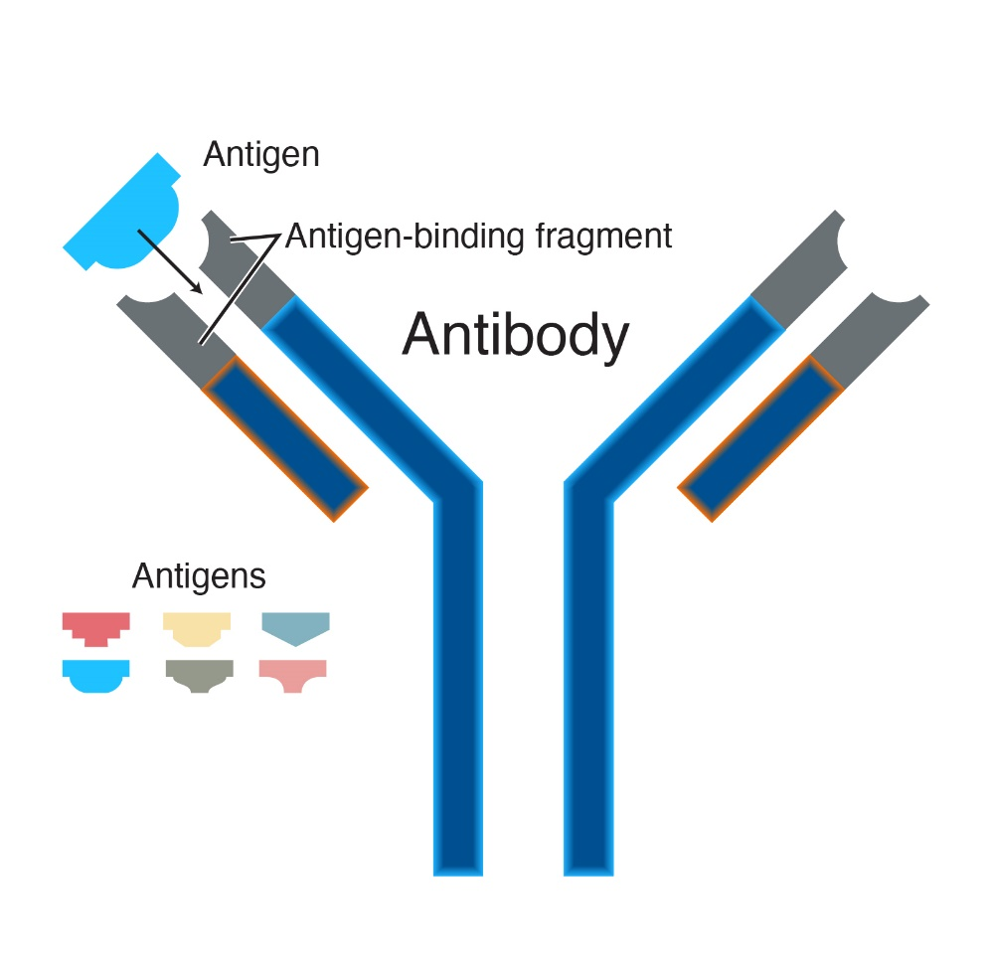
What We Know
Bodily Defenses
Fighting the Invaders! Cont’d
Organ Systems: Bodily Defenses
Pre-Test
Introduction
Why It Matters
What We Know
How We Know
Story Time
Common Hazards
Activities
Self-Study Game
Post-Test
Glossary
2. Binding and inactivation by protective molecules, called antibodies.
These either circulate in blood and lymph vessels or are attached to membranes of cell surfaces, as described previously. When they bind to foreign molecules, they make it easier for the invaders to be broken down. In the case of viruses, the binding can also stop the division of the virus.
An antibody is a protein component of the immune system that circulates in the blood, recognizes foreign substances like bacteria and viruses, and neutralizes them. After exposure to a foreign substance, called an antigen, antibodies continue to circulate in the blood, providing protection against future exposures to that antigen.
Source: https://www.genome.gov/genetics-glossary/Antibody

Slide 27
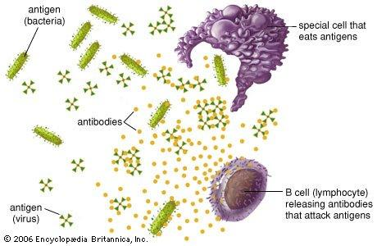
What We Know
Bodily Defenses
There are Two Types of Immunity
Organ Systems: Bodily Defenses
Pre-Test
Introduction
Why It Matters
What We Know
How We Know
Story Time
Common Hazards
Activities
Self-Study Game
Post-Test
Glossary
1. Innate Immunity
Innate immunity is the immunity that an organism is born with. It is mediated (carried out) by the innate immune system. The innate immune system is made up of certain physical barriers, such as skin and mucous membranes, and fast-acting immune cells, such as neutrophils, macrophages, eosinophils, basophils, monocytes, and natural killer cells. The innate immune system responds quickly and nonspecifically. In other words, it always reacts in the same manner no matter what kind of invader it is fighting off. Consequently, it is not always the most efficient way to get rid of a foreign body. There are differences in immunity among species.
Image from Encyclopedia Britannica

Slide 28
What We Know
Bodily Defenses
There are two types of Immunity
Organ Systems: Bodily Defenses
Pre-Test
Introduction
Why It Matters
What We Know
How We Know
Story Time
Common Hazards
Activities
Self-Study Game
Post-Test
Glossary
2. Acquired/Adaptive Immunity
Acquired immunity is carried out by the adaptive immune system. It is “acquired” because it requires exposure to an antigen at some level before it develops, and it is called the “adaptive” immune system because the cells and proteins it produces can change and adapt to fight a given invader more effectively. Acquired immunity is slower but much more specific than innate immunity (mentioned previously). This specificity allows the acquired immunity to be more efficient at fighting off the exact antigen that is infecting the body. The adaptive immune system involves white blood cells called lymphocytes and proteins called antibodies. There are two ways to acquire immunity:

Slide 29
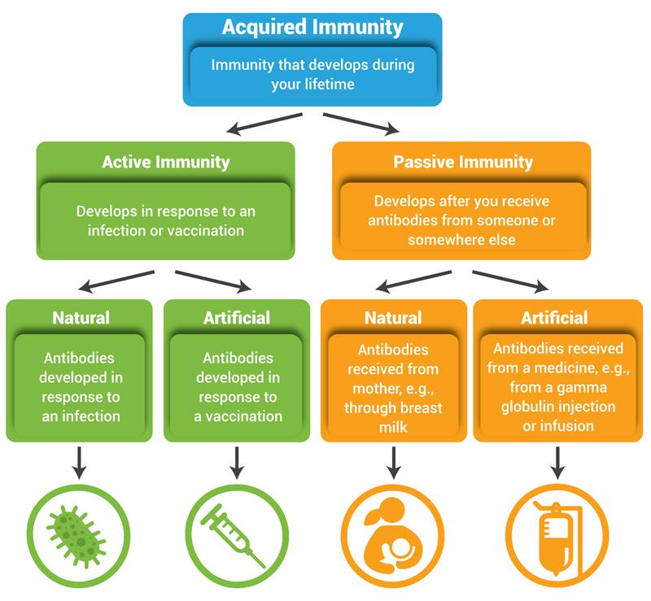
What We Know
Bodily Defenses
There are two types of Immunity
Organ Systems: Bodily Defenses
Pre-Test
Introduction
Why It Matters
What We Know
How We Know
Story Time
Common Hazards
Activities
Self-Study Game
Post-Test
Glossary
1. Active immunity develops after exposure to a disease-causing infectious microorganism or other foreign substance, such as following infection or vaccination. The active response takes several days to build up, but the protection may last several years or more.
2. Passive immunity develops after an organism receives immune system components, most commonly antibodies, from another organism. Passive immunity can occur naturally, such as when an infant receives a mother's antibodies through the placenta or breast milk, or artificially, such as when an organism receives antibodies in the form of an injection (gamma globulin injection). Passive immunity provides immediate protection against an antigen, but does not provide long-lasting protection.
Source: https://aidsinfo.nih.gov/understanding-hiv-aids/glossary/2/acquired-immunity

Slide 30
What We Know
Bodily Defenses
There are two types of Immunity
Organ Systems: Bodily Defenses
Pre-Test
Introduction
Why It Matters
What We Know
How We Know
Story Time
Common Hazards
Activities
Self-Study Game
Post-Test
Glossary
"Sneaky Pete" Organisms: some microbes hide from the body's defense system by inserting themselves into the cells. The parasite that causes malaria is a good example; it hides inside red blood cells.
Let’s look at how we learned all of this about the immune system.

Slide 31
Bodily Defenses
Organ Systems: Bodily Defenses
Pre-Test
Introduction
Why It Matters
What We Know
How We Know
Story Time
Common Hazards
Activities
Self-Study Game
Post-Test
Glossary
How We Know

Slide 32
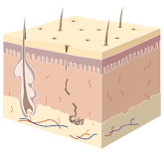
The First Line of Defense: Skin
How We Know
Bodily Defenses
Organ Systems: Bodily Defenses
Pre-Test
Introduction
Why It Matters
What We Know
How We Know
Story Time
Common Hazards
Activities
Self-Study Game
Post-Test
Glossary
Careful observation is one way to learn about the skin. Look at your own skin. Describe it. How many words can you come up with to describe the surface of your skin?
Diagram of skin section

Slide 33
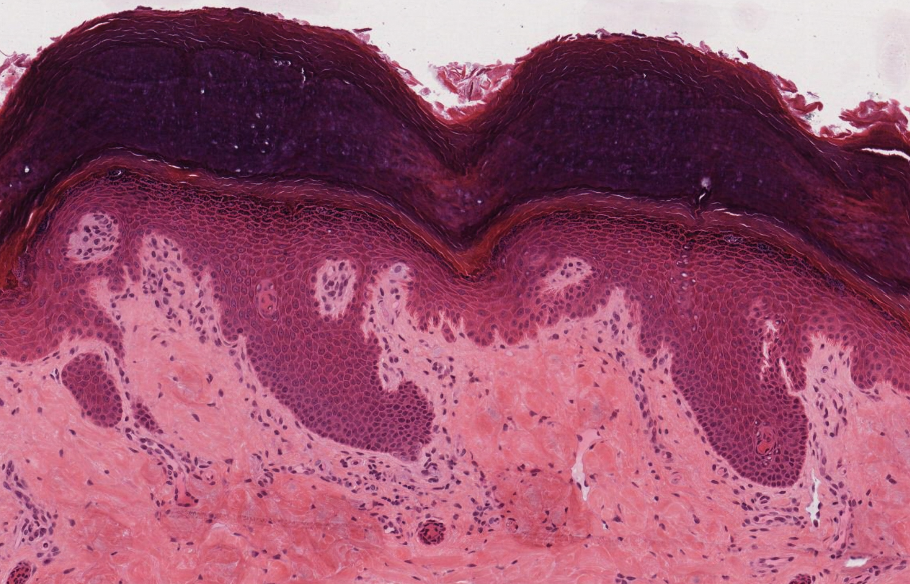
The First Line of Defense: Skin Cont’d
How We Know
Bodily Defenses
Organ Systems: Bodily Defenses
Pre-Test
Introduction
Why It Matters
What We Know
How We Know
Story Time
Common Hazards
Activities
Self-Study Game
Post-Test
Glossary
Observing and Studying Skin
You can't really see how skin acts as a barrier by only superficial observation. To look closer, we need to examine skin under a microscope. To do this, a piece of skin is needed and a series of steps that make the cells visible under a microscope need to be completed. The steps to examine skin under a microscope are:
The skin sample is sliced very thin, so that the sample is translucent (light can be seen through it).
The skin sample is placed on a microscope slide.
The skin is stained with a dye so that cell parts become visible.
Once these steps are completed, skin cells will be visible, as shown in the photo on the right. A slide of skin cells can also be made by gently scraping the inside of your cheek with a toothpick and rubbing the toothpick on a slide. The skin cells will have to be stained to be visible.

Slide 34
The First Line of Defense: Skin Cont’d
How We Know
Bodily Defenses
Organ Systems: Bodily Defenses
Pre-Test
Introduction
Why It Matters
What We Know
How We Know
Story Time
Common Hazards
Activities
Self-Study Game
Post-Test
Glossary
To learn about the chemical properties of skin, various substances can be placed on the outer surface of the skin and observations can be made. Some substances just stay on the surface, while other substances disappear (absorb) into the skin. Can you think of some substances that are absorbed into the skin? What are some other conditions or situations that can impact your skin?
What happens when infection gets beneath the skin and breaks through the first line of defense? Your body relies on its second line of defense - the immune system.

Slide 35
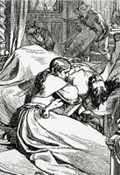
The Second Line of Defense: The Immune System
How We Know
Bodily Defenses
Organ Systems: Bodily Defenses
Pre-Test
Introduction
Why It Matters
What We Know
How We Know
Story Time
Common Hazards
Activities
Self-Study Game
Post-Test
Glossary
Before the immune system was discovered, how do you suppose scientists knew to even look for such a system?
History provides many examples of disease outbreaks that affected some people but not others. Even in the days before we knew about infection, during the black plague of the Middle Ages, for example, thousands of people died, but many others got sick and did not die. This was explained through superstitious myths about good spirits and bad spirits.
When the age of science dawned, it was only natural to want to investigate why some people did not catch certain diseases. How did scientists go about answering this question?
One clue emerged when scientists saw that boils or pustules would develop in the skin as a response to localized injuries, such as splinters in the skin. It was as if something about the injury triggered the formation of pus.
Ever have zits? The next page shows how zits can tell us about the immune system.

Slide 36
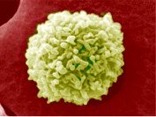
Oh No, Zits!
How We Know
Bodily Defenses
Organ Systems: Bodily Defenses
Pre-Test
Introduction
Why It Matters
What We Know
How We Know
Story Time
Common Hazards
Activities
Self-Study Game
Post-Test
Glossary
Many teenagers have a frustrating time dealing with the little bumps on their face called "pimples". Instead of focusing on how to treat them, let's discuss why the small pustules (zits) typically appear as white bumps.
Why are they white? It is because of the white blood cells (see the photo of a white blood cell on the right). If you smeared the pustule on a glass slide, stained the slide, and looked at it under a microscope you would actually be able to see the white blood cells! The white blood cells are attracted to bacteria under your skin. Why?
Remember the description of a splinter from the introduction to the unit? The splinter and the bacteria on it crossed the first line of defense, the skin. The second line of defense is the white blood cells. White blood cells are attracted to wounds or areas where bacteria has injured the skin. The white blood cells become concentrated in an area, as they block bacteria from entering surrounding tissues. Your first and second lines of defense, the skin and immune system, work together to keep your body healthy and free from infection.

Slide 37
Oh No, Zits! Cont’d
How We Know
Bodily Defenses
Organ Systems: Bodily Defenses
Pre-Test
Introduction
Why It Matters
What We Know
How We Know
Story Time
Common Hazards
Activities
Self-Study Game
Post-Test
Glossary
Why do white cells gather at the site of injury? There must be some kind of signal to attract them to leave the blood and to gather at the injury site. Likewise, it seems natural to suspect that the white blood cells have something in them that neutralizes or destroys bacteria. How can we learn about the ways in which white blood cells protect us from infection?

Slide 38
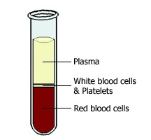
Studying White Blood Cells
How We Know
Bodily Defenses
Organ Systems: Bodily Defenses
Pre-Test
Introduction
Why It Matters
What We Know
How We Know
Story Time
Common Hazards
Activities
Self-Study Game
Post-Test
Glossary
When you have a pustule under the skin the white blood cells had to get there either locally or be carried in from somewhere else. Where is the first place you would consider? The blood, of course!
Next, you would need to see if white cells are in the blood stream. But how could you do that? Just for a moment, think about what happens if you are in a car and the driver turns the corner quickly. You get thrown in a direction opposite to the turn of the car.
This is the principle behind the "centrifuge," a device that spins biological samples in a horizontal plane at high speeds (see the photo on the right). If you have tubes of fluid that contain large heavy particles or cells, and spin the tubes really fast, the heavier material will get thrown to the end of the tube. The cells, both white and red, spin down to one end. Pour off the liquid, and the cells from the blood are left. In fact, white cells are lighter than red cells, so they spin down in a separate layer on top of the red cells. This makes finding the white blood cells easier.
Source: Dean L. Bethesda (MD): National Center for Biotechnology Information (US); 2005.
Retrieved from: https://www.ncbi.nlm.nih.gov/books/NBK2263/

Slide 39
Culturing White Cells
How We Know
Bodily Defenses
Organ Systems: Bodily Defenses
Pre-Test
Introduction
Why It Matters
What We Know
How We Know
Story Time
Common Hazards
Activities
Self-Study Game
Post-Test
Glossary
If you want to study a cluster of white blood cells to examine what they do, you can collect them from blood or flush body cavities. But it is also possible to culture them. (Learn more details about cell cultures.)
If you put bacteria in a culture of white blood cells and look at the cells under a microscope, you will see that one type of white cell actually "eats" the bacteria. This is accomplished by the membrane folding over the bacterium to seal off the bacterium and pull it into the cell. Once inside the white blood cell, the bacterium is digested and destroyed by enzymes in the white cells.

Slide 40
Outside Help for Bodily Defenses
How We Know
Bodily Defenses
Organ Systems: Bodily Defenses
Pre-Test
Introduction
Why It Matters
What We Know
How We Know
Story Time
Common Hazards
Activities
Self-Study Game
Post-Test
Glossary
So what happens when your white blood cells cannot fight an infection? Then it is time to help your immune system with medicines and antibiotics. Sometimes the immune systems can be boosted through vaccines! How do vaccines work?

Slide 41
Behind the Scenes with Vaccines
How We Know
Bodily Defenses
Organ Systems: Bodily Defenses
Pre-Test
Introduction
Why It Matters
What We Know
How We Know
Story Time
Common Hazards
Activities
Self-Study Game
Post-Test
Glossary
Vaccines are medications that are usually injected to help prevent you from getting certain diseases. Remember "getting your shots?" Perhaps you got shots for whooping cough or diphtheria. Some vaccines contain proteins (called antibodies) that give immediate protection. But most vaccines are designed to stimulate the body to develop its own antibodies, and that can take up to a few weeks to happen.
Vaccines for certain diseases actually contain the infectious agent, but it is weakened by culturing it in some other system, such as eggs or tissue culture. The goal in vaccine manufacturing is to make the infectious organism weak enough so that it won't cause the disease but strong enough so that it will activate the body's immune system.

Slide 42
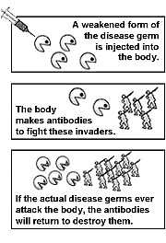
Behind the Scenes with Vaccines Cont’d
How We Know
Bodily Defenses
Organ Systems: Bodily Defenses
Pre-Test
Introduction
Why It Matters
What We Know
How We Know
Story Time
Common Hazards
Activities
Self-Study Game
Post-Test
Glossary
Once the immune system is activated by the disease agent, proteins called antibodies are generated to fight the disease. The antibodies are "programmed" specifically to fight that particular infectious agent. The original antibodies that are generated in response to a vaccination eventually go away, but the immune system has a "memory" and can make new ones later on if challenged by the same disease agent.
Booster shots can be used to trigger an even bigger response than only one vaccination would provide. Many vaccinations have to be repeated every year or so, although for some diseases you can be protected for a lifetime by a single injection.
Source: https://www.cdc.gov/vaccines/vac-gen/howvpd.htm

Slide 43
Diseases of the Immune System
How We Know
Bodily Defenses
Organ Systems: Bodily Defenses
Pre-Test
Introduction
Why It Matters
What We Know
How We Know
Story Time
Common Hazards
Activities
Self-Study Game
Post-Test
Glossary
Examples include:
"auto-immune" diseases such as rheumatoid arthritis and fibromyalgia in which the immune system loses the ability to recognize normal proteins, and the immune system begins to attack its own body
AIDS (acquired immunodeficiency syndrome), a fatal disease that attacks the immune system and for which there is no vaccine or cure

Slide 44
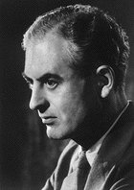
Bodily Defenses
Storytime
Organ Systems: Bodily Defenses
Pre-Test
Introduction
Why It Matters
What We Know
How We Know
Story Time
Common Hazards
Activities
Self-Study Game
Post-Test
Glossary
Peter Medawar (1915-1987)
Even in 1915, it was a small world for Peter Medawar. Peter's father was from Lebanon but moved to England to seek his fortune and marry an Englishwoman. He did marry, and after their marriage, the couple moved to Rio de Janeiro, Brazil, where Peter's father became a salesman for a dental supply company out of England. Peter was born in Rio but nonetheless was declared a citizen of England.

Slide 45
Childhood Interests
Storytime
Bodily Defenses
Organ Systems: Bodily Defenses
Pre-Test
Introduction
Why It Matters
What We Know
How We Know
Story Time
Common Hazards
Activities
Self-Study Game
Post-Test
Glossary
Before entering school, Peter Medawar learned Portuguese, the first language of Brazil, because school was taught in that language. He recalls of his mathematics teacher that she "considered it her business to teach us addition, subtraction, and the like, and she jolly well did." A main childhood interest of Peter was reading comic books. He and his brother had quite a collection. Another perhaps surprising interest was opera. Peter fell in love with the gramophone, the forerunner of today's record player or CD player. Due to the kinds of music his parents played in the house, he acquired a love for opera, even as a child. He would save his pocket money for weeks in order to buy a record. He enjoyed pretending to be an orchestra conductor in front of a mirror.
Most of Peter's free time as a child was spent with his brother on Copacabana Beach. He marvels that he did not catch polio, which afflicted many children in his neighborhood. His very own brother was crippled for life by the disease. Peter recalls how the town's sewers emptied directly onto the beach, and the children played around huge stagnant pools of sewage.

Slide 46
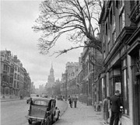
School Experiences
Storytime
Bodily Defenses
Organ Systems: Bodily Defenses
Pre-Test
Introduction
Why It Matters
What We Know
How We Know
Story Time
Common Hazards
Activities
Self-Study Game
Post-Test
Glossary
While Peter was still in grade school, the family moved back to England and lived in an apartment in suburban London. Soon thereafter, his mother and father returned to Rio and left Peter and his brother in an English boarding school. Many people think of English boarding schools as an elite educational experience, preparing students for premier English colleges such as Oxford or Cambridge. In Peter Medawar's day, however, many such boarding schools had low standards, poorly qualified teachers, and run-down facilities. The students came from average families, not wealth. Such was the case with Peter and his boarding school.
His favorite teacher was a middle-aged, bald, language teacher who loved drinking his ale and was an avid football (soccer) fan. Reading and writing quickly became major activities for Peter. In later years, Peter became famous for the quality of his writing, not only in his scientific papers, but also in his essays on a variety of topics.

Slide 47
School Experiences Cont’d
Storytime
Bodily Defenses
Organ Systems: Bodily Defenses
Pre-Test
Introduction
Why It Matters
What We Know
How We Know
Story Time
Common Hazards
Activities
Self-Study Game
Post-Test
Glossary
When he was thirteen, Peter's mother thought he should attend a "public" boarding school. Such schools in England were designed to train boys for leadership in the home civil service or for colonial administration and the foreign service. Peter hated his experience at the public boarding school. The school building itself had a prison-block design. The people were snobbish. Every boy had to take a cold bath every morning, even on the coldest days. The bathrooms were scrawled with dirty graffiti. Whippings were common. A great deal of authority was given to the boys themselves, who abused the privilege by bullying the boys with lesser authority. In addition to the usual abuse, Peter endured further harassment because his Middle Eastern facial features led others to assume that he was Jewish.
Peter was also disappointed because of his lack of athletic skills. If a boy did not have the talent to do well in sports, he was banished from sports and ridiculed around school. Just as today, a lot of emphasis was put on students' athletic talents when it came to winning approval and popularity.

Slide 48
School Experiences Cont’d
Storytime
Bodily Defenses
Organ Systems: Bodily Defenses
Pre-Test
Introduction
Why It Matters
What We Know
How We Know
Story Time
Common Hazards
Activities
Self-Study Game
Post-Test
Glossary
Peter did encounter a teacher he admired--a biology teacher who inspired two other boys at the school to become university professors. He was a crude and aggressive man who was hired, Peter thought, to discredit science so that students would become more adept in other subjects which were deemed more relevant for leadership and government service.
So why did Peter, and the other boys too, like this man? Maybe it was because he did not put on airs, as did so many other teachers. Peter never figured out why he and the other students were inspired by this teacher. In any case, Peter quickly realized that he wanted to study biology in college.

Slide 49
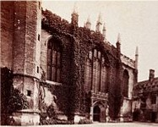
Oxford Education
Storytime
Bodily Defenses
Organ Systems: Bodily Defenses
Pre-Test
Introduction
Why It Matters
What We Know
How We Know
Story Time
Common Hazards
Activities
Self-Study Game
Post-Test
Glossary
Peter Medawar applied for a scholarship to Oxford but failed. He did, however, score well enough on the tests to be admitted as a "commoner," which is what the British call the regular undergraduate student. A new and much more civilized world opened for Peter at Oxford. At Oxford, students are grouped and housed as social units called "colleges." His college was Magdalen. Peter did not fit in well with many of those in Magdalen, but he did get along well with students who shared his interests in music and biology. The administrators of Magdalen College did not recruit students for their scholarship, but rather they wanted "regular guys" who would bring distinction to the college through sports and leadership activities. Thus, Peter encountered far too many of the same types of social snobs that he had lived with at boarding school. Despite the situation, Peter loved Oxford, for it was full of stimulating people of substance and high achievement.

Slide 50
Oxford Education Cont’d
Storytime
Bodily Defenses
Organ Systems: Bodily Defenses
Pre-Test
Introduction
Why It Matters
What We Know
How We Know
Story Time
Common Hazards
Activities
Self-Study Game
Post-Test
Glossary
In those days, Oxford had a 1:1 student teacher ratio. Teaching was administered through one on one tutoring. Students met their tutor once each week, while studying, completing lab and learning exercises, and writing papers between sessions. The tutor did not "lecture," nor provide factual information. The tutor's role was to guide students to the right books and papers, to set standards, to inspire a love for the subject, and to judge the adequacy of student achievement. Tutors had to be generalists in their subjects. Biology students, for example, did not go to a physiologist to learn physiology, an anatomist to learn anatomy, or a geneticist to learn genetics, etc. One tutor guided the learning in all aspects and specialties. Peter was lucky enough to have as one of his tutors, John Young, a famous neurobiologist, who helped him appreciate the breadth and inter-relatedness of all biology. Shortly after graduation, Peter himself became a tutor and found it to be "about the hardest work" he'd ever done.
As much as Peter generally enjoyed his tutoring experiences, he was quick to point out the problems. He summarized the problems as follows: "Some tutors are dull in themselves and a cause of dullness in others.... some tutors were lazy and self-indulgent."

Slide 51
Peter’s Research and Studies
Storytime
Bodily Defenses
Organ Systems: Bodily Defenses
Pre-Test
Introduction
Why It Matters
What We Know
How We Know
Story Time
Common Hazards
Activities
Self-Study Game
Post-Test
Glossary
Each student at Oxford negotiated with his tutor a program of study, which included the level of standard to which the student would be held. Standards could be set low enough to allow students to focus on partying and social life (a "pass" degree) or set as high as to require high scores on rigorous examinations (leading to a degree labeled First, Second, or Third).
Peter Medawar graduated with a First. Because his interest was well kindled in zoology, he stayed on as a graduate student at Oxford. He plunged into research on embryos, using the then revolutionary technique of culturing cells. His first studies identified a compound in malt extract that inhibited connective tissue cells in culture. He showed the first draft of his manuscript describing the research to Howard Florey, the discoverer of penicillin. Florey pulled no punches in denouncing the paper, saying that "it sounds more like philosophy than science." Despite the criticism, Florey encouraged him to fix the paper and to pursue his line of research, putting him in touch with chemists with whom he could consult to learn more about the mysterious inhibitory compound. Peter never identified the chemical nature of this compound. In the meantime, he did use the malt extract to study the mathematics that describe growth of cells in culture.

Slide 52
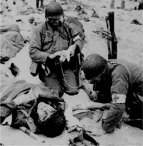
Peter’s Research and Studies Cont’d
Storytime
Bodily Defenses
Organ Systems: Bodily Defenses
Pre-Test
Introduction
Why It Matters
What We Know
How We Know
Story Time
Common Hazards
Activities
Self-Study Game
Post-Test
Glossary
While conducting his research, Peter also worked in Florey's laboratory, where everyone studied wound and burn healing to aid in the World War II effort in Britain. At that time, people with severe burns were kept alive with blood transfusions and sulfa drugs to combat infections. This created a problem as the burned tissue would fall away and leave in its place raw areas that were very vulnerable to infection. Peter tested a variety of antibacterial substances, finding that some of the sulfa drugs were effective when applied as a powder to the raw areas. In a tissue culture, one sulfa drug's crystals actually enhanced the ability of epithelial cells to spread, using the crystals as a support "pole" for tent-like coverings. Thus, this drug not only reduced infections but also accelerated the covering of raw burn areas by new skin growth.

Slide 53
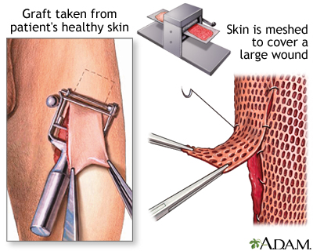
Peter’s Research and Studies Cont’d
Storytime
Bodily Defenses
Organ Systems: Bodily Defenses
Pre-Test
Introduction
Why It Matters
What We Know
How We Know
Story Time
Common Hazards
Activities
Self-Study Game
Post-Test
Glossary
These war wound experiences also shaped Peter's future research. He became intrigued with the fact that skin grafts only worked if the grafted skin came from the same person receiving the graft. Somehow, the body could recognize alien tissue and would not accept it. How? He took on this problem as his "duty and pleasure" to investigate. As World War II continued in Europe, he applied for and received a grant to study the issue in a surgical unit where there were plenty of patients with skin wounds needing grafts.
Figure 1: Skin Graft
From: https://medlineplus.gov/ency/imagepages/19083.htm

Slide 54
Peter’s Research and Studies Cont’d
Storytime
Bodily Defenses
Organ Systems: Bodily Defenses
Pre-Test
Introduction
Why It Matters
What We Know
How We Know
Story Time
Common Hazards
Activities
Self-Study Game
Post-Test
Glossary
One of his first clues was the observation that a second graft of "foreign" skin did not last as long as the first one. This suggested that the body had some kind of memory of the first graft experience. He and his colleague, Tom Gibson, published a paper on the data and concluded that the body has a mechanism that resists alien tissue, much like the mechanism by which the body resists other foreign invaders, such as bacteria, viruses, and parasites. The mechanism allows the body to adapt to or reject foreign intrusion. Moreover, the resistance system can retain a residual memory and respond even more vigorously at the second time of exposure.
Peter then embarked on a large program involving animal testing of skin-graft rejection. He cut and stained tissue samples taken from the grafts and observed cellular changes occurring at various stages of graft rejection. Because the war was in full sway, Peter had little help. He was responsible for all of the animal feeding, surgeries, nursing care, and laboratory work. He felt guilty if he did less, though he took some comfort from the fact that he was helping to develop treatments for war injuries. He was also proud to be teaching medical students who would become the doctors saving lives during the war. He acquired the habit of working long days and bringing home a briefcase of documents to read before the next morning.

Slide 55
Peter’s Research and Studies Cont’d
Storytime
Bodily Defenses
Organ Systems: Bodily Defenses
Pre-Test
Introduction
Why It Matters
What We Know
How We Know
Story Time
Common Hazards
Activities
Self-Study Game
Post-Test
Glossary
Peter's most important work was to demonstrate that the rejection of donor grafts was due to an immunological reaction and that tolerance could be built up by injections into embryos. Thus was born the idea of acquired immunological tolerance, an idea that is still spawning new research to this day, because how this tolerance develops is still not fully understood. The body's capacity for reacting to foreign proteins can be reduced by repeated exposure to the protein, preferably in small, graded amounts. Applications of Peter Medawar's research include the common practice of treating allergies with allergy shots and of reducing rejection of tissue transplants. Although most of his work was immediately accepted and appreciated by his peers, Peter is often quoted for the famous quip:
“The human mind treats a new idea the way the body treats a strange protein -- it rejects it.”
For his important discoveries, Peter was awarded the Nobel Prize in 1960. It was his research on tissue transplantation which eventually helped make organ transplants possible.
His book, "Advice to a Young Scientist," has been widely read and is still available at http://www.amazon.com/Advice-Young-Scientist-Alfred-Foundation/dp/0465000924

Slide 56
References
Storytime
Bodily Defenses
Organ Systems: Bodily Defenses
Pre-Test
Introduction
Why It Matters
What We Know
How We Know
Story Time
Common Hazards
Activities
Self-Study Game
Post-Test
Glossary
Medawar, Peter. 1990. The Threat and the Glory. Reflections on Science and Scientists. Harper Collins. New York, N.Y.
Medawar, Peter. 1986. Memoir of a Thinking Radish. Oxford University Press, Oxford, England.
Medawar, Peter. 1973. Advice To A Young Scientist. Harper and Row, New York.
Figure 1. Skin graft. Reprinted from MedlinePlus, by D. G. Wechter & D. Zieve, 2019, https://medlineplus.gov/ency/imagepages/19083.htm
The Scientist Staff. (25 Jan 1988). In Memoriam Peter Medawar. Retrieved from https://www.the-scientist.com/news/in-memoriam-peter-medawar-63180
Biographical sketch http://www.magd.ox.ac.uk/discover-magdalen/history-of-college/famous-alumni/sir-peter-medawar/

Slide 57
Bodily Defenses
Organ Systems: Bodily Defenses
Pre-Test
Introduction
Why It Matters
What We Know
How We Know
Story Time
Common Hazards
Activities
Self-Study Game
Post-Test
Glossary
Common Hazards

Slide 58
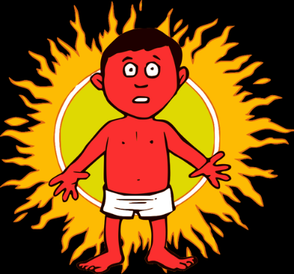
Sunburn
Common Hazards
Bodily Defenses
Organ Systems: Bodily Defenses
Pre-Test
Introduction
Why It Matters
What We Know
How We Know
Story Time
Common Hazards
Activities
Self-Study Game
Post-Test
Glossary
Overview:
What happens when the sun hits your skin? Either you get tanned or you get burned. Why do some people tan while other people burn? How does sunscreen help? What happens when you have prolonged exposure to the sun? What the sun does to your skin is very important because the skin is your first line of defense!
What the sun does to your skin:
Sunburn is caused by ultraviolet light from the sun. These rays activate melanin, which is the body's protective pigment against the sun, and turn the melanin brown. This creates a tan. Radiation has to hit something in order to dissipate its energy. Melanin provides target molecules that safely absorb radiation energy.
However, sometimes the body can't handle the amount of rays that the sun is giving off. In this case, the sun will actually burn the skin - a sunburn!

Slide 59
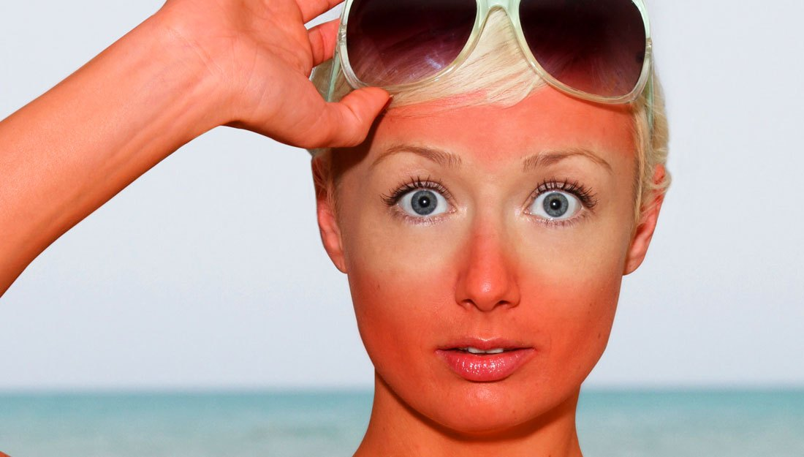
Sunburn Cont’d
Common Hazards
Bodily Defenses
Organ Systems: Bodily Defenses
Pre-Test
Introduction
Why It Matters
What We Know
How We Know
Story Time
Common Hazards
Activities
Self-Study Game
Post-Test
Glossary
What causes your skin to be red from a sunburn?
Everyone knows that you get a sunburn from being outside too long. Don't confuse a sunburn with a burn that you will get from a fire, because they are different. What is happening under your skin when you get burned? You’ve learned that your skin is an organ and when it’s damaged the immune system is activated. Your body responds like it is fighting an infection. The red color of the skin is partly due to increased blood flow to the injured area. When cells' membranes are damaged, certain chemicals leak out. Two of these are histamine and bradykinin, which cause the blood vessels to dilate. This reaction is common when a part of the body has been injured. Also, the body will begin certain inflammatory processes, which causes the pain and soreness felt as your body attempts to heal itself. When a burn is severe, you can actually have blisters filled with lymph fluid, blood serum, blood plasma, or pus. This is caused by the movement of protective cells in the blood to the extremely injured areas.

Slide 60
Sunburn Cont’d
Common Hazards
Bodily Defenses
Organ Systems: Bodily Defenses
Pre-Test
Introduction
Why It Matters
What We Know
How We Know
Story Time
Common Hazards
Activities
Self-Study Game
Post-Test
Glossary
What happens when you have prolonged exposure to the sun?
Unfortunately, skin cancer can develop from being in the sun too much. When you burn, you are causing damage and death to cells. This injury can cause damage to your DNA (mutations), which is very serious! This DNA damage causes the cells to grow out of control, causing patches or lumps to form. These skin formations are cancerous. Skin cancer is the most common cancer in the United States and worldwide. More people are diagnosed with skin cancer each year in the U.S. than all other cancers combined. It is estimated that one in five people in the United States will develop some form of skin cancer by the age of 70. Researchers believe that having five or more serious sunburn can double your risk of skin cancer. If skin cancer is caught early, you have a good chance of survival and complete recovery. The common treatment for skin cancer in the early stages is removal of the cancerous area. However, in further stages, chemotherapy and radiation may be used. The use of radiation may seem weird because that is what caused the cancer in the first place, right? Well, the radiation received at the doctor's office is actually a very strong dose, so that it kills or disables the cancerous cells. You can reduce your risk of skin cancer by limiting or avoiding exposure to ultraviolet (UV) radiation. Checking your skin for suspicious changes can help detect skin cancer at its earliest stages. Early detection of skin cancer gives you the greatest chance for successful skin cancer treatment.

Slide 61

Sunburn Cont’d
Common Hazards
Bodily Defenses
Organ Systems: Bodily Defenses
Pre-Test
Introduction
Why It Matters
What We Know
How We Know
Story Time
Common Hazards
Activities
Self-Study Game
Post-Test
Glossary
How can sunscreen prevent a sunburn?
Sunscreen can not only prevent a sunburn, it can greatly reduce your chances of getting skin cancer from the sun. When you look at a bottle of sunscreen, you will see a number, called the SPF, or sun protection factor. This number, which varies according to the strength of the sunscreen you need, is actually a number you can use to find out how many minutes you can stay in the sun without being burned. If you are normally okay in the sun for 10 minutes and you use a lotion with a SPF of 10, then you would be okay in the sun for 100 minutes!
Source: CDC

Slide 62
Sunburn Cont’d
Common Hazards
Bodily Defenses
Organ Systems: Bodily Defenses
Pre-Test
Introduction
Why It Matters
What We Know
How We Know
Story Time
Common Hazards
Activities
Self-Study Game
Post-Test
Glossary
Do certain ethnicities have a higher chance of getting skin cancer?
Melanin is the pigment that gives human skin, hair, and eyes their color. Dark-skinned people naturally have more melanin in their skin that light-skinned people do. Melanin provides some protection against skin damage from the sun. The cells that make melanin, called melanocytes, increase their production of melanin in response to sun exposure. That’s why you get a tan after being in the sun. A light-skinned person may have only 1-3% melanin in their skin, whereas a darker-skinned person may have as much as 43%. That is a big difference! Melanoma, one common type of skin cancer, is seen more often in light-skinned people than in dark-skinned people. Melanoma is more than 20 times more common in whites than in African Americans.

Slide 63
Sunburn Cont’d
Common Hazards
Bodily Defenses
Organ Systems: Bodily Defenses
Pre-Test
Introduction
Why It Matters
What We Know
How We Know
Story Time
Common Hazards
Activities
Self-Study Game
Post-Test
Glossary
Conclusion
The sun is a powerful enemy of the body's first line of defense, the skin. Prolonged exposure to the sun can cause a painful sunburn or even skin cancer! So before you head outside next time, make sure that you apply sunscreen that is strong enough to protect you! For further information, take a look at these websites:
https://kidshealth.org/en/parents/sun-safety.html
https://www.healthychildren.org/English/safety-prevention/at-play/Pages/Sun-Safety-and-Protection-Tips.aspx
To look up a current UV report on a map of the United States:
https://www.epa.gov/sunsafety/uv-index-1

Slide 64
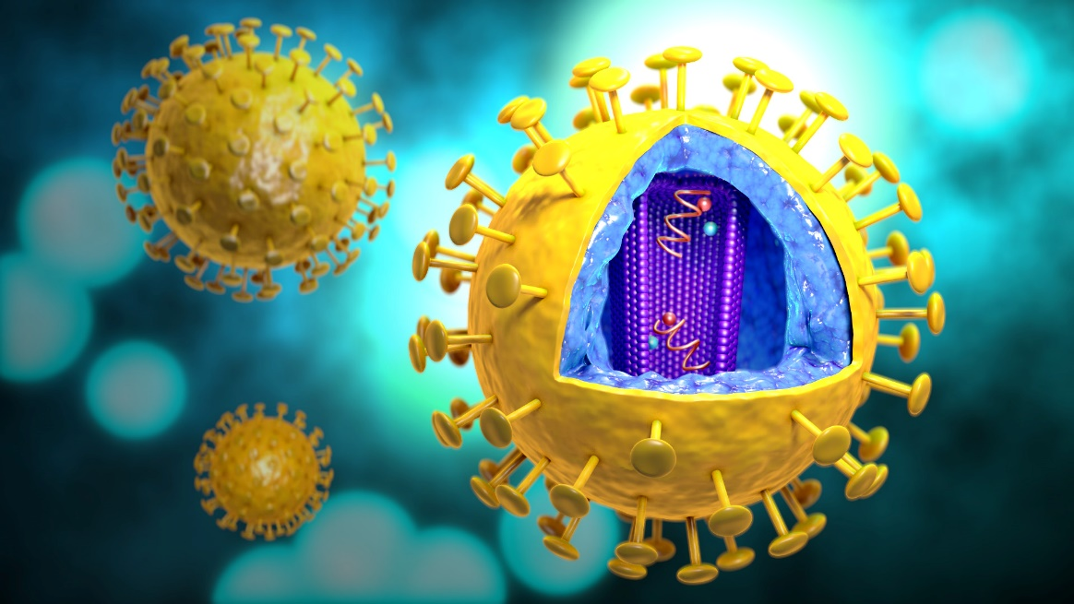
HIV/AIDS
Common Hazards
Bodily Defenses
Organ Systems: Bodily Defenses
Pre-Test
Introduction
Why It Matters
What We Know
How We Know
Story Time
Common Hazards
Activities
Self-Study Game
Post-Test
Glossary
Overview
AIDS is a fatal disease. The best way to combat the disease is knowledge about how to prevent it. There is not a cure nor a vaccine.
What is AIDS?
We need to start with a couple of acronyms and their definitions:
1) AIDS- acquired immunodeficiency syndrome 2) HIV- human immunodeficiency virus.
Artist depiction of Human Immunodeficiency Virus (HIV)
Source: CDC

Slide 65
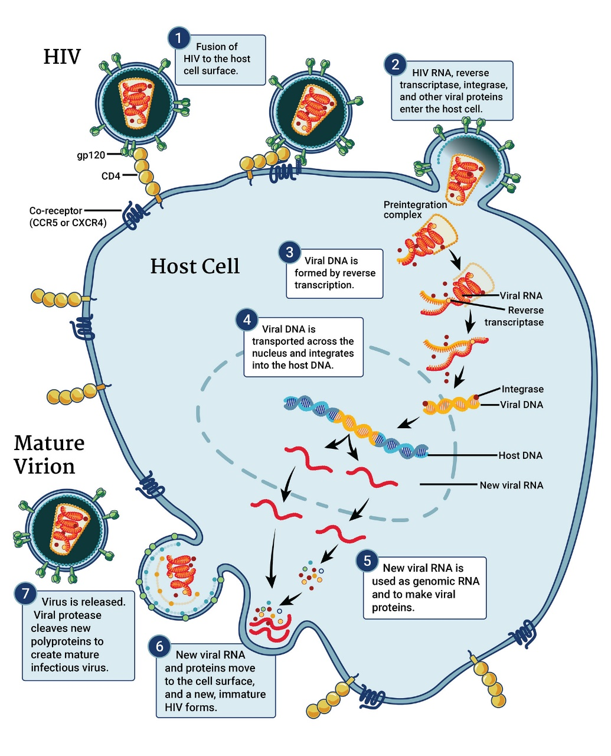
HIV/AIDS Cont’d
Common Hazards
Bodily Defenses
Organ Systems: Bodily Defenses
Pre-Test
Introduction
Why It Matters
What We Know
How We Know
Story Time
Common Hazards
Activities
Self-Study Game
Post-Test
Glossary
How HIV Infects a Cell
Source: NIH
AIDS is not actually a virus. It is the disease caused by human immunodeficiency virus, HIV. In a two-step process, HIV uses a protein on its surface, gp120, to bind to a pair of receptors on the surface of T-cells, allowing the virus to enter the cell. Once inside, the HIV virus fuses with the cell’s genetic machinery and begins to multiply, producing thousands more HIV particles. In time, the T-cell bursts like a seedpod, scattering new HIV virus to infect and kill other cells. The cycle is then repeated countless times. Once this happens many times over and the T-cell level drops to a certain point, an individual is considered to have AIDS. AIDS is a disease that impairs your immune system by lowering the lymphocyte count, eventually rendering white blood cell functions almost useless.

Slide 66
HIV/AIDS Cont’d
Common Hazards
Bodily Defenses
Organ Systems: Bodily Defenses
Pre-Test
Introduction
Why It Matters
What We Know
How We Know
Story Time
Common Hazards
Activities
Self-Study Game
Post-Test
Glossary
How do you get AIDS?
HIV is spread only in certain body fluids from a person who has HIV. Most of all cases can be traced to one of three routes:
sexual intercourse or other specific sexual activities
contact with blood including blood transfusion (blood is now rigorously tested before use and this method of transmission is rare), needle or syringe sharing, accidental stick of HIV-contaminated needle or other sharp object (mostly for health-care workers)
mother-to-child transmission through pregnancy, birth, or in breast milk
You can’t get HIV by shaking hands or hugging a person who has HIV. You also can’t get HIV from contact with objects such as dishes, toilet seats, or doorknobs used by a person with HIV. HIV is not spread through the air or in water or by mosquitoes, ticks, or other blood-sucking insects.
To know if you have contracted AIDS, a blood test is typically conducted to find out if you have HIV antibodies circulating in your blood. But the antibodies may not be present for up to 3 months after transmission, so you may actually have HIV and still test negative because not enough time has passed to produce the antibodies.

Slide 67
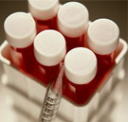
HIV/AIDS Cont’d
Common Hazards
Bodily Defenses
Organ Systems: Bodily Defenses
Pre-Test
Introduction
Why It Matters
What We Know
How We Know
Story Time
Common Hazards
Activities
Self-Study Game
Post-Test
Glossary
Why is AIDS so bad?
As discussed earlier, AIDS/HIV causes the immune system to no longer function. HIV causes people to become sick with infections that normally wouldn't affect them. Diseases like cancer and pneumonia can set in. These diseases are called opportunistic diseases because they invade after the immune system has been compromised. Although the HIV virus itself can cause some flu-like symptoms, it is actually the opportunistic diseases that kill AIDS victims.
How is AIDS treated?
Currently there is no cure or vaccination for the HIV virus. Treatment with HIV medicines is called antiretroviral therapy (ART). Doctors will prescribe a variety of medicines, including antiviral drugs (those that destroy viruses) and immunomodulator drugs (those that increase the effects of the immune system). However, most drugs are used to treat the symptoms, not the cause. While drugs will prolong the life of the patient, it will not cure them.

Slide 68
HIV/AIDS Cont’d
Common Hazards
Bodily Defenses
Organ Systems: Bodily Defenses
Pre-Test
Introduction
Why It Matters
What We Know
How We Know
Story Time
Common Hazards
Activities
Self-Study Game
Post-Test
Glossary
Where is AIDS most prevalent?
AIDS has reached epidemic proportions in several areas of the world. However, Africa has been the center of the crisis since the beginning. The sub-Saharan Africa is the area of the world with the greatest prevalence of AIDS, followed by southeast Asia. Several relief projects are underway to give these people medicine and treatment. For global maps showing the distribution of AIDS cases, click here.
Conclusion
We now know how HIV is transmitted and how we can prevent the disease. Armed with this knowledge, hopefully people will protect themselves, and we can hold the epidemic in check until there is a vaccine or a cure for the disease. The good news is that new HIV infections have been reduced by 40% since the peak of infections in 1997. Also, AIDS-related deaths have been reduced by more than 55% since the peak in 2004. To find out more information concerning AIDS and the HIV virus, check out these websites:
https://aidsinfo.nih.gov/understanding-hiv-aids/fact-sheets
https://www.hiv.gov/hiv-basics
https://www.mayoclinic.org/diseases-conditions/hiv-aids/symptoms-causes/syc-20373524

Slide 69
Bodily Defenses
Organ Systems: Bodily Defenses
Pre-Test
Introduction
Why It Matters
What We Know
How We Know
Story Time
Common Hazards
Activities
Self-Study Game
Post-Test
Glossary
Activities

Slide 70
Click to download an activity
Activities
Bodily Defenses
Organ Systems: Bodily Defenses
Pre-Test
Introduction
Why It Matters
What We Know
How We Know
Story Time
Common Hazards
Activities
Self-Study Game
Post-Test
Glossary
Student Activity Sheet #1- Skin Observations
Student Activity Sheet #2- Ready, set, infect!

Slide 71
Bodily Defenses
Organ Systems: Bodily Defenses
Pre-Test
Introduction
Why It Matters
What We Know
How We Know
Story Time
Common Hazards
Activities
Self-Study Game
Post-Test
Glossary
Self-Study Game

Slide 72
Click to play a game
Self-Study Game
Bodily Defenses
Organ Systems: Bodily Defenses
Pre-Test
Introduction
Why It Matters
What We Know
How We Know
Story Time
Common Hazards
Activities
Self-Study Game
Post-Test
Glossary
Quizizz

Slide 73
Bodily Defenses
Post-Test
Organ Systems: Bodily Defenses
Pre-Test
Introduction
Why It Matters
What We Know
How We Know
Story Time
Common Hazards
Activities
Self-Study Game
Post-Test
Glossary
Click below to take the post-test for this unit!
Google assessment

Slide 74

A-Ce
Bodily Defenses
Glossary
Organ Systems: Bodily Defenses
Pre-Test
Introduction
Why It Matters
What We Know
How We Know
Story Time
Common Hazards
Activities
Self-Study Game
Post-Test
Glossary
antibody - Y-shaped 4 chain protein synthesized by specialized lymphocytes called plasma cells. These proteins circulate in the bloodstream and recognize and attach to foreign substances called antigens. Return to What We Know
antigen - anything (usually a protein) that elicits an immune response. Bacteria and viruses are two examples of antigens. Return to What We Know
bacteria – single-celled microorganisms that can be free living or live in/on other organisms. Return to How We Know
Source: https://www.genome.gov/genetics-glossary/Antibody
blood transfusion - the process of transferring blood from one person (donor) to another person (recipient). This may be done as a life saving technique for someone who has lost a lot of blood from a surgery or accident. Return to Common Hazards
carbohydrates - compounds composed of only carbon, oxygen, and hydrogen. Carbohydrates consist of starches and sugars, such as glucose. Glucose is necessary for production of energy, especially in the brain. Return to What We Know
centrifuge - a machine that rotates (spins) rapidly and uses centrifugal force to separate substances of different densities. You've used a centrifuge before. Have you ever watched a washing machine on spin cycle? A washing machine uses centrifugal force in the spin cycle to separate the water from your clothes. Return to How We Know

Slide 75
Co-Li
Bodily Defenses
Glossary
Organ Systems: Bodily Defenses
Pre-Test
Introduction
Why It Matters
What We Know
How We Know
Story Time
Common Hazards
Activities
Self-Study Game
Post-Test
Glossary
compromise - as used in biology, it means to cause the impairment of; to injure or weaken. Return to Common Hazards
diphtheria - a potentially deadly infectious disease that attacks the upper respiratory tract. It occurs when the bacterium, Corynebacterium diphtheriae, infects the body. Return to How We Know
filtrate - fluid that has passed through a filter. The filter removes some components of the original fluid. For example, lymph is a filtrate of the blood that does not have red blood cells nor some of the proteins that blood does have. Return to What We Know
immune system - body system composed of many cells, organs and tissues, including skin, white blood cells, lymph nodes, spleen, and thymus. The purpose of this system is to defend the body against foreign invaders. Return to What We Know
integumentary system - organ system consisting of the skin and its appendages like hair, feathers, nails, and exocrine glands. Its primary purpose is to protect the body from damage and water loss. Return to What We Know
lipids - Lipids are also known as fats, but they include compounds of many different kinds. Chemically, these compounds are built on a backbone of glycerol, which was a three-carbon chain. Each carbon, in turn, bonds via an oxygen molecule to so-called fatty acids. Fatty acids have an acid group (COOH) at one end that is attached to a chain of carbons. Lipids differ mainly in the nature of the fatty acid chains. Return to What We Know

Slide 76
Ly-T
Bodily Defenses
Glossary
Organ Systems: Bodily Defenses
Pre-Test
Introduction
Why It Matters
What We Know
How We Know
Story Time
Common Hazards
Activities
Self-Study Game
Post-Test
Glossary
lymphatic system - a body system composed of a network of vessels and nodes that carry and filter a fluid called lymph. This system is part of both the immune and cardiovascular systems. Return to What We Know
lymphocytes - small white blood cells that are responsible for the immune response. There are two main types of lymphocytes: B-cells and T-cells. B-cells produce antibodies that attack bacteria and other toxins. T-cells directly attack and destroy cells infected with a virus or cancerous cells. Return to What We Know
phagocytosis - the process by which certain cells destroy toxins and other organic matter by wrapping their cell membrane around it and incorporating it into the phagocytic cell, where enzymes break down the chemicals and destroy them. Return to What We Know
proteins - molecules made of long strings of repeating units, called amino acids. Amino acids have carbon, hydrogen, oxygen, and nitrogen in them. When they attach to each other in long strings, they coil. The coiled folds back on itself to form an irregularly shaped clump. Return to What We Know
toxin - a poisonous agent produced by certain animals, plants, and bacteria. A toxin usually has a large molecular weight and is antigenic. Return to What We Know

Slide 77
V-W
Bodily Defenses
Glossary
Organ Systems: Bodily Defenses
Pre-Test
Introduction
Why It Matters
What We Know
How We Know
Story Time
Common Hazards
Activities
Self-Study Game
Post-Test
Glossary
virus - a microorganism, smaller than bacteria, that invades a cell and uses the cell's metabolic systems to reproduce. A virus consists of either DNA or RNA surrounded by a protective coat. Unlike most bacteria, viruses cannot live on their own. They have to have a host cell to survive. Return to Common Hazards
white blood cell - (one main type is called a leukocyte) One of the cells in the immune system that helps fight invaders. The white blood cell count (WBC) increases when a foreign antigen, such as bacteria or virus, enters the body. A normal WBC is between 4,000 and 11,000 white blood cells per microliter. Return to What We Know | Return to How We Know

