Slide 1
Life Science Organ Systems Bodily Defenses
Pre-Test

Slide 2
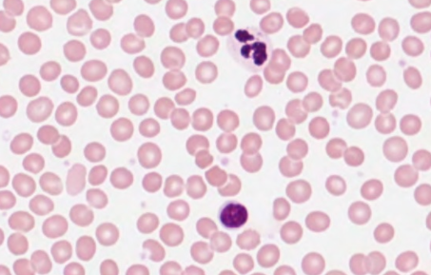
The following image shows a microscope slide with stained human blood. What are the round structures?
A. artifacts (things that shouldn’t be there)
B. organs
C. drops of stain
D. cells

Slide 3
2. What are the main functions of the immune system?
A. To break food down into absorbable nutrients
B. To protect the body against disease and injury
C. To transport oxygen and other nutrients throughout the body
D. To release neurotransmitters during times of stress

Slide 4
3. A lymphocyte would be at what level of organization in the lymphatic system?
A. Cell
B. Tissue
C. Organ
D. Organ system

Slide 5
4. After getting a splinter, a pocket of pus forms around the area. Which of the following best describes why this happens?
A. The splinter is blocking blood flow so blood, including white blood cells, collects in the area
B. The immune system recognizes the presence of a foreign body and white blood cells like neutrophils and macrophages collect to eliminate the antigen
C. The splinter likely punctured a lymph node and all of the lymphocytes started leaking out
D. The splinter is dissolving and the resulting liquid forms pus

Slide 6
5. The lymphatic and integumentary systems work together for what main purpose?
A. To facilitate communication between body systems
B. To circulate blood throughout the body
C. To protect and defend the body from injury and disease
D. To exchange oxygen and carbon dioxide to support cellular respiration

