Slide 1
CELLS ARE US
GATEWAY TO THE CELL

Slide 2
NAVIGATION TABLE
Cells Are Us: Gateway to the Cell
Pre-Test
Introduction
What We Know
How We Know
Story Time
Common Hazards
Activities
Self-Study Game
Post-Test
Glossary

Slide 3
Gateway to the Cell
Pre-Test
Cells Are Us: Gateway to the Cell
Pre-Test
Introduction
What We Know
How We Know
Story Time
Common Hazards
Activities
Self-Study Game
Post-Test
Glossary
Google assessment

Slide 4
Gateway to the Cell
Cells Are Us: Gateway to the Cell
Pre-Test
Introduction
What We Know
How We Know
Story Time
Common Hazards
Activities
Self-Study Game
Post-Test
Glossary
Introduction

Slide 5
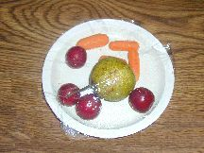
WHAT IS A MEMBRANE? CAN YOU THINK OF AN EXAMPLE?
Introduction
Gateway to the Cell
Cells Are Us: Gateway to the Cell
Pre-Test
Introduction
What We Know
How We Know
Story Time
Common Hazards
Activities
Self-Study Game
Post-Test
Glossary
Does your mother ever put plastic wrap around leftover food? .... or over a dish of leftovers? You could think of the plastic sheet as a membrane. The plastic wrap has two characteristics of cell membranes:
  1) it is thin.
  2) it restricts what can go through it.
In a living cell, the cell membrane is a structure much like the plastic wrap around the leftover food. The most obvious thing a membrane does, like the plastic wrap, is to keep bulky materials inside the cell. You could say that the membrane helps hold things together, but the cell membrane does more than that. It must let some substances pass from the outside to the inside of the cell and other substances pass in the opposite direction.

Slide 6

WHAT IS A MEMBRANE? CAN YOU THINK OF AN EXAMPLE?
Introduction
Gateway to the Cell
Cells Are Us: Gateway to the Cell
Pre-Test
Introduction
What We Know
How We Know
Story Time
Common Hazards
Activities
Self-Study Game
Post-Test
Glossary
Can you think of something familiar that is like a cell with a membrane around it? An even better comparison would be a tennis ball, because the fuzz on a tennis ball can be compared with large molecules of proteins and complex sugars that are found stuck through the outer membrane.
Membranes are everywhere - around cells and surrounding structures inside of cells.

Slide 7
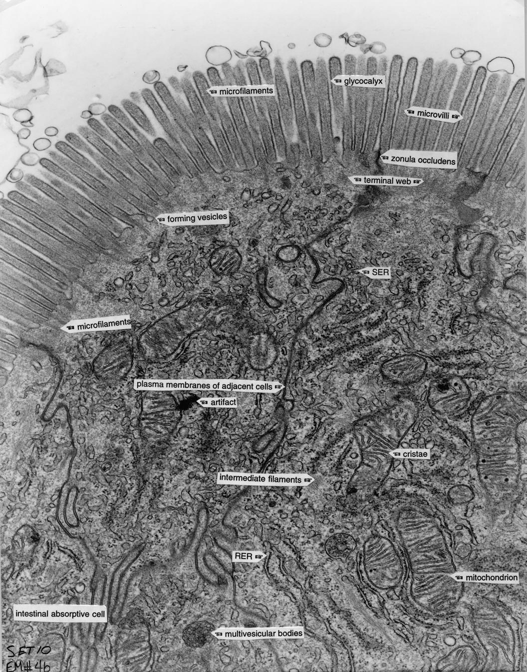
Gateway to the Cell
Objectives
Cells Are Us: Gateway to the Cell
Pre-Test
Introduction
What We Know
How We Know
Story Time
Common Hazards
Activities
Self-Study Game
Post-Test
Glossary
After completing this lesson, each student should be able to:
  Understand the structure and function of the cell membrane.
  Identify the molecules of a membrane, including the locations of their electric charges.
  Explain how membranes can self-organize.
  Understand how alcohol affects the cell membrane.
High magnification of part of a cell, showing that it contains many components.

Slide 8
Gateway to the Cell
Cells Are Us: Gateway to the Cell
Pre-Test
Introduction
What We Know
How We Know
Story Time
Common Hazards
Activities
Self-Study Game
Post-Test
Glossary
What We Know

Slide 9
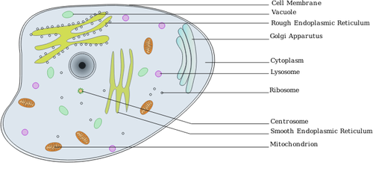
WHAT IS THE CELL MEMBRANE?
What We Know
Gateway to the Cell
Cells Are Us: Gateway to the Cell
Pre-Test
Introduction
What We Know
How We Know
Story Time
Common Hazards
Activities
Self-Study Game
Post-Test
Glossary
The cell membrane, also known as the plasma membrane, is the structure that separates the world outside of the cell (extracellular) from the world inside the cell (intracellular). The cell membrane is present in both plant and animal cells.
A diagram of a cell, showing the cell membrane surrounding the cell.
Source: https://openclipart.org/detail/66739/animal-cell-labelledby-ramchand

Slide 10
THE FUNCTIONS OF THE CELL MEMBRANE ARE:
What We Know
Gateway to the Cell
Cells Are Us: Gateway to the Cell
Pre-Test
Introduction
What We Know
How We Know
Story Time
Common Hazards
Activities
Self-Study Game
Post-Test
Glossary
To hold the cell together, keeping its parts in place.
To mediate cellular processes by regulating the materials that enter and exit the cell. To do this, cell membranes are partially porous. This is known as being semipermeable. Proteins imbedded in the membrane to create adjustable holes (pores). This allows the cell to control which molecules enter and leave it. This also allows the cell to generate electrical currents, as you will see shortly.
To carry markers that allow cells to recognize one another and transmit signals to other cells via receptors.

Slide 11
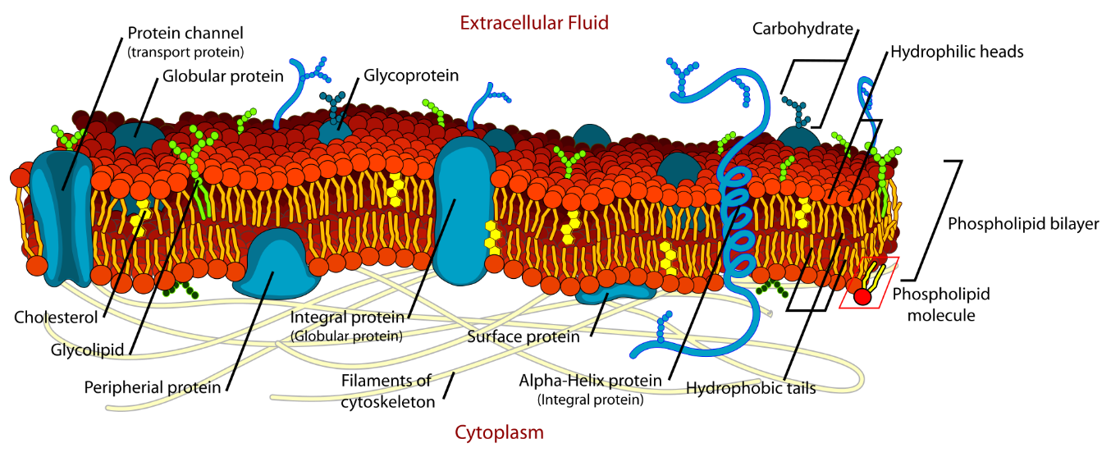
WHAT IS THE STRUCTURE OF THE CELL MEMBRANE?
What We Know
Gateway to the Cell
Cells Are Us: Gateway to the Cell
Pre-Test
Introduction
What We Know
How We Know
Story Time
Common Hazards
Activities
Self-Study Game
Post-Test
Glossary
Image By LadyofHats Mariana Ruiz - Own work. Image renamed from File: Cell membrane detailed diagram.svg, Public Domain, https://commons.wikimedia.org/w/index.php?curid=6027169
If you look at the diagram of the cell membrane above, you can see the parts illustrated in different colors. The red and yellow portion of the cell membrane is made of lipids. The blue structures are proteins that are imbedded in the membrane. Let’s take a look at what these structures do and how they were discovered.

Slide 12
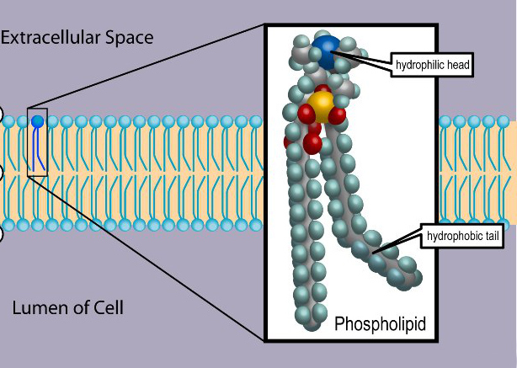
WHAT DO WE KNOW ABOUT THE LIPIDS THAT MAKE MEMBRANES?
What We Know
Gateway to the Cell
Cells Are Us: Gateway to the Cell
Pre-Test
Introduction
What We Know
How We Know
Story Time
Common Hazards
Activities
Self-Study Game
Post-Test
Glossary
The word “lipid” is another word for “fat.” The lipids that make up the cell membrane are predominately phospholipids. They are made of a phosphate “head” linked to 2 fatty acid chains. The head is hydrophilic and interacts with water. The chains or “tails” are hydrophobic and do not interact with water.

Slide 13
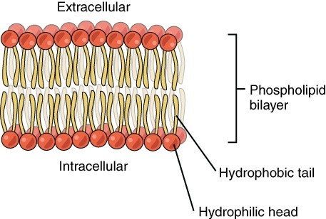
LOLLIPOP LIPIDS!
What We Know
Gateway to the Cell
Cells Are Us: Gateway to the Cell
Pre-Test
Introduction
What We Know
How We Know
Story Time
Common Hazards
Activities
Self-Study Game
Post-Test
Glossary
Would you believe that chemists represent lipids with little drawings that look like lollipops?
  The circle at one end represents an electrically charged "phosphate group head," which is the atom phosphorous bonded to four molecules of oxygen.
  These phosphate groups are hydrophilic (attracted to water) because water is charged (the + pole of water molecules attracts to the negative pole of the phosphate.)
  The stem of the lollipop represents the fatty acid chain that is attached to the phosphate group.
Most drawings of lipid symbols show two stems because real lipids have two parallel chains of carbons attached to the phosphate group. Lipids line up parallel to each other in the presence of water. In other words, at water's surface, the lipid molecules are "standing on their heads." The layer made of the two lines of phospholipids is called the phospholipid bilayer.

Slide 14
MEMBRANES SELF-ORGANIZE
What We Know
Gateway to the Cell
Cells Are Us: Gateway to the Cell
Pre-Test
Introduction
What We Know
How We Know
Story Time
Common Hazards
Activities
Self-Study Game
Post-Test
Glossary
Ever notice that when your mother cooks soup, the fat rises to the top and congeals after it cools? When hot, the fats do not aggregate well but rather mix in with the water part of the soup. What happens if you pour a little oil or other kind of fat into a bowl of water? It will self-organize as a film of oil at the top. It floats because fat is lighter than water. It forms a film because the electrical forces of water grab the charged head groups and make them line up.
  The amount of lipid in red blood cells, which have only protein on the inside, is double what it would take to cover the outside diameter of the cell. Thus, it must occur in two layers. (See "How We Know" for more details.)
  In water, lipids group together spontaneously to form membranes. Think about what this says about the importance of water.

Slide 15
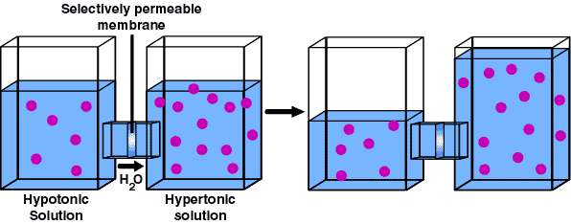
MEMBRANES ALSO ACT AS BARRIERS
What We Know
Gateway to the Cell
Cells Are Us: Gateway to the Cell
Pre-Test
Introduction
What We Know
How We Know
Story Time
Common Hazards
Activities
Self-Study Game
Post-Test
Glossary
Cell membranes can let some compounds pass through them, while restricting most others. Water can usually pass freely, and its molecules tend to distribute themselves ("diffuse").
In the diagram below, let us assume that we have two solutions in physical communication but separated by a membrane that will only let water through.
  Solution on the left is relatively short on salts (hypotonic)
  Solution on the right has a surplus of salts (hypertonic)
  Only water can move through the membrane
  The relative "surplus" water in the left chamber would move into the right-hand chamber, making it swell, as seen on the right
What would happen if you put cells in water? Remember, the cell membrane lets water through, and cells have lots of salts and other dissolved substances, whereas water would have little salt.

Slide 16
CELL MEMBRANES HAVE MANY IMBEDDED PROTEINS.
What We Know
Gateway to the Cell
Cells Are Us: Gateway to the Cell
Pre-Test
Introduction
What We Know
How We Know
Story Time
Common Hazards
Activities
Self-Study Game
Post-Test
Glossary
Image By LadyofHats Mariana Ruiz - Own work. Image renamed from File: Cell membrane detailed diagram.svg, Public Domain, https://commons.wikimedia.org/w/index.php?curid=6027169
Now, let’s go back to our cell membrane diagram. Shown in blue are the proteins that make up part of the cell membrane. These proteins have specific functions in the cell membrane. Notice there are different types of proteins with different structures.

Slide 17
MEMBRANE PROTEINS DO MANY THINGS:
What We Know
Gateway to the Cell
Cells Are Us: Gateway to the Cell
Pre-Test
Introduction
What We Know
How We Know
Story Time
Common Hazards
Activities
Self-Study Game
Post-Test
Glossary
They send signals. These proteins provide a way for communication between substances on the outside of the cell with target molecules on the inside of the cell.
They transport molecules. Like trucks, these proteins carry other molecules. They move molecules from one side of the membrane to the other side, even against a high concentration of similar molecules. This is like breaking the "laws of diffusion." Think of it like driving a truck up a steep hill.
They separate chemicals. Very big molecules, such as proteins, cannot escape the cell, but smaller chemicals may.
They generate electricity. Proteins, which are electrically negative, are trapped inside a cell and make the inside of the cell relatively negative, with respect to the outside. It is like a battery.

Slide 18
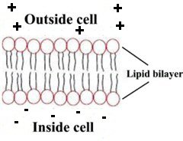
MEMBRANE PROTEINS DO MANY THINGS CONT’D
What We Know
Gateway to the Cell
Cells Are Us: Gateway to the Cell
Pre-Test
Introduction
What We Know
How We Know
Story Time
Common Hazards
Activities
Self-Study Game
Post-Test
Glossary
The electrical field influences the movement of electrically charged ions across the membrane. Remember, like charges repel and unlike charges attract. Thus, positive ions accumulate inside cells and negative ions accumulate outside.
Example of electric charges:
  Dust is attracted to TV screens by electrical force.
  Touching metal on a very dry day may cause sparks to fly from your hand.

Slide 19
WHY IS CHARGE SEPARATION IMPORTANT?
What We Know
Gateway to the Cell
Cells Are Us: Gateway to the Cell
Pre-Test
Introduction
What We Know
How We Know
Story Time
Common Hazards
Activities
Self-Study Game
Post-Test
Glossary
Separated electrical charges are a form of stored energy (like a battery). Anything that changes permeability (porousness) of a membrane would change the distribution of charged atoms, for two reasons:
  Charged atoms move from areas of high concentration to areas of low concentration (like a drop of ink in a glass of water).
  Charged atoms are attracted to regions of opposite electrical charge.
This is how nerve and muscle cells generate electricity. The electricity is actually the movement of electrically charged atoms that move according to electrical and chemical forces. Think of it as "liquid-state electronics," as opposed to the solid-state electronics of computer chips. A good narrated and animated explanation of ion movements across a membrane can be found at: https://phet.colorado.edu/en/simulation/membrane-channels
For a good video on this, click here.

Slide 20
Gateway to the Cell
Cells Are Us: Gateway to the Cell
Pre-Test
Introduction
What We Know
How We Know
Story Time
Common Hazards
Activities
Self-Study Game
Post-Test
Glossary
How We Know

Slide 21
How We Know
Gateway to the Cell
Cells Are Us: Gateway to the Cell
Pre-Test
Introduction
What We Know
How We Know
Story Time
Common Hazards
Activities
Self-Study Game
Post-Test
Glossary
Over 100 years ago, a scientist named Ernest Overton found that the ability of substances to enter cells depended on their ability to dissolve in oils. We call these substances that dissolve in oils lipids. Overton suggested the barrier between the outside and the inside of a cell was itself a lipid or at least had a lot of lipid in it.

Slide 22
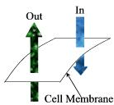
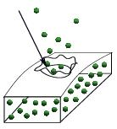
HOW DO WE KNOW MEMBRANES EXIST IF WE CAN’T SEE THEM?
How We Know
Gateway to the Cell
Cells Are Us: Gateway to the Cell
Pre-Test
Introduction
What We Know
How We Know
Story Time
Common Hazards
Activities
Self-Study Game
Post-Test
Glossary
At the time when the basic ideas about membranes were being worked out, membranes could not be seen. Scientists made a reasonable guess that something like membranes must exist. Two observations led scientists to conclude membranes must exist:
  Something was regulating how water and chemical substances were getting into and out of cells.
  If you punctured a cell surface, materials inside the cell leaked out.

Slide 23
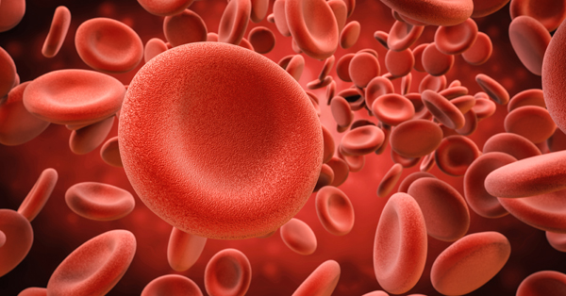
WHAT MODEL WAS USED TO STUDY CELL MEMBRANES?
How We Know
Gateway to the Cell
Cells Are Us: Gateway to the Cell
Pre-Test
Introduction
What We Know
How We Know
Story Time
Common Hazards
Activities
Self-Study Game
Post-Test
Glossary
Much of the early research on membranes was done on red blood cells. Red blood cells have lost all their organelles. They contain only the oxygen-carrying protein, hemoglobin.
Red cells are important to learn about for several reasons:
  Red cells are easy to get (from people, animal slaughterhouses, etc.).
    Small amounts of blood have lots of cells (1 ml has about 5,000,000,000 or 5 billion cells). So, if you want to measure a single cell you can measure a whole bunch and then divide by the total number of cells. This would give you information for each cell.
  Red cells are fairly sturdy. When put in a test tube, they can be spun at high speeds to pack all the cells tightly together at the bottom of the tube.
  The round shape makes it easy to use equations to estimate diameter and surface area.
Many of our ideas about membranes came from the study of red blood cells.
Red Blood Cells

Slide 24
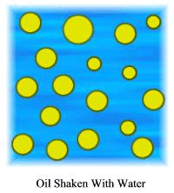
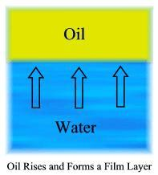
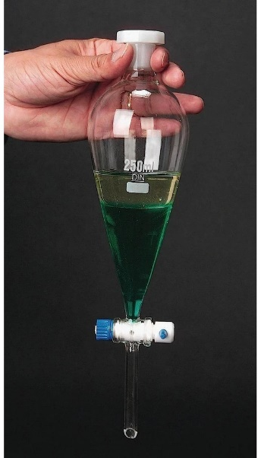
HOW DO WE KNOW WHAT CHEMICALS MAKE UP A MEMBRANE?
How We Know
Gateway to the Cell
Cells Are Us: Gateway to the Cell
Pre-Test
Introduction
What We Know
How We Know
Story Time
Common Hazards
Activities
Self-Study Game
Post-Test
Glossary
The first clue was the observation that fatty substances easily entered cells, while other kinds of chemicals passed slowly or not at all. Secondly, if you pull out the red pigment in red blood cells, most of what is left is lipid.
You can observe how lipids organize themselves. Have you ever seen cold soup with a film of fat on top? Or do this: shake up a bottle of water that has some oil in it. If you let the water stand undisturbed for a few hours, you will see the oil rise to the top and form a film all by itself
Using vessels like the one shown on the right, we can collect oil separate from water by draining off the lower liquid compartment.

Slide 25
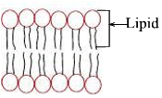
HOW DID THEY PROVE THAT MEMBRANES EXIST AS TWO LAYERS OF LIPID?
How We Know
Gateway to the Cell
Cells Are Us: Gateway to the Cell
Pre-Test
Introduction
What We Know
How We Know
Story Time
Common Hazards
Activities
Self-Study Game
Post-Test
Glossary
When lipid molecules are in water, the nature of their chemistry is such that they separate in a way that is a little more complicated than just a single film of lipid. A key discovery came in 1925, when two scientists, Groter and Grendel, discovered that the total surface area of a lipid that could be separated from a red blood cell was directly related to the surface area of the red blood cells. Indeed, the amount of lipid that could be extracted was exactly double that needed to completely surround the cell.
Lipid Bilayer
The surface area of lipid extracted from a red blood cell is exactly double the surface area of the cell. This observation led to the idea that cell membranes must contain two layers of lipid.
Maybe the lipid wrapped around the cell twice! We could guess at this just by knowing the chemistry. A lipid molecule has two chains of carbon atoms. Think of it like a kite with two tails. These carbon chains are not attracted to water, but they are attracted to the carbon chains of other lipids.

Slide 26
HOW DID THEY PROVE THAT MEMBRANES EXIST AS TWO LAYERS OF LIPID? CONT’D
How We Know
Gateway to the Cell
Cells Are Us: Gateway to the Cell
Pre-Test
Introduction
What We Know
How We Know
Story Time
Common Hazards
Activities
Self-Study Game
Post-Test
Glossary
If we know the chemical properties of lipids, we can figure out how they must self-organize in cells, which contain mostly water.
  One end has chains of carbon, which are repelled by water.
  The other end dissolves in water (that is, is attracted to water).
  Thus, at the surface of water, one end of the lipid is attracted to water, and the carbon tails point out away from water.
  A second layer can occur because the carbon tails of two lipids attract each other.
How do you think membrane lipids interact with proteins?

Slide 27
HOW DO THE MEMBRANES INTERACT WITH THE PROTEINS?
How We Know
Gateway to the Cell
Cells Are Us: Gateway to the Cell
Pre-Test
Introduction
What We Know
How We Know
Story Time
Common Hazards
Activities
Self-Study Game
Post-Test
Glossary
Drs. Danielli and Davson's "sandwich" model of proteins and lipid seemed reasonable at the time and was accepted for several decades. But more research revealed that some portions of proteins were anchored IN the double layer of lipids.
Membrane proteins are classified into two groups, depending on how they are anchored to the membrane.
Peripheral proteins are anchored on the side of the membrane and do not go completely through the membrane.
Integral proteins pass completely through the membrane, with parts of the protein hanging out of either side of the membrane.
Because integral proteins pass completely through the membrane, they can provide a channel to let substances move into and out of cells (see the channel in the picture above). You might think of this like a miniature sponge. The size and shape of the channels regulate the size of the molecules that can pass through these protein gateways.

Slide 28
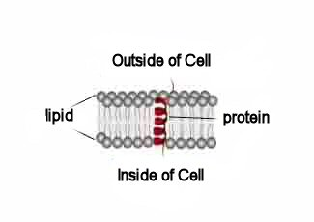
HOW DO MODERN SCIENTISTS PICTURE THE POSITION OF PROTEINS IN THE CELL MEMBRANE?
How We Know
Gateway to the Cell
Cells Are Us: Gateway to the Cell
Pre-Test
Introduction
What We Know
How We Know
Story Time
Common Hazards
Activities
Self-Study Game
Post-Test
Glossary
Scientists discovered that portions of membrane proteins "hang outside" the membrane, both on the inner and outer surfaces. The portion of the protein embedded inside the membrane is coiled (red part of diagram), but outside the membrane, the chemical forces of water partially uncoil the proteins.

Slide 29
WHY DO PARTS OF THE PROTEIN REMAIN OUTSIDE THE MEMBRANE?
How We Know
Gateway to the Cell
Cells Are Us: Gateway to the Cell
Pre-Test
Introduction
What We Know
How We Know
Story Time
Common Hazards
Activities
Self-Study Game
Post-Test
Glossary
These portions of membrane proteins MUST reside outside the membrane, because the terminals of proteins have electrically charged regions that are attracted by the water on the inner and outer surfaces. These parts of the protein are not attracted to lipid because the lipid core has no electrical charge.

Slide 30
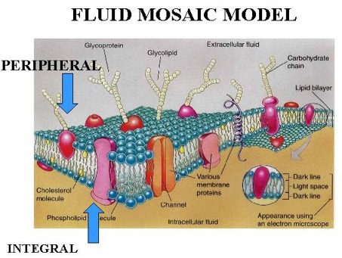
How We Know
Gateway to the Cell
With this new understanding of how proteins and membranes interact, an overall model of the structure of cell membranes was developed.
Cells Are Us: Gateway to the Cell
Pre-Test
Introduction
What We Know
How We Know
Story Time
Common Hazards
Activities
Self-Study Game
Post-Test
Glossary
In 1972, S. J. Singer and G. L. Nelson proposed the modern model of membranes below:
Diagram of the modern view of membrane proteins (the orange, pink, and purple structures in the membrane). The globs are 3-dimensional representations of protein, which, in reality, consist of multiple coils bunched together in ways that a pore could be created. Blue structures are lipid.
Image taken from ZY 560 Mammalian Physiology Homepage at http://www.auburn.edu/academic/classes/zy/560/membrane/sld003.htm
Note how old ideas in science sometimes get re-instated. In the process of disproving the Danielli-Davson model, modern scientists have actually proved that the original ideas were partially right. There IS protein on the outside and inside of membranes.

Slide 31
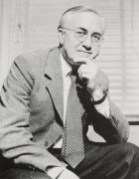
JAMES FREDERICK DANIELLI (1911-1984)
Gateway to the Cell
Story Time
Cells Are Us: Gateway to the Cell
Pre-Test
Introduction
What We Know
How We Know
Story Time
Common Hazards
Activities
Self-Study Game
Post-Test
Glossary
Jim's friends said that he had a good sense of humor. When he was grown up and famous, he liked to trick newspaper reporters and pull jokes on them. He also had the reputation of being a "Boy Scout", and "never breaking any rules, even when there was no one around to watch him,'' as one friend put it.
Jim was a Jr., as his father had the same name. Jim's father was a well-known civil servant in the British civil government. Apparently, no one in his family had any interest or involvement in science.

Slide 32
YOUNG ADULTHOOD
Story Time
Levels of Organization
Cells Are Us: Gateway to the Cell
Pre-Test
Introduction
What We Know
How We Know
Story Time
Common Hazards
Activities
Self-Study Game
Post-Test
Glossary
So how did Jim get interested in science? We think it was because Jim grew up in the country and lived close to animals and plants. He went to a rural school, where he turned out to be the best student. He won a scholarship to the University College of London. He quickly developed an interest in chemistry, and he and one of his classmate friends, Hugh Davson, spent many hours debating how membranes might be built. Years later, they developed a theory that dominated scientific thought for several decades, and parts of that theory are still accepted today.
After he obtained his first doctoral degree, he took a job at Princeton University in New Jersey during the Great Depression. At Princeton, Jim became a Socialist and, when he wasn't in the laboratory, he was on the street corners preaching the need to make the U.S. a Socialist state. He was attracted to Communism, but eventually became disillusioned with it and became more conservative. About this time, Jim married Mary Guy, a poet, who later became an anthropologist. They were life-long friends and enjoyed sharing their interests in science.

Slide 33
RESEARCH
Story Time
Levels of Organization
Cells Are Us: Gateway to the Cell
Pre-Test
Introduction
What We Know
How We Know
Story Time
Common Hazards
Activities
Self-Study Game
Post-Test
Glossary
In 1935, Jim and his family returned to England to work at Cambridge University. There he renewed his friendship with Hugh Davson. When World War II started, Jim conducted experiments on practical things like wound healing. During this time he also developed an antidote to the poison Lewisite. This discovery resulted from working with compounds that could not cross membranes and thus stay in the blood to combat the circulating poison.
In later years, Jim also worked in Buffalo at the State University of New York. From 1970 on, he became closely involved in NASA research. He studied the possibility of life on other planets and several projects related to environmental health issues, such as waste-water treatment, overgrowth of plant life in lakes and ponds, pollution effects of urban water runoff, and effects of pollution on life in the sea.

Slide 34
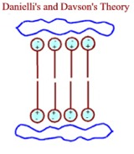
MEMBRANES
Story Time
Levels of Organization
Cells Are Us: Gateway to the Cell
Pre-Test
Introduction
What We Know
How We Know
Story Time
Common Hazards
Activities
Self-Study Game
Post-Test
Glossary
Jim became famous for his work on biological membranes. In 1952, he wrote a famous book with his old friend, Hugh Davson, in which they developed a mental model of how membranes were built. Their model grew out of their research and that of others on the transport of materials across capillaries and red blood cell membranes. This model dominated thinking among world scientists for over a decade.
Davson and Jim also developed the idea that proteins associated with membranes could help move certain chemicals across the membrane, which otherwise would not occur. This idea has stood the test of time. See "What We Know" pages on membrane proteins.
What was important about the Davson-Danielli membrane model was that though it was not entirely correct, it stimulated other scientists to study the question of how membranes are built. The D-D model correctly viewed the membrane as consisting of two layers of lipid with their electrically charged head groups facing outward toward the water-based environment both outside and inside of the membrane.

Slide 35
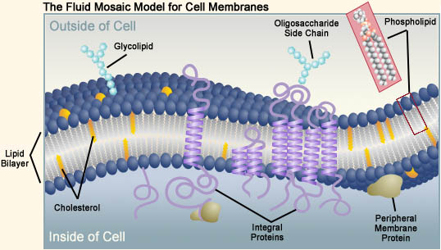
MEMBRANES CONT’D
Story Time
Levels of Organization
Cells Are Us: Gateway to the Cell
Pre-Test
Introduction
What We Know
How We Know
Story Time
Common Hazards
Activities
Self-Study Game
Post-Test
Glossary
What was wrong with the model was the location of proteins. Proteins were thought to be attached as a thin layer on the inner and outer surfaces of the membrane. Today, we know that proteins float around in the membrane, forming multiple coils that weave in and out of the membrane, with tails of the proteins projecting out on both the outside and inside of the cell.

Slide 36
LASTING IMPACT
Story Time
Levels of Organization
Cells Are Us: Gateway to the Cell
Pre-Test
Introduction
What We Know
How We Know
Story Time
Common Hazards
Activities
Self-Study Game
Post-Test
Glossary
In one of the great ironies of science, it turns out that what was considered to be wrong has proved to be at least partially right. We now know that some proteins ARE adsorbed on the cell membrane, especially on the inner surface. These interact with the proteins that are coiled within the membrane, and these in turn have regions of the protein that extend outside the cell to act as detectors for chemicals. Think of these outside areas as chemical antennae and the inside areas as a "tuner" that amplifies the chemical signals detected on the outside.
Danielli's contribution was that he got scientists pointed in the right direction - that is, asking the right questions. Many great discoveries, including several Nobel prizes, developed out of work that was spawned by Jim Danielli.

Slide 37
REFERENCES
Story Time
Levels of Organization
Cells Are Us: Gateway to the Cell
Pre-Test
Introduction
What We Know
How We Know
Story Time
Common Hazards
Activities
Self-Study Game
Post-Test
Glossary
Stein, W. D. 1987. James Frederic Danielli. The Royal Society. University Press, Cambridge, Great Britain.
Davson, H., and Danielli, J. F. 1970. The Permeability of Natural Membranes. Hafner Publishing Company. Darien, Conn. pp. 365.
[James Danielli Photo] Retrieved from https://www.kcl.ac.uk/lsm/about/history/heroes#JDanielli
Figure 1. Graphic of Fluid Mosaic Model for Cell Membrane. Reprinted from The Biology Project: Department of Biochemistry and Molecular Biophysics University of Arizona, http://www.biology.arizona.edu/cell_bio/problem_sets/membranes/fluid_mosaic_model.html

Slide 38
Gateway to the Cell
Cells Are Us: Gateway to the Cell
Pre-Test
Introduction
What We Know
How We Know
Story Time
Common Hazards
Activities
Self-Study Game
Post-Test
Glossary
Common Hazards

Slide 39
A TOXIC SUBSTANCE - ALCOHOL
Common Hazards
Gateway to the Cell
Cells Are Us: Gateway to the Cell
Pre-Test
Introduction
What We Know
How We Know
Story Time
Common Hazards
Activities
Self-Study Game
Post-Test
Glossary
Why is alcohol a toxic, or hazardous, substance?
  Alcohol is attracted to cell membranes, and it concentrates there. When it reaches nerve cell membranes, the alcohol can change the function of nerve cells and thus affect behavior. This change in behavior is commonly called intoxication.
The word intoxication comes from a Latin word, intoxicare, which means "to poison."
How does alcohol affect cell membranes?
  At one time, scientists believed that alcohol "dissolved" into the membrane interior and made the carbon chains of the lipids more fluid. (It was thought to be like converting hard butter into soft margarine.)
  When scientists tested this idea on fish, they realized that the "melted butter" idea could not explain intoxication. Warming fish by a few degrees can cause the same degree of lipid "melting", but the fish do NOT get intoxicated.

Slide 40
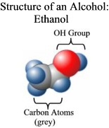
A TOXIC SUBSTANCE - ALCOHOL
Common Hazards
Gateway to the Cell
Cells Are Us: Gateway to the Cell
Pre-Test
Introduction
What We Know
How We Know
Story Time
Common Hazards
Activities
Self-Study Game
Post-Test
Glossary
So what causes intoxication?
  The answer can be answered in part from the chemistry of alcohol (CH₃CHOH). The carbon part of the molecule makes it attracted to the carbon tails of the lipids in cell membranes. But the OH group of alcohol makes it attracted to water.
  Thus, you might expect that these influences would cause alcohol to orient itself in a membrane so that the carbon part of the molecule inserts itself into the membrane interior (where the lipid carbon tails are) and the OH part of the molecule is out near the surface, where the water is. This idea was confirmed by the author of Cells Are Us and his colleagues at Texas A&M.

Slide 41
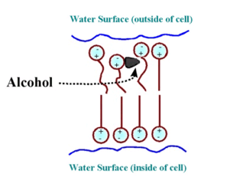
A TOXIC SUBSTANCE - ALCOHOL
Common Hazards
Gateway to the Cell
Cells Are Us: Gateway to the Cell
Pre-Test
Introduction
What We Know
How We Know
Story Time
Common Hazards
Activities
Self-Study Game
Post-Test
Glossary
How does alcohol affect the structure of a cell membrane?
Alcohol disrupts the normal organization of the lipid carbon chains (see picture below).
Your scientist/author of this module believes that alcohol sticks to a membrane near its surface because it displaces some of the water molecules that are usually anchored there. Some of the evidence that supports this idea was obtained with a simple artificial lipid membrane. Several methods demonstrated that alcohol binds just underneath the electrically charged head group of surface lipid, displacing some of the water that is normally there. The importance of this physical disruption is not so much what it does to the lipid but what it does to the proteins (not shown) that are embedded in the lipid. Disturbing the shape of the lipids changes the shape of the proteins and the exposure of their electrically charged regions, thus changing how the proteins interact with other molecules. This is particularly relevant in neurons because the binding of certain neurotransmitters to their receptor protein can be altered.
This drawing uses lollipop symbols for the phospholipids (the lipid portion of cell membranes.) The presence of alcohol (the black blob) shifts the lipid molecules out of place and breaks up their orderly arrangement. This makes the membrane more liquid like. (Like changing cold butter to a more liquid form like warm margarine.)

Slide 42
A TOXIC SUBSTANCE - ALCOHOL
Common Hazards
Gateway to the Cell
Cells Are Us: Gateway to the Cell
Pre-Test
Introduction
What We Know
How We Know
Story Time
Common Hazards
Activities
Self-Study Game
Post-Test
Glossary
Why does shifting the lipids cause problems?
  Think about how the substitution of alcohol for water might affect the large, complex sugars and proteins that are embedded in the lipid membrane. Ask yourself:
Proteins that are not in their normal shape in the cell membrane may not be able to do their jobs.
    Wouldn't the substitution cause proteins to change shape?
    If they changed shape, could that cause them to change function?
See unit on "Making Protein Machinery”
    Although the lipid of a membrane has no special function of its own, it does influence the large functional molecules (proteins and sugars) that the membrane contains. This is not a good thing.
Changing a protein's shape or location can change the protein's function. Some membrane proteins are affected more by alcohol than are other proteins.
For a learning activity about alcohol intoxication, see Activity #3

Slide 43
Gateway to the Cell
Cells Are Us: Gateway to the Cell
Pre-Test
Introduction
What We Know
How We Know
Story Time
Common Hazards
Activities
Self-Study Game
Post-Test
Glossary
Activities

Slide 44
CLICK TO DOWNLOAD AN ACTIVITY
Activities
Gateway to the Cell
Cells Are Us: Gateway to the Cell
Pre-Test
Introduction
What We Know
How We Know
Story Time
Common Hazards
Activities
Self-Study Game
Post-Test
Glossary
Student Activity Sheet #1 – How Membranes Form (All by Themselves!)
Student Activity Sheet #2 – The Effect of Alcohol and Tobacco on Living Cells
Student Activity Sheet #3 – Think About It!

Slide 45
Gateway to the Cell
Cells Are Us: Gateway to the Cell
Pre-Test
Introduction
What We Know
How We Know
Story Time
Common Hazards
Activities
Self-Study Game
Post-Test
Glossary
Self-Study Game

Slide 46
CLICK BELOW TO PLAY A STUDY GAME!
Self-Study Game
Gateway to the Cell
Cells Are Us: Gateway to the Cell
Pre-Test
Introduction
What We Know
How We Know
Story Time
Common Hazards
Activities
Self-Study Game
Post-Test
Glossary
Quizizz

Slide 47
Gateway to the Cell
Post-Test
Cells Are Us: Gateway to the Cell
Pre-Test
Introduction
What We Know
How We Know
Story Time
Common Hazards
Activities
Self-Study Game
Post-Test
Glossary
Google assessment

Slide 48
D-L
Gateway to the Cell
Glossary
Cells Are Us: Gateway to the Cell
Pre-Test
Introduction
What We Know
How We Know
Story Time
Common Hazards
Activities
Self-Study Game
Post-Test
Glossary
Diffusion - molecules have energy, so when they are dissolved in water they move around a lot. The motion of any one atom or molecule has no particular direction, but a whole population of molecules will eventually get distributed more or less uniformly in the solution. Think about what happens if you put a drop of ink in a glass of water. Return to What We Know
Intoxication - to make drunk with alcohol, drugs or other substances. When using intoxication to describe an effect of a substance on the body (the pathology of a substance) intoxication also means poison or to poison someone. Return to Common Hazards
Ions - an atom that has lost or gained one or more electrons. Thus, a positively charged ion is one that has lost an electron and a negatively charged ion is one that has gained an electron. Return to What We Know
Lipids - Lipids are also known as fats, but they include compounds of many different kinds. Chemically, these compounds are built on a backbone of glycerol, which was a three-carbon chain. Each carbon, in turn, bonds via an oxygen molecule to so-called fatty acids. Fatty acids have an acid group (COOH) at one end that is attached to a chain of carbons. Lipids differ mainly in the nature of the fatty acid chains. Return to What We Know | Return to How We Know

Slide 49
M-P
Gateway to the Cell
Glossary
Cells Are Us: Gateway to the Cell
Pre-Test
Introduction
What We Know
How We Know
Story Time
Common Hazards
Activities
Self-Study Game
Post-Test
Glossary
Molecules - When two or more atoms bond together, they are called molecules. Examples include water (H2O - two atoms of hydrogen and one of water), carbon dioxide (CO2 - one atom of carbon and two atoms of oxygen). Return to Introduction
Permeability - the speed at which a membrane will allow substances to pass through it. Return to What We Know
Phospholipids - Phospholipids are typical lipids, except that a phosphate group (POO4) is bonded to one end of one of the fatty acid chains. See lipids. Return to Common Hazards
Porous - containing pores, or holes that permit the movement of fluids or gases. An example of a porous material is a sponge. Porosity is the extent to which a substance contains pores. Swiss cheese has high porosity compared to cheddar. Return to What We Know
Proteins - molecules made of long strings of repeating units, called amino acids. Amino acids have carbon, hydrogen, oxygen, and nitrogen in them. When they attach to each other in long strings, they coil. The coiled folds back on itself to form an irregularly shaped clump. Return to Introduction

Slide 50
S
Gateway to the Cell
Glossary
Cells Are Us: Gateway to the Cell
Pre-Test
Introduction
What We Know
How We Know
Story Time
Common Hazards
Activities
Self-Study Game
Post-Test
Glossary
Semipermeable - relating to a material or membrane that allows certain substances, especially solvent, to pass through it but not others, like solutes. Return to What We Know
Sugar - compounds that contain only carbon, hydrogen, and oxygen, usually in a ring structure of 5 or six carbons. Common table sugar (sucrose) is the best-known example, but there are other kinds of sugar; it has two molecules of the body's most common sugar, glucose. Return to Introduction

