Slide 1
Life Science
Cells Are Us Levels of Organization
Post-Test

Slide 2
From the following, identify the smallest unit of life.
A. Atom
B. Molecule
C. Cell
D. Organism

Slide 3
2. Which of the following lists the levels of organization in plants and animals from smallest to most complex?
A. Organ, tissue, organism, cell, organ system
B. Cell, tissue, organ, organ system, organism
C. Organism, organ system, organ, tissue, cell
D. Cell, tissue, organism, organ, organ system

Slide 4
3. Which of the following matches the cell function to its corresponding organelle?
A. Gel-like fluid that suspends organelles and transports substances within the cell - Golgi body
B. Store waste, water, and necessary materials - Vacuoles
C. Store DNA and coordinate cell activities - Endoplasmic reticulum
D. Packages and sends out proteins - Cell membrane

Slide 5
4. The nucleus is an organelle that stores information and directs cellular activity. This is most similar to what organ system?
A. Excretory System
B. Circulatory System
C. Digestive System
D. Nervous System

Slide 6
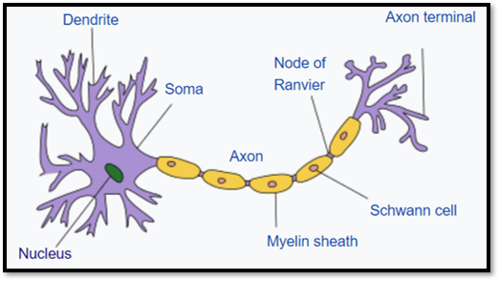
5. A neuron (pictured below) has a special shape for its function of facilitating communication in the body. What level of organization is a neuron? (image by: Quasar Jarosz)
A. Cell
B. Tissue
C. Organ
D.Organ system

