Slide 1
Earth And Space
Life on Earth

Slide 2
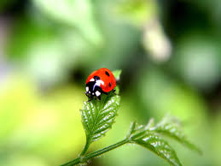
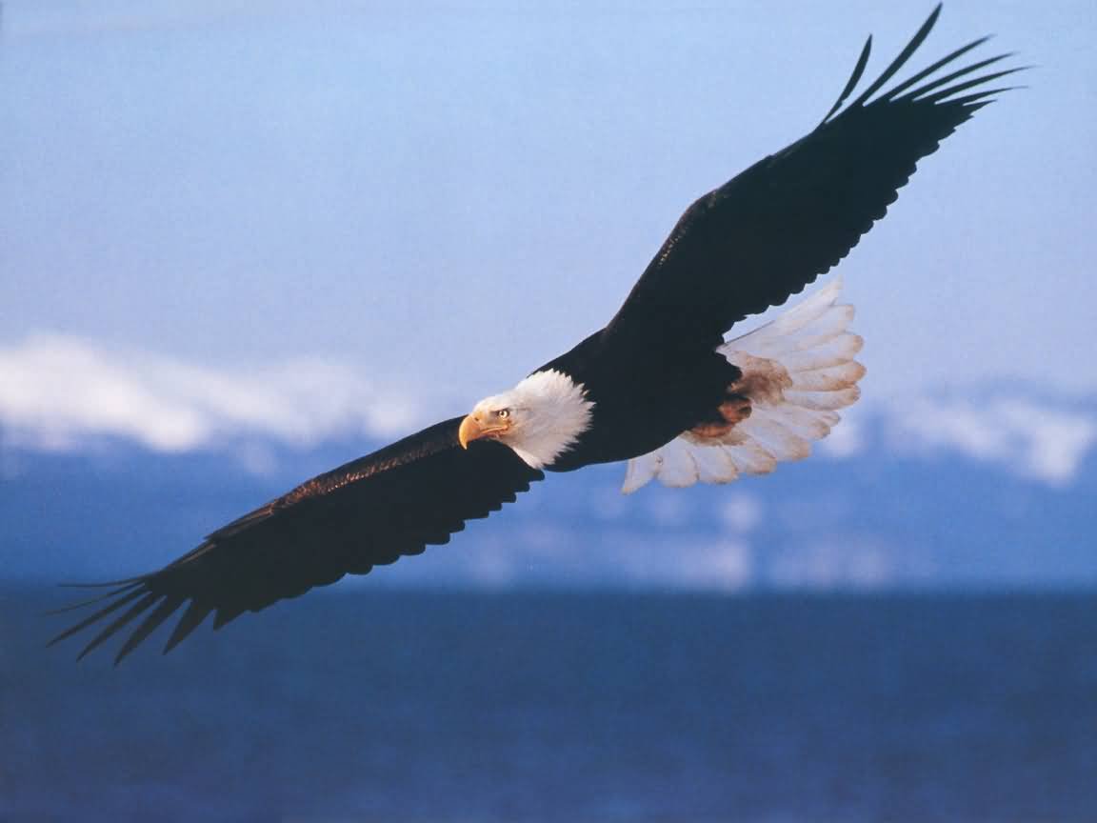
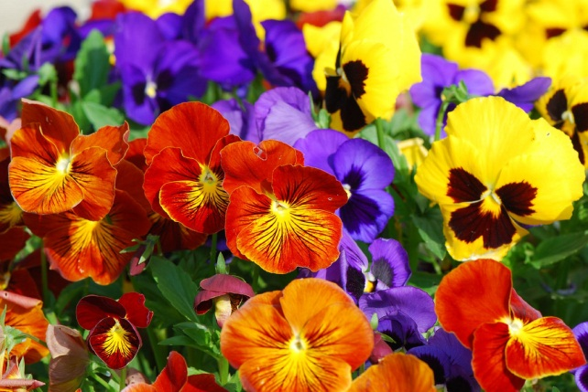
Why Earth??
Life is great and we get to experience it every day. But what makes us able to have such a luxury? Why are we the only planet that has life on it and is it possible lose this privilege?????

Slide 3
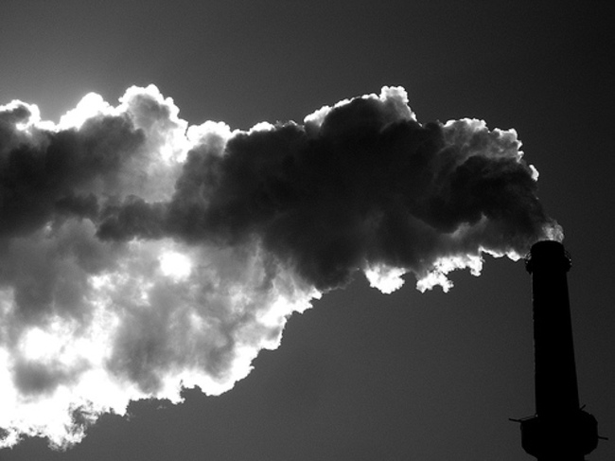
The Atmosphere
Earth’s atmosphere is one of the primary reasons life is sustainable. Oxygen is present in the atmosphere and is the gas that keeps humans alive. There is also Carbon Dioxide which keeps heat on the surface of the planet. However too much of the Carbon Dioxide can be harmful because it is a poisonous gas. An example of a planet that has too much Carbon Dioxide is Venus.

Slide 4
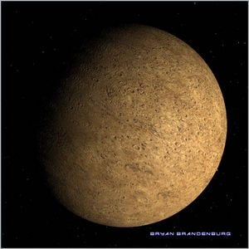
The Climate
A major reason that life is able to be kept on Earth is its climate. The Earth’s climate stays fairly constant which allows us to survive. Other planets such as Mercury can go from -200 degrees Celsius to 375 degrees Celsius! These extremes could not support human or plant life.

Slide 5
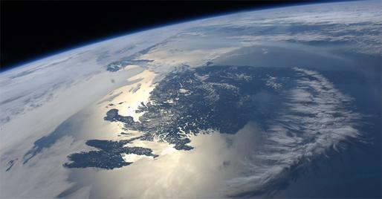
FUN FACT!
It takes sunlight about 8 minutes and 19 seconds to actually reach the Earth!

Slide 6
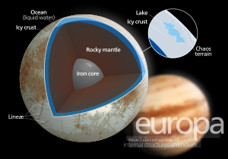
The earth has water!
Water is one of the primary necessities of life and without it we would not be able to survive. The Earth has an abundance of water which makes it able to support life. One of Jupiter’s moons Europa has a frozen ocean of water under its surface. With water there is a possibility of life.

Slide 7

Light
Earth receives light from the Sun, but so do all of the other planets. So why is it a part of sustaining life? The reason light is so important is because Earth uses is better than any other planet. Plants use light to produce oxygen which is gas that we as humans need to survive. If you have ever tried growing a plant in the dark, you won’t be very successful. Light is important for the Earth to sustain life.

Slide 8
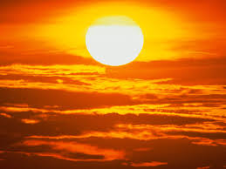
The Sun
Without the Sun there would be no life on Earth. The distance that Earth is from the sun allows it to receive the perfect amount of light and heat to have life. It also keeps the Earth in its orbit and without it the Earth would be floating around in space likely to collide with another object.

